Slide 1
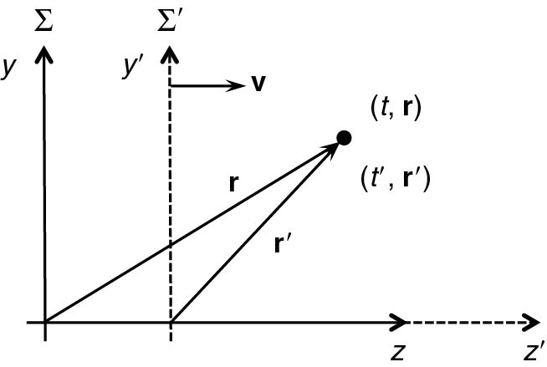
Thomson_Fig-2-2-1
© Cambridge University Press 2013

Slide 2
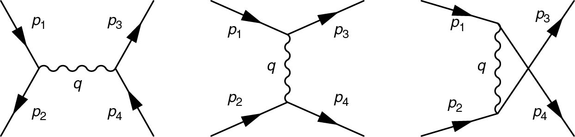
Thomson_Fig-2-2-2
© Cambridge University Press 2013

Slide 3
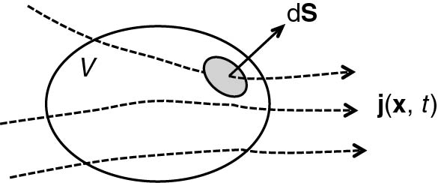
Thomson_Fig2-3-1
© Cambridge University Press 2013

Slide 4
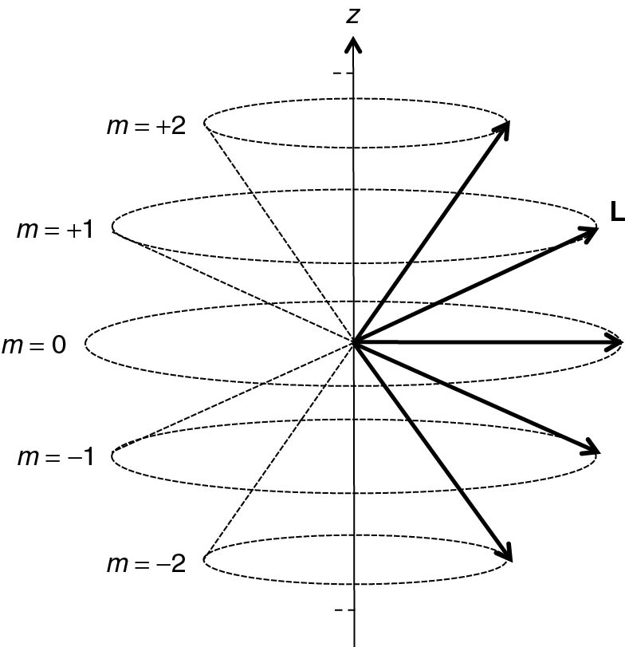
Thomson_Fig2-3-2
© Cambridge University Press 2013

Slide 5
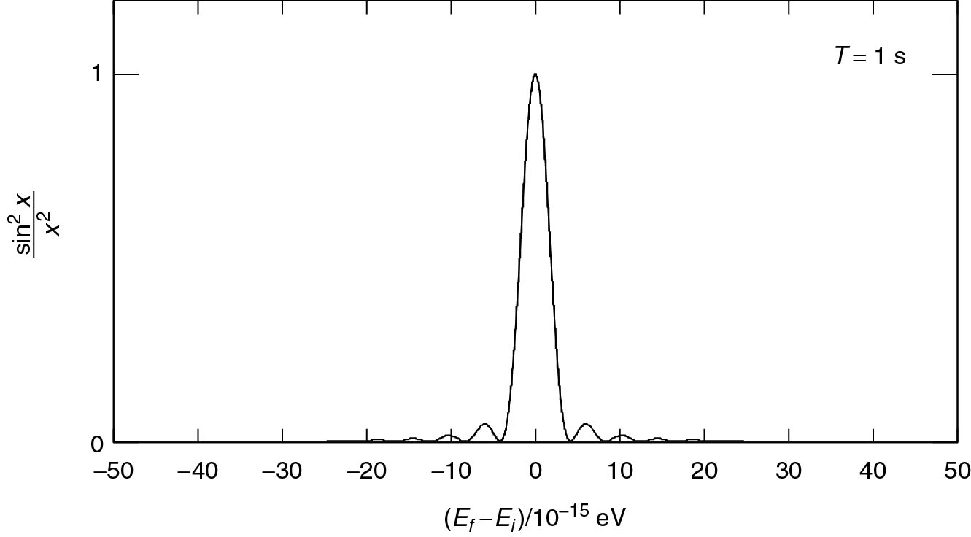
Thomson_Fig2-3-3
© Cambridge University Press 2013

