Slide 1
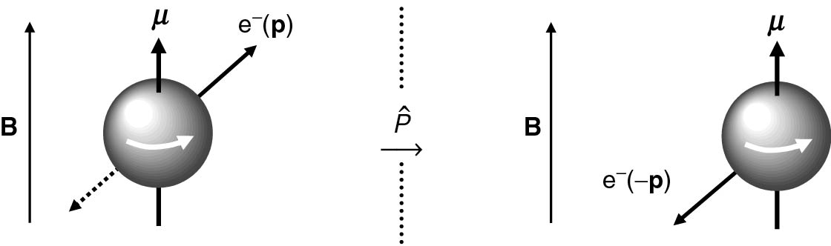
Thomson_cobalt
© Cambridge University Press 2013

Slide 2
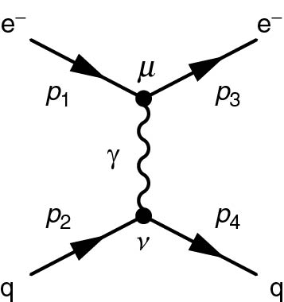
Thomson_eqeq
© Cambridge University Press 2013

Slide 3
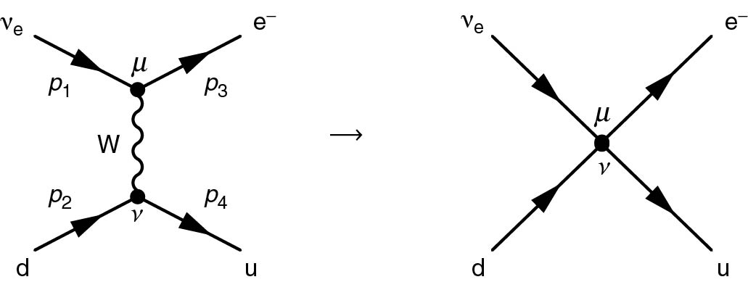
Thomson_Fig11-6
© Cambridge University Press 2013

Slide 4
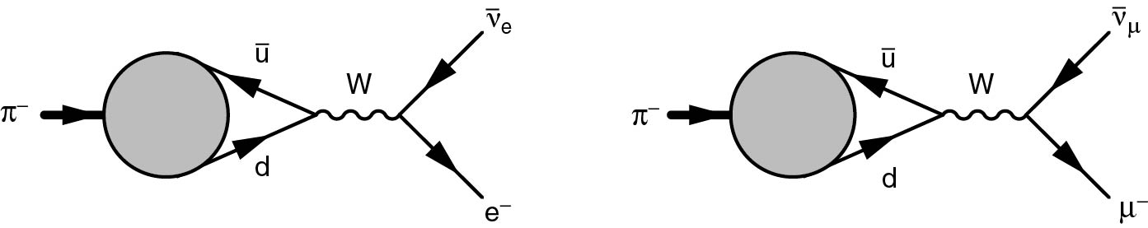
Thomson_Fig11-7
© Cambridge University Press 2013

Slide 5
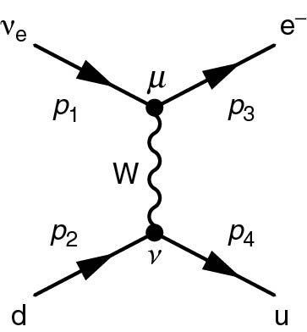
Thomson_ndeu
© Cambridge University Press 2013

Slide 6
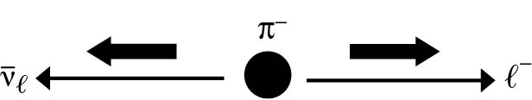
Thomson_piDecayHelicity
© Cambridge University Press 2013

Slide 7
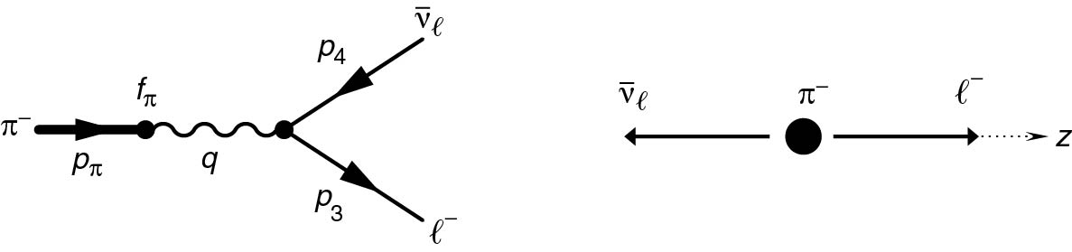
Thomson_piDecayZ
© Cambridge University Press 2013

Slide 8
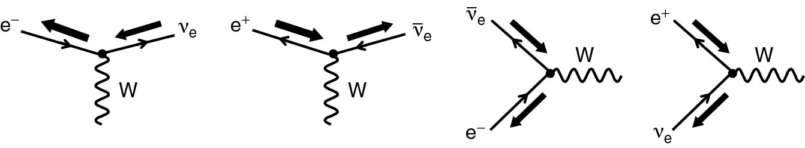
Thomson_wev
© Cambridge University Press 2013

Slide 9
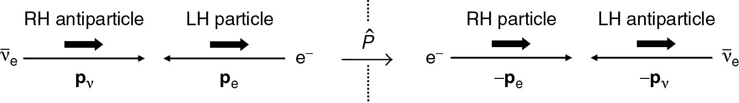
Thomson_wevParity
© Cambridge University Press 2013

