Slide 1
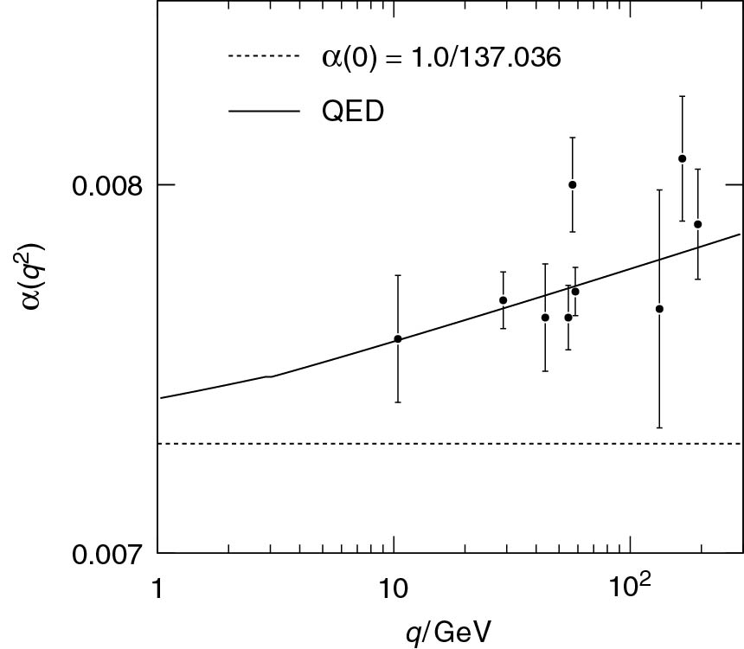
Thomson_alphaem
© Cambridge University Press 2013

Slide 2
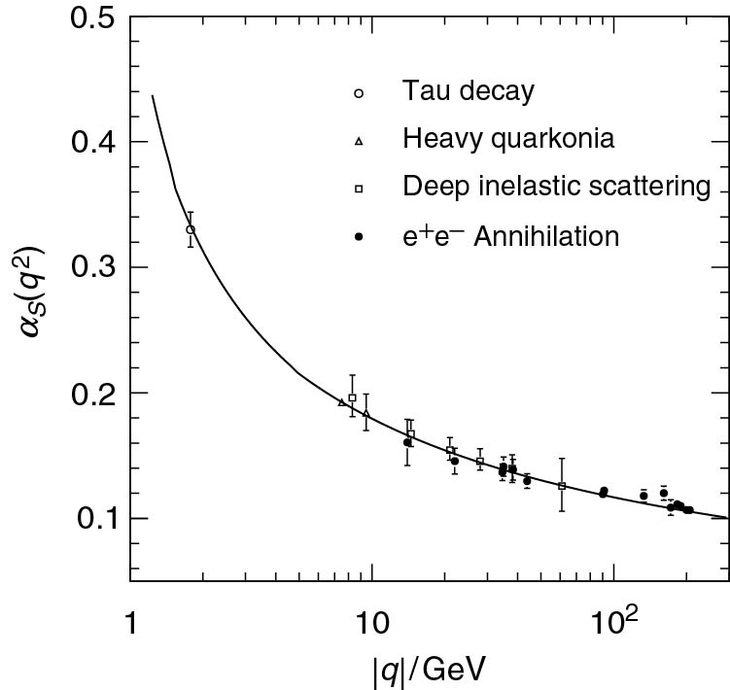
Thomson_alphaS
© Cambridge University Press 2013

Slide 3
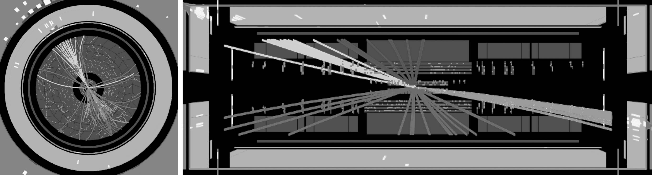
Thomson_ATLASDijetZoom
© Cambridge University Press 2013

Slide 4
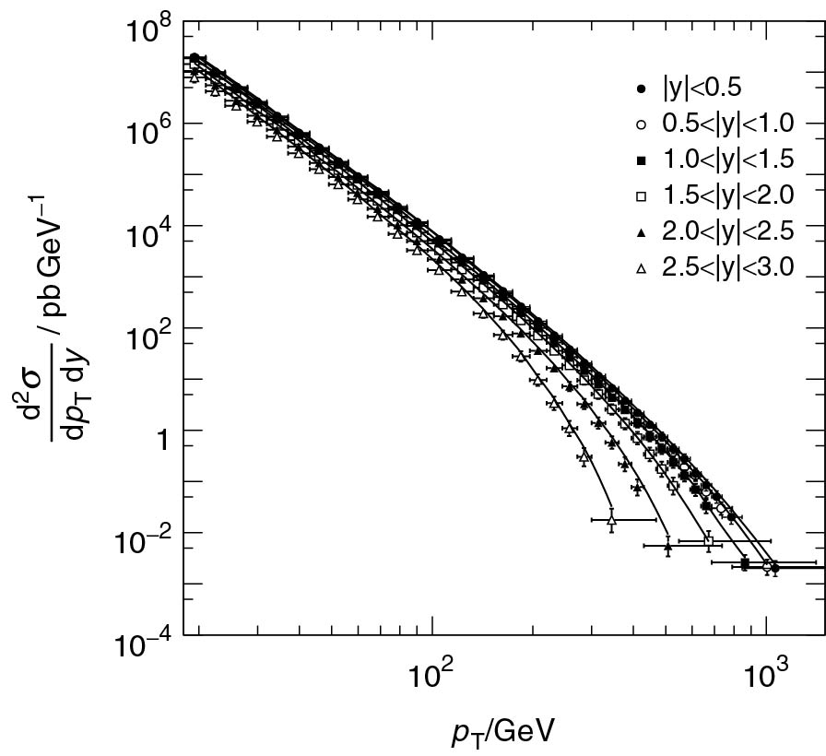
Thomson_CMSQCDNew
© Cambridge University Press 2013

Slide 5
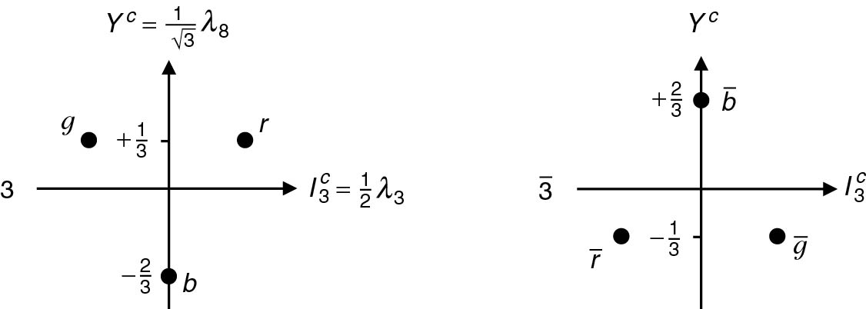
Thomson_ColourRep
© Cambridge University Press 2013

Slide 6
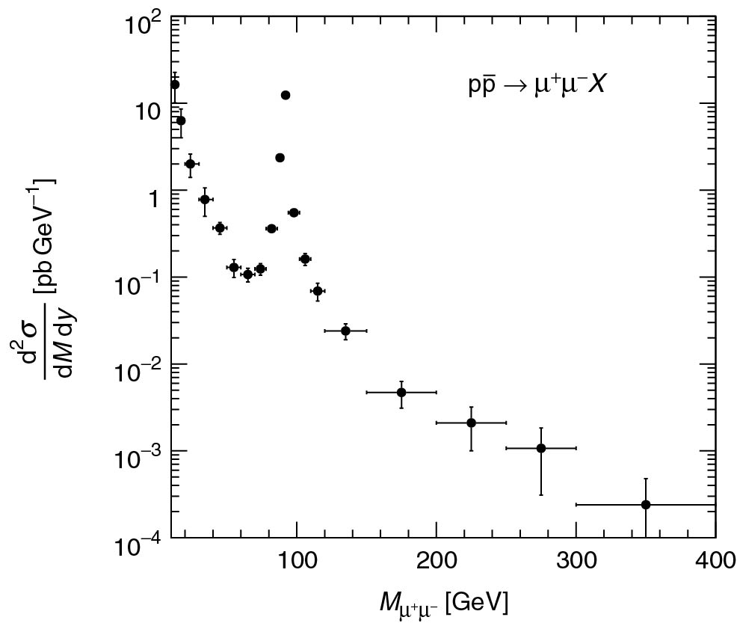
Thomson_DYCDF
© Cambridge University Press 2013

Slide 7
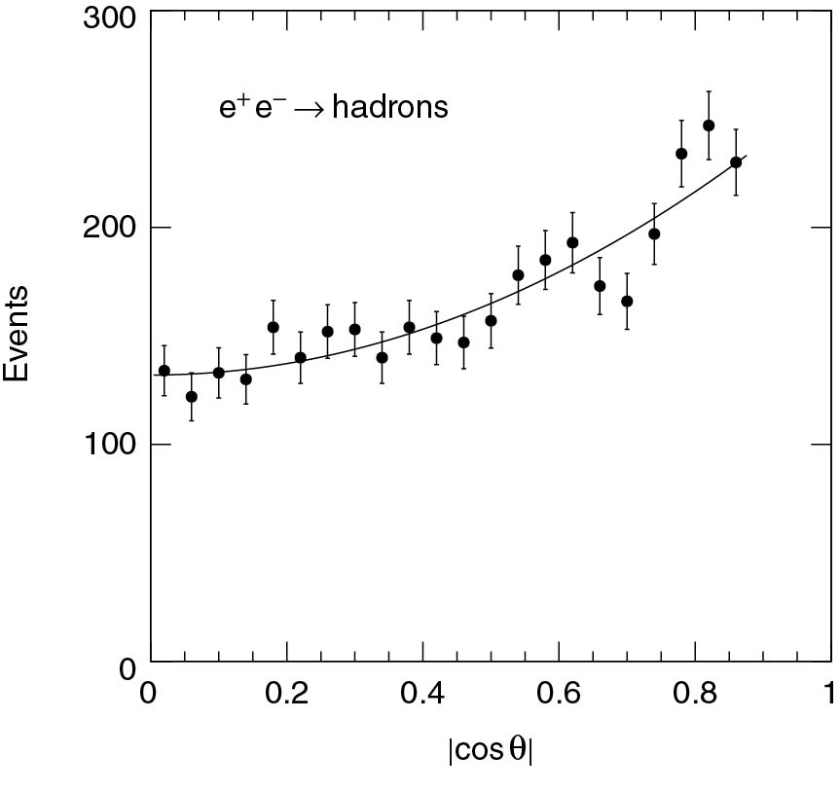
Thomson_eeqqDiff
© Cambridge University Press 2013

Slide 8
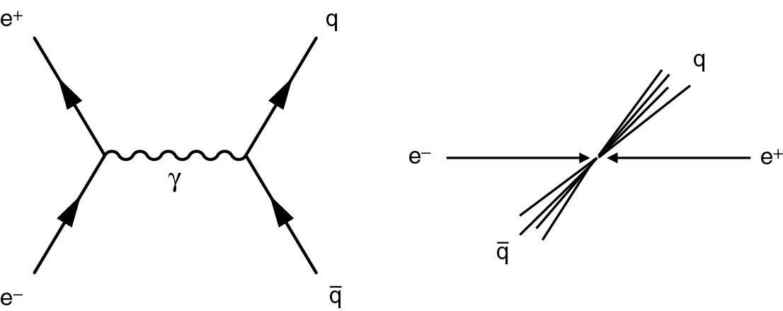
Thomson_eeqqJets
© Cambridge University Press 2013

Slide 9
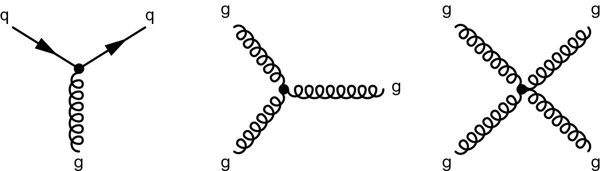
Thomson_Fig-10-1-1
© Cambridge University Press 2013

Slide 10
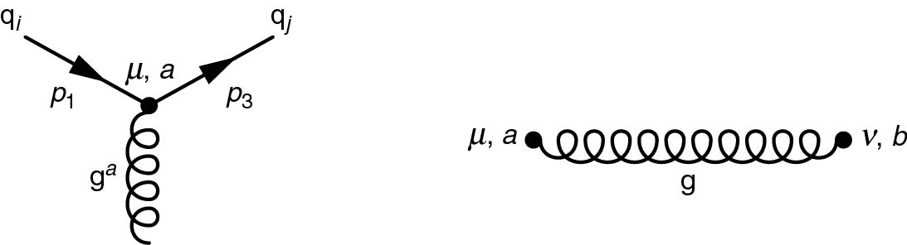
Thomson_Fig-10-2-2
© Cambridge University Press 2013

Slide 11
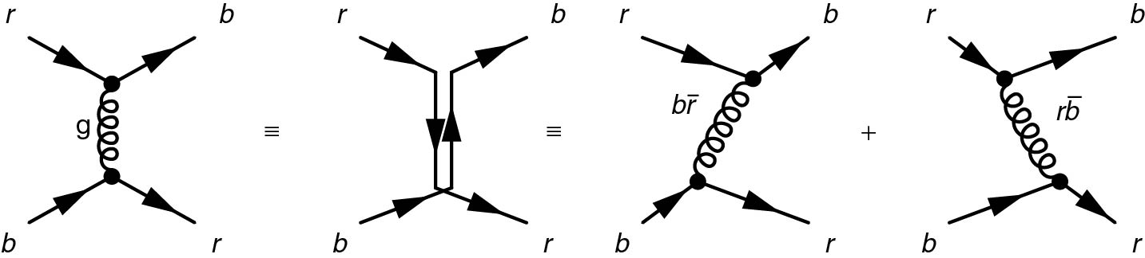
Thomson_Fig-10-3-1
© Cambridge University Press 2013

Slide 12
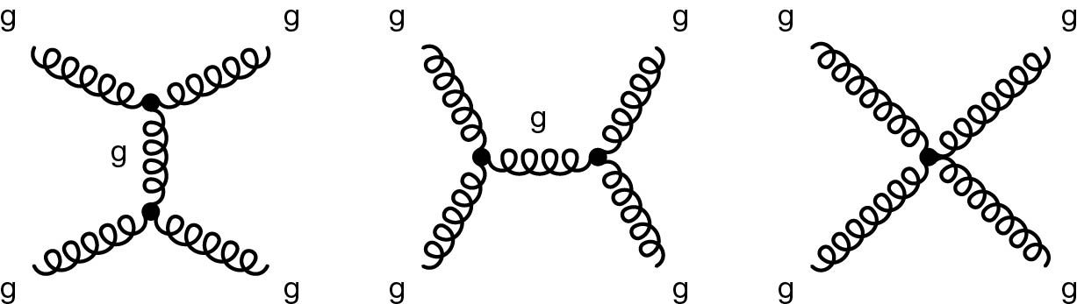
Thomson_Fig-10-4-1
© Cambridge University Press 2013

Slide 13
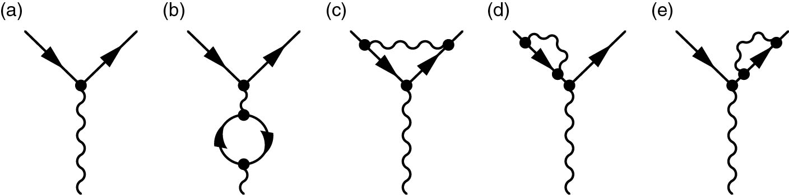
Thomson_Fig-10-5-1
© Cambridge University Press 2013

Slide 14
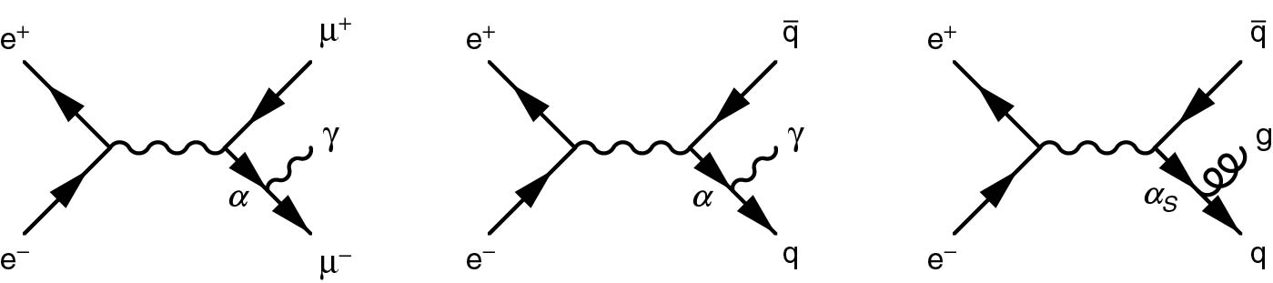
Thomson_Fig-10-6-4
© Cambridge University Press 2013

Slide 15
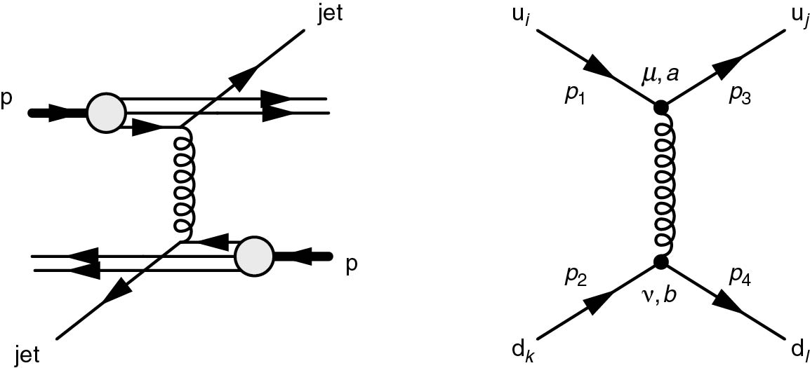
Thomson_Fig-10-7-1
© Cambridge University Press 2013

Slide 16
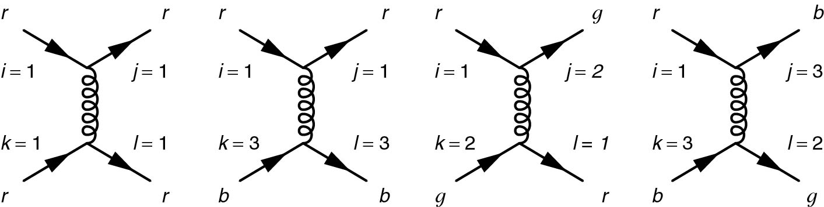
Thomson_Fig-10-7-2
© Cambridge University Press 2013

Slide 17
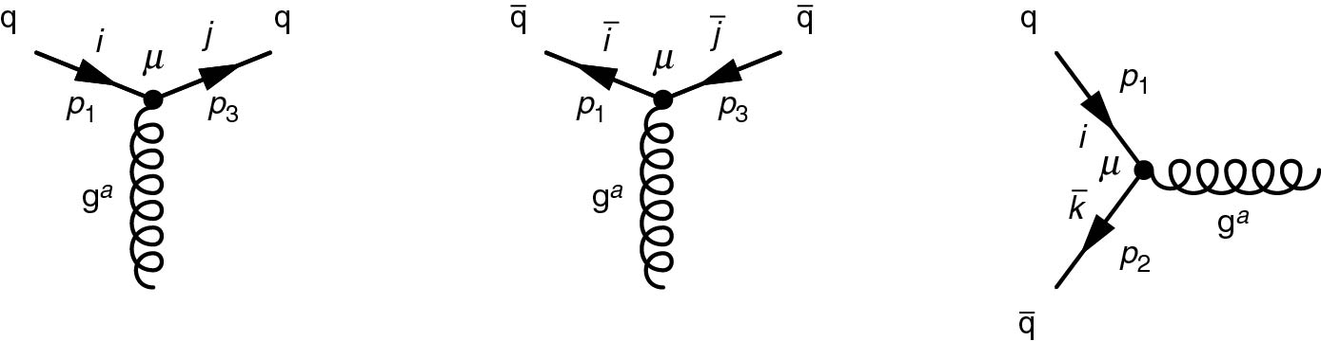
Thomson_Fig-10-7-3
© Cambridge University Press 2013

Slide 18
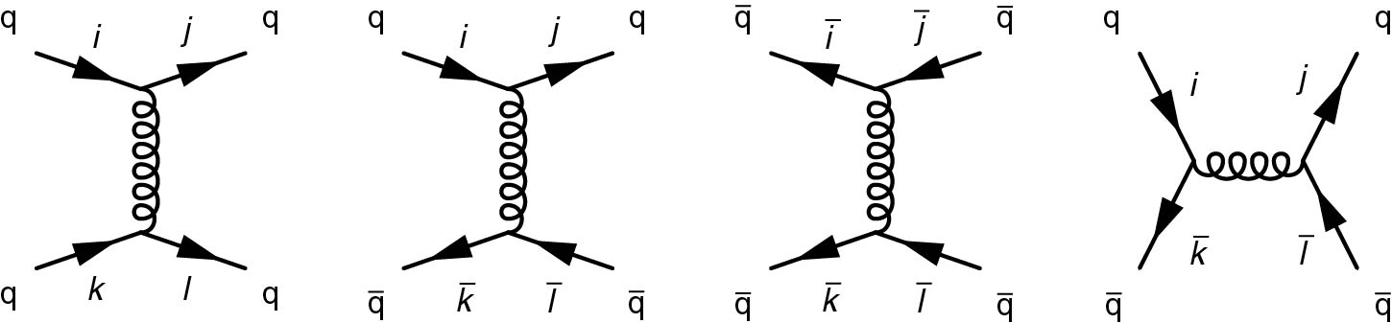
Thomson_Fig-10-7-4
© Cambridge University Press 2013

Slide 19
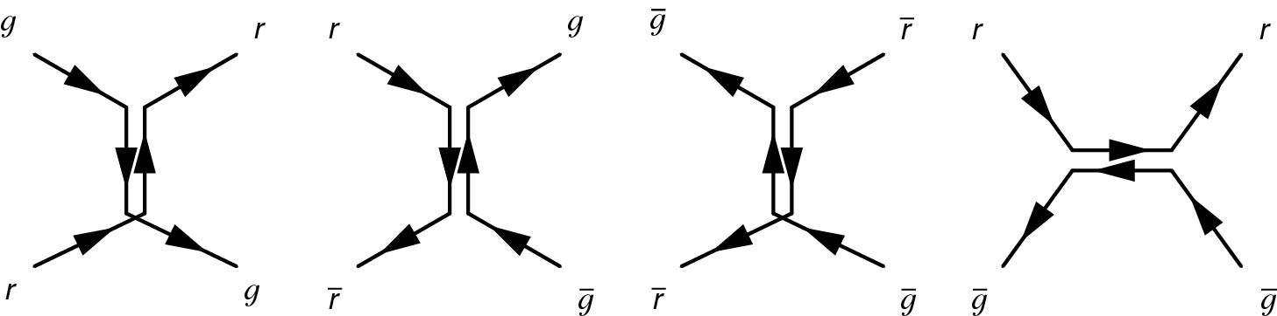
Thomson_Fig-10-7-5
© Cambridge University Press 2013

Slide 20
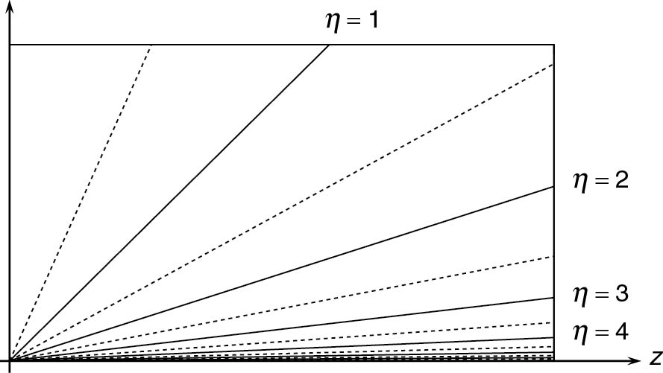
Thomson_Fig-10-9-1
© Cambridge University Press 2013

Slide 21
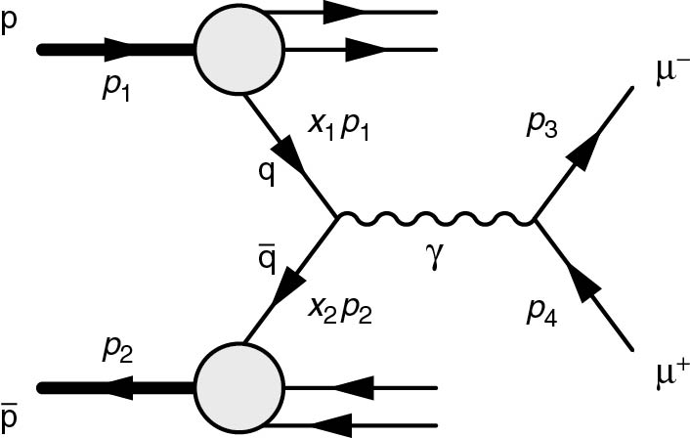
Thomson_Fig-10-9-2
© Cambridge University Press 2013

Slide 22
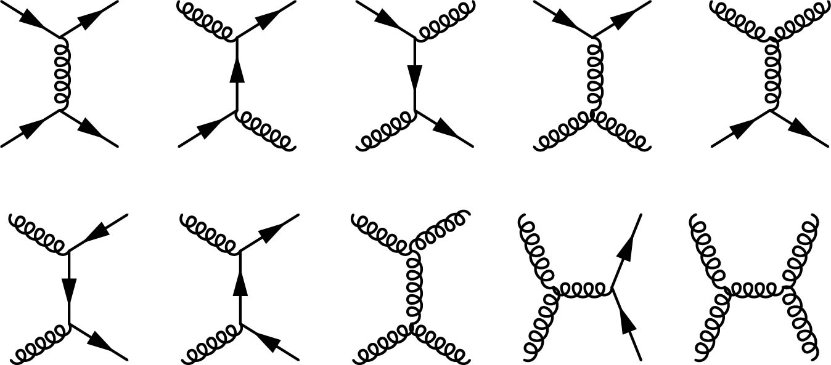
Thomson_Fig-10-9-5
© Cambridge University Press 2013

Slide 23
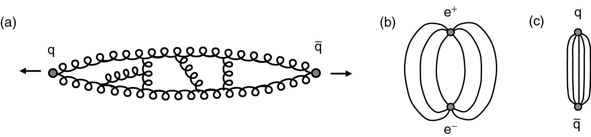
Thomson_gluonString
© Cambridge University Press 2013

Slide 24
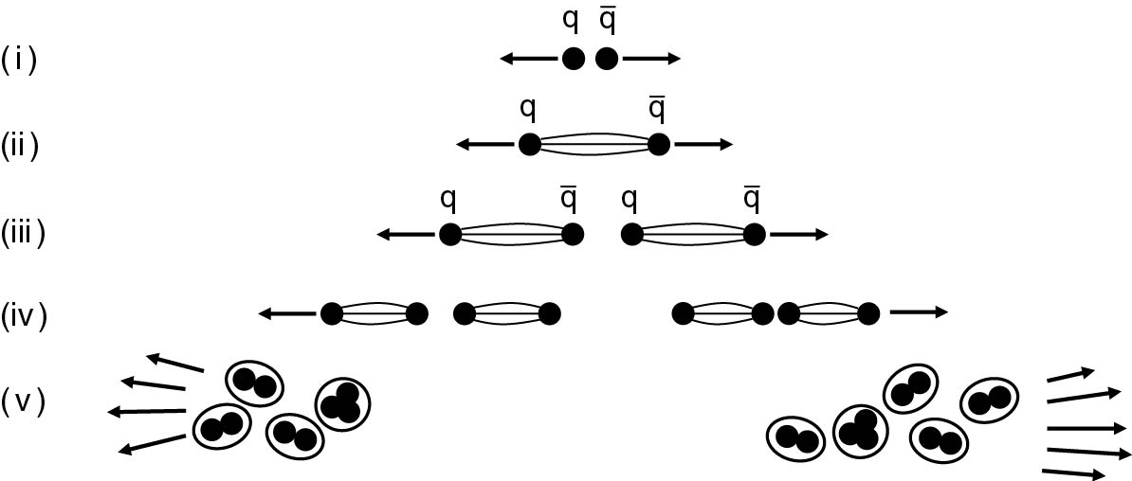
Thomson_hadronisation
© Cambridge University Press 2013

Slide 25
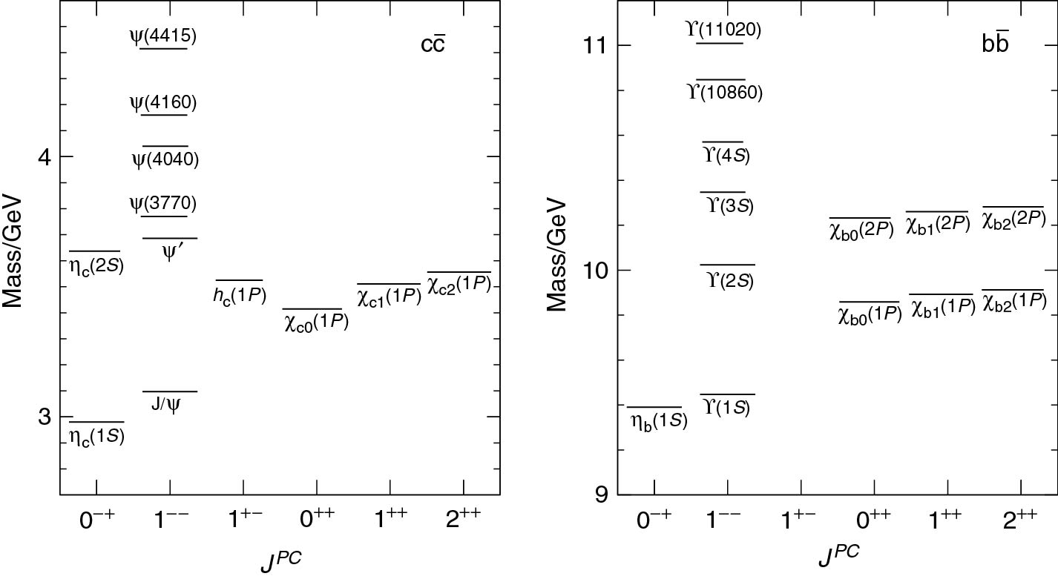
Thomson_onia
© Cambridge University Press 2013

Slide 26
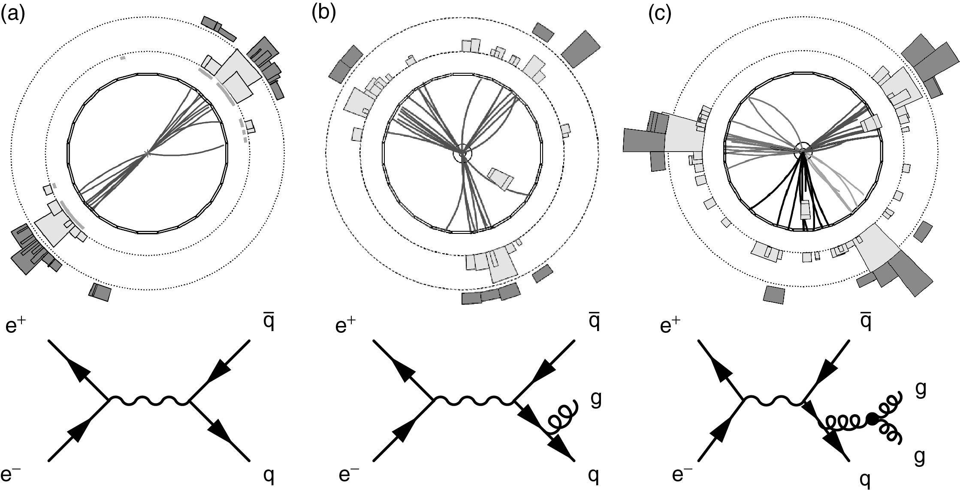
Thomson_opaljets
© Cambridge University Press 2013

Slide 27
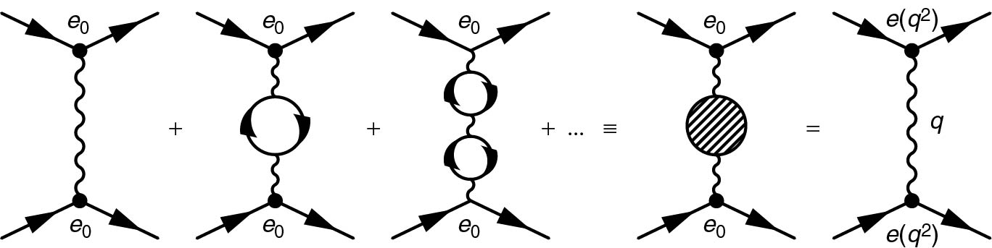
Thomson_QED

Slide 28
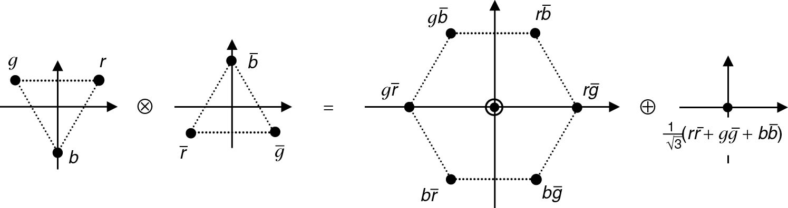
Thomson_qqbarColour

Slide 29
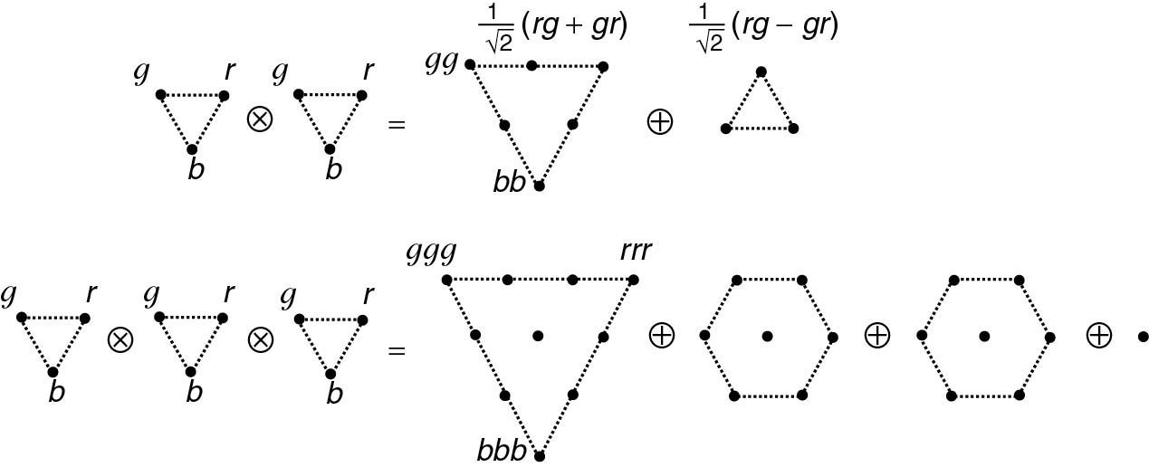
Thomson_qqqColour
© Cambridge University Press 2013

Slide 30
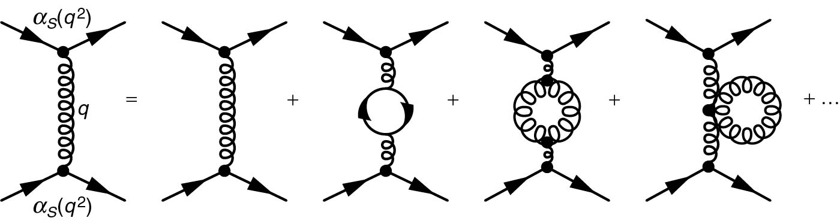
Thomson_RenormalisationQCD
© Cambridge University Press 2013

Slide 31
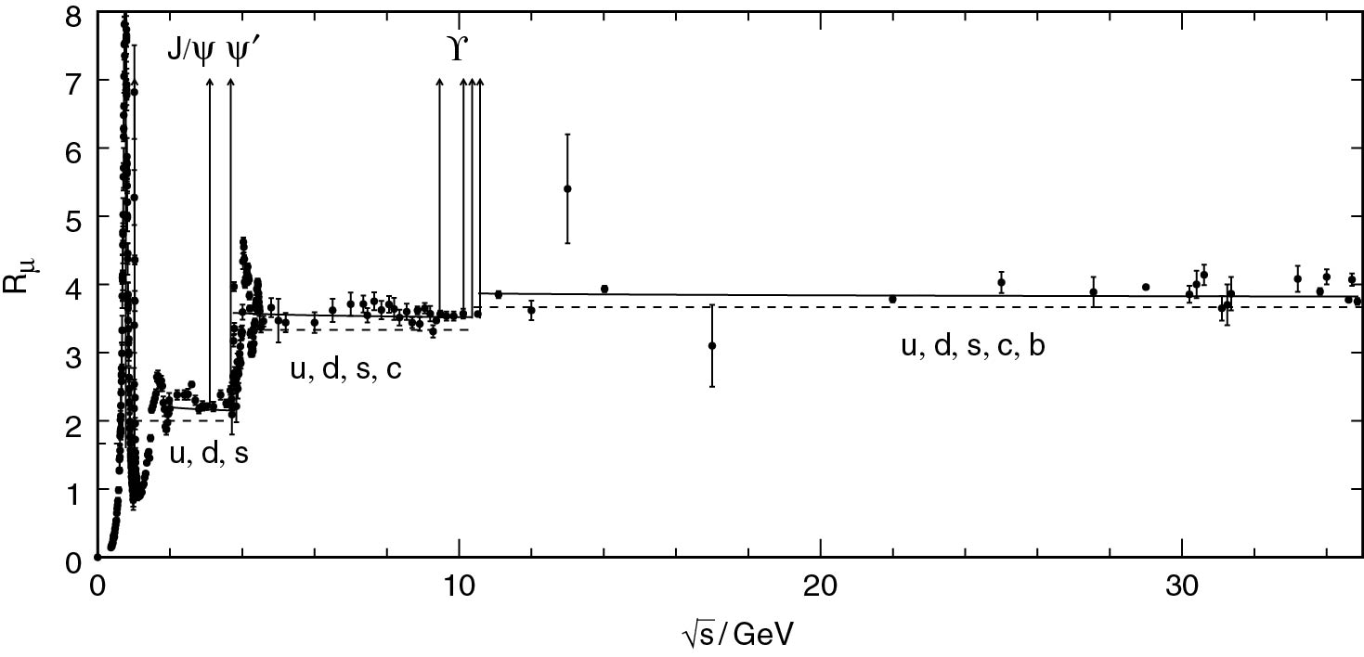
Thomson_Rmu
© Cambridge University Press 2013

Slide 32
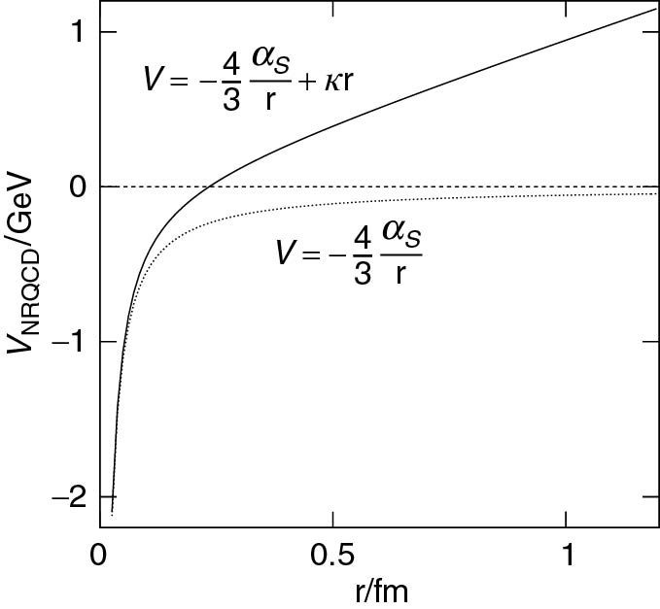
Thomson_Vqcd
© Cambridge University Press 2013

