Slide 1
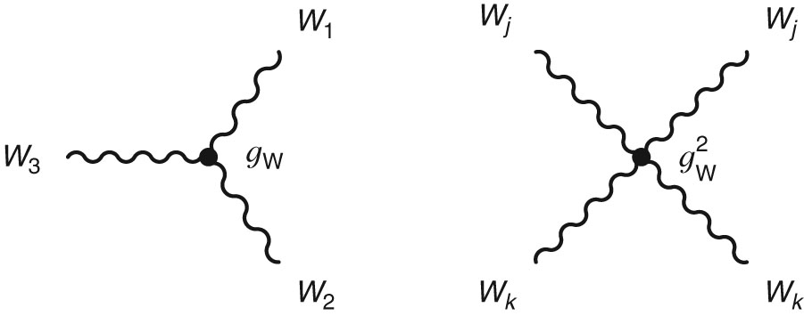
Thomson_Fig-F-1
© Cambridge University Press 2013

Slide 2
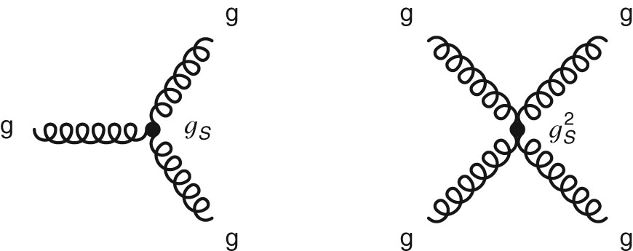
Thomson_Fig-F-2
© Cambridge University Press 2013

