Slide 1
Thomson_Baryonqq1
© Cambridge University Press 2013

Slide 2
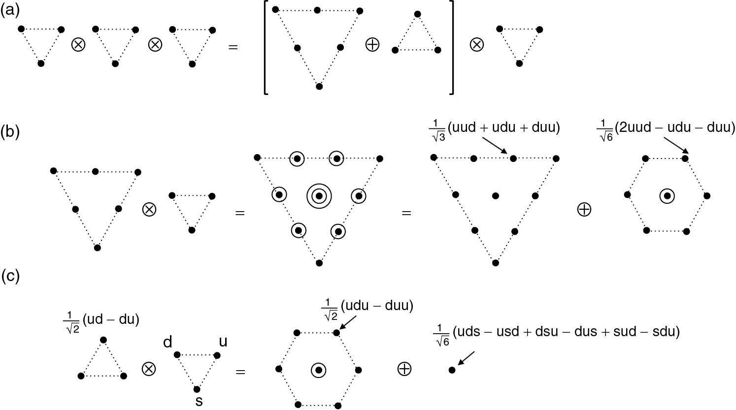
Thomson_BaryonQQQ
© Cambridge University Press 2013

Slide 3
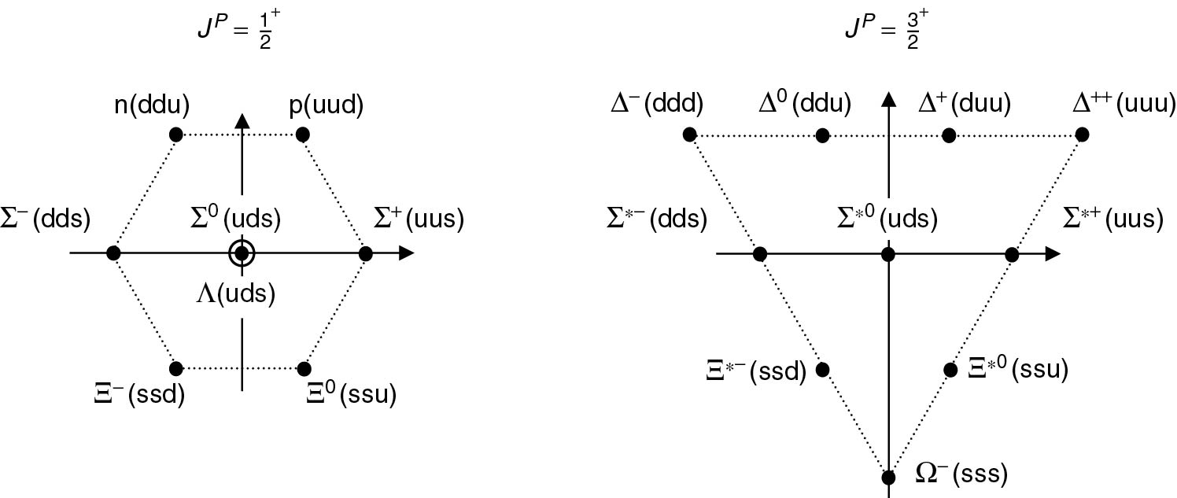
Thomson_BaryonUDS
© Cambridge University Press 2013

Slide 4
Thomson_deltas
© Cambridge University Press 2013

Slide 5
Thomson_isoAq
© Cambridge University Press 2013

Slide 6
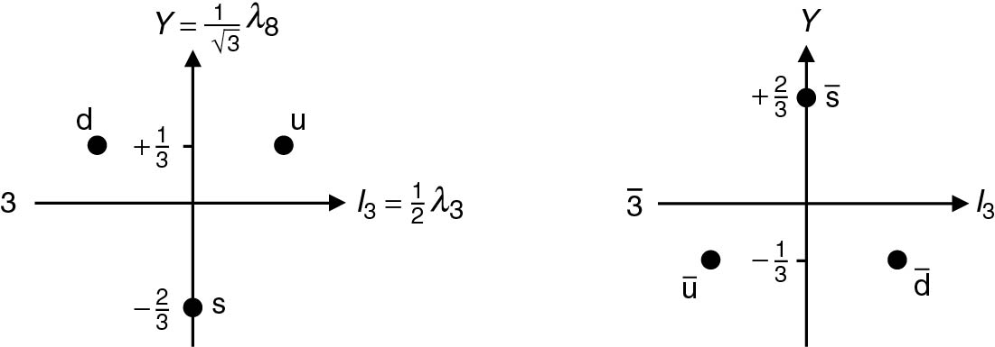
Thomson_iy
© Cambridge University Press 2013

Slide 7
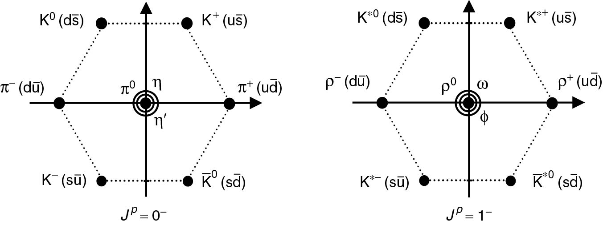
Thomson_mesons
© Cambridge University Press 2013

Slide 8
Thomson_qAq
© Cambridge University Press 2013

Slide 9
Thomson_qq
© Cambridge University Press 2013

Slide 10
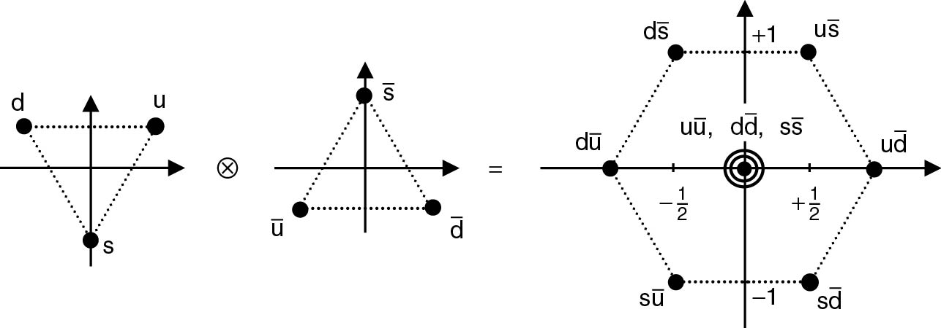
Thomson_qqbar
© Cambridge University Press 2013

Slide 11
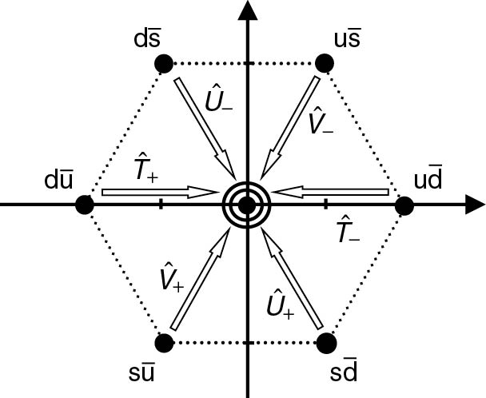
Thomson_qqbarLadder
© Cambridge University Press 2013

Slide 12
Thomson_qqbarMultiplets
© Cambridge University Press 2013

Slide 13
Thomson_qqcomb
© Cambridge University Press 2013

Slide 14
Thomson_qqq
© Cambridge University Press 2013

Slide 15
Thomson_qqq422
© Cambridge University Press 2013

Slide 16
Thomson_Tpm
© Cambridge University Press 2013

Slide 17
Thomson_ud
© Cambridge University Press 2013

