Slide 1
Thomson_epCartoonNew
© Cambridge University Press 2013

Slide 2
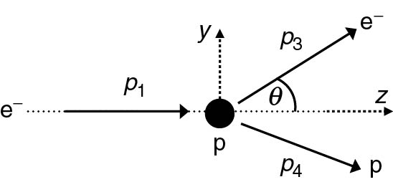
Thomson_epKinematics
© Cambridge University Press 2013

Slide 3
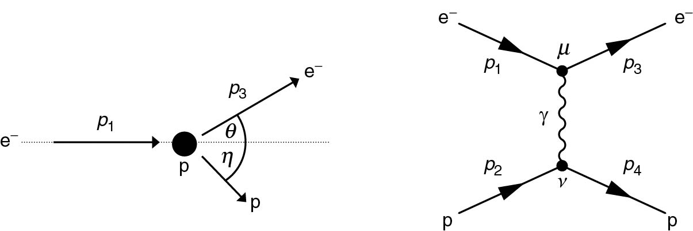
Thomson_epRutherford
© Cambridge University Press 2013

Slide 4
Thomson_Form
© Cambridge University Press 2013

Slide 5
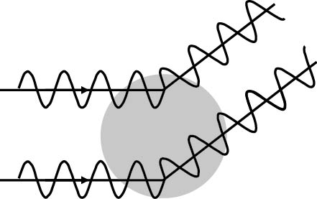
Thomson_FormCartoon
© Cambridge University Press 2013

Slide 6
Thomson_FormExamples
© Cambridge University Press 2013

Slide 7
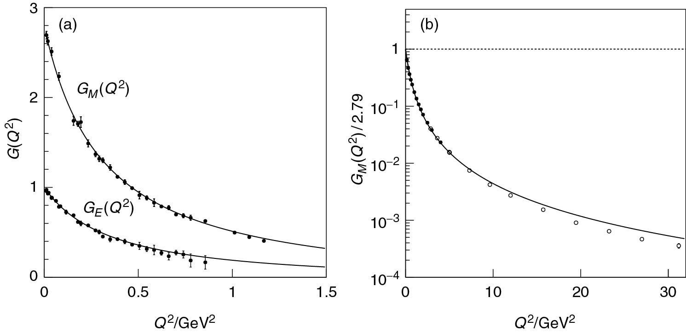
Thomson_GEGM
© Cambridge University Press 2013

Slide 8
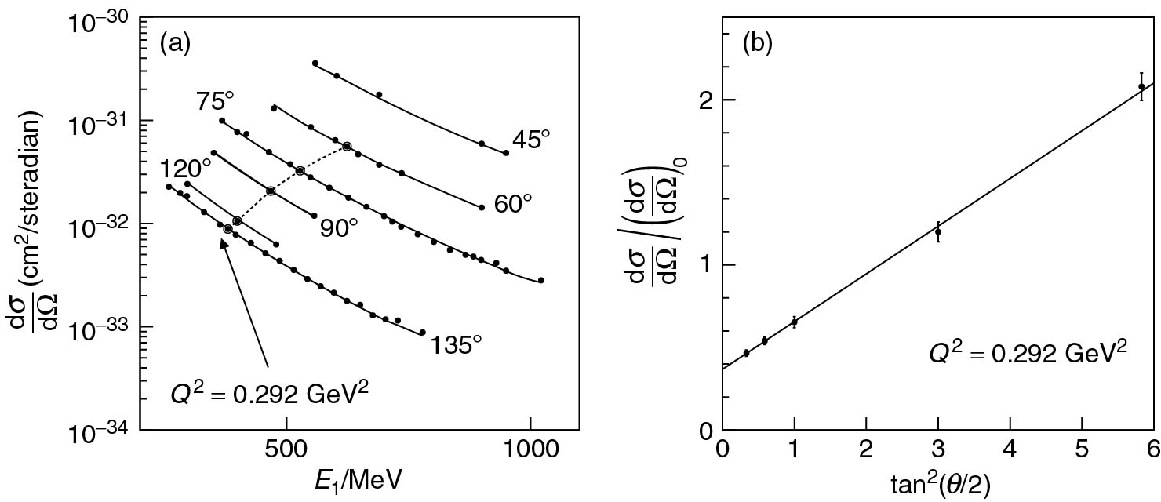
Thomson_Rosen
© Cambridge University Press 2013

