Slide 1
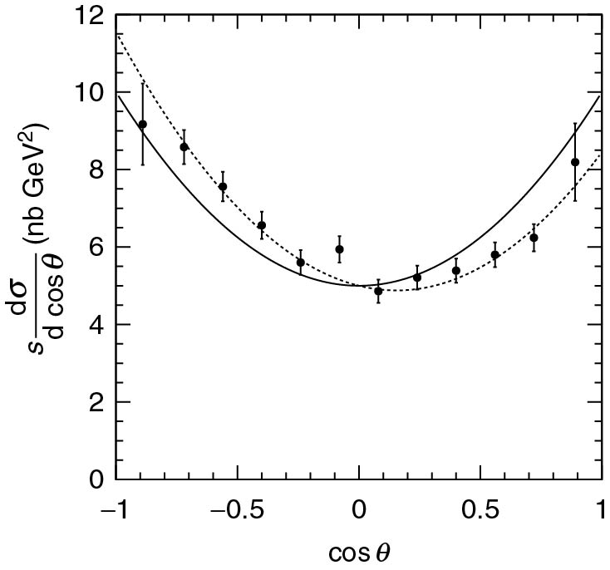
Thomson_dataDiff
© Cambridge University Press 2013

Slide 2
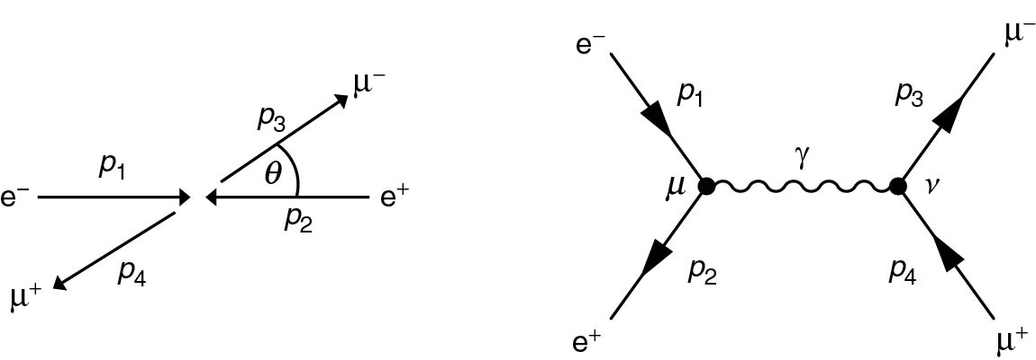
Thomson_eemmCoM
© Cambridge University Press 2013

Slide 3
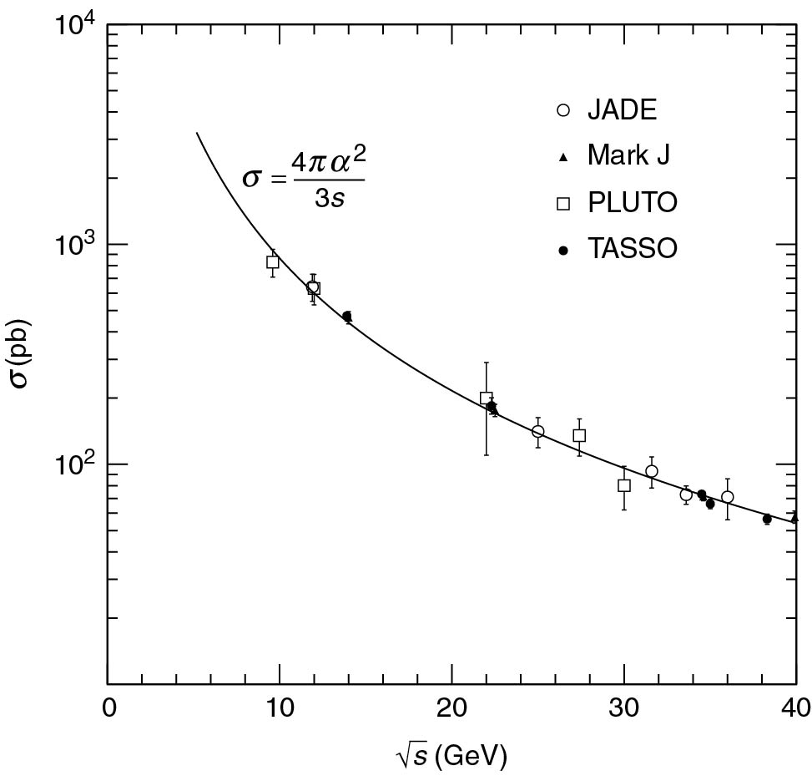
Thomson_eemmData
© Cambridge University Press 2013

Slide 4
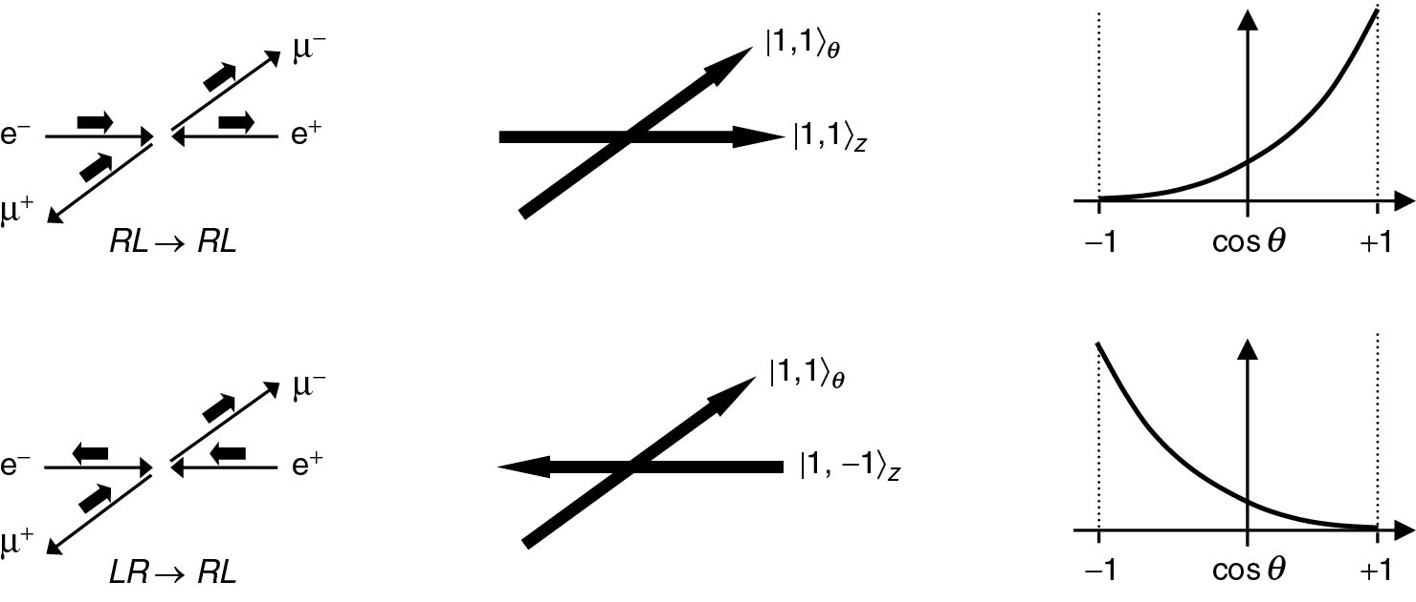
Thomson_eemmSpin
© Cambridge University Press 2013

Slide 5
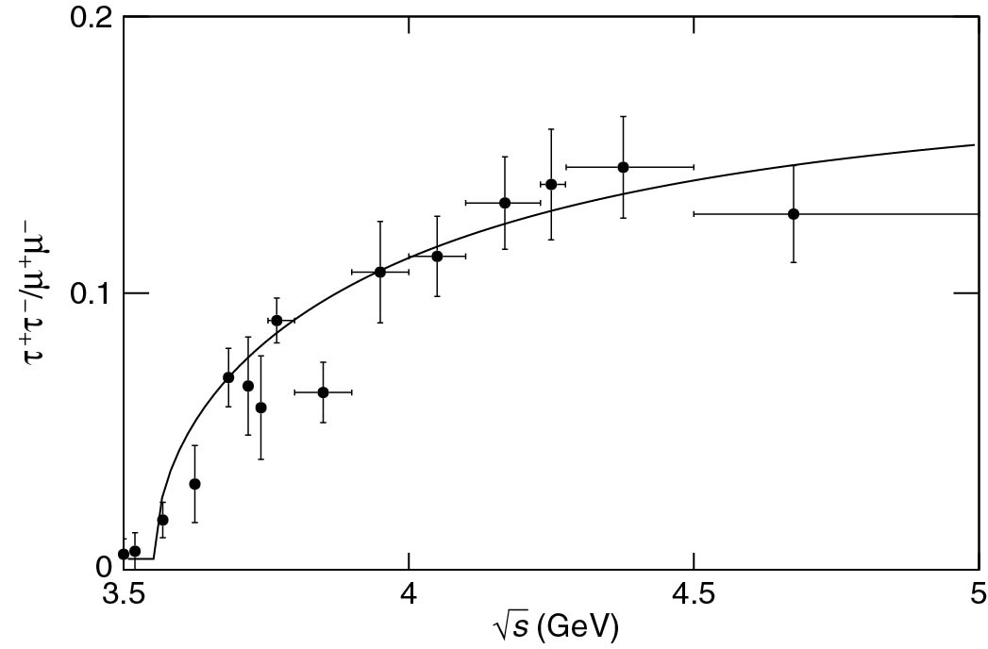
Thomson_eettThresh
© Cambridge University Press 2013

Slide 6
Thomson_epemspins
© Cambridge University Press 2013

Slide 7
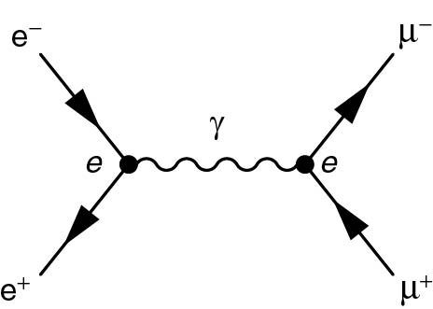
Thomson_Fig-6-1-1
© Cambridge University Press 2013

Slide 8
Thomson_Fig-6-1-2
© Cambridge University Press 2013

Slide 9
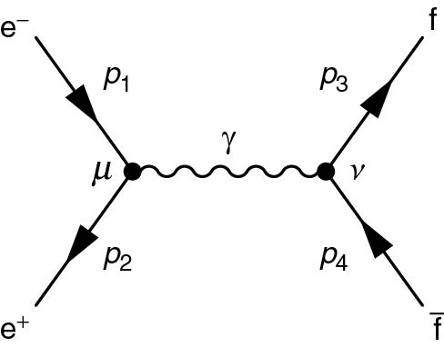
Thomson_Fig-6-5-1
© Cambridge University Press 2013

Slide 10
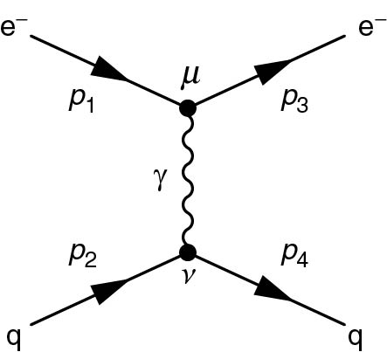
Thomson_Fig-6-5-3
© Cambridge University Press 2013

Slide 11
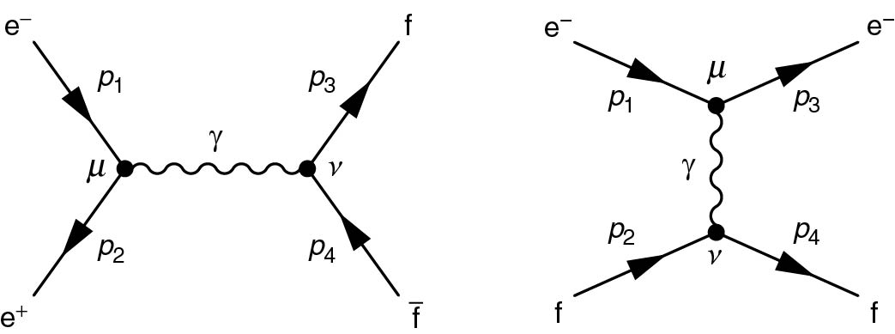
Thomson_Fig-6-5-4
© Cambridge University Press 2013

Slide 12
Thomson_helicityCons
© Cambridge University Press 2013

Slide 13
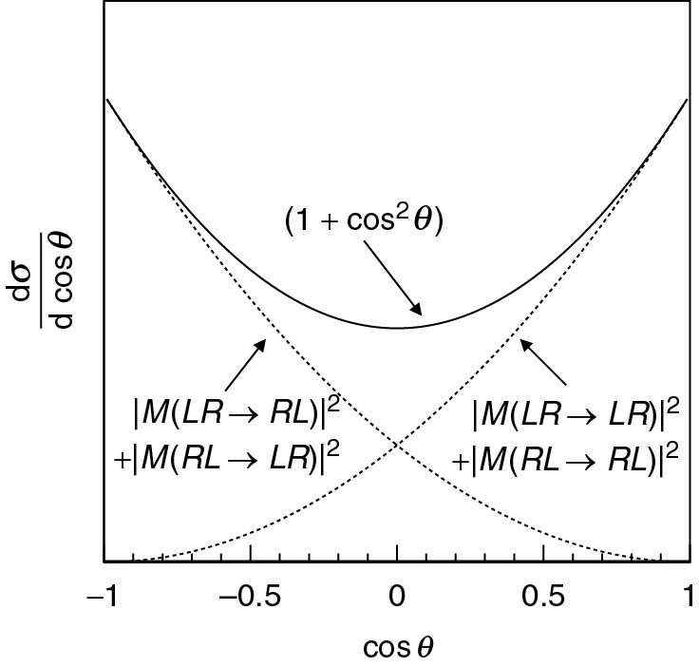
Thomson_idealDiff
© Cambridge University Press 2013

Slide 14
Thomson_mpmmspins
© Cambridge University Press 2013

Slide 15
Thomson_SpinCombs
© Cambridge University Press 2013

