Slide 1
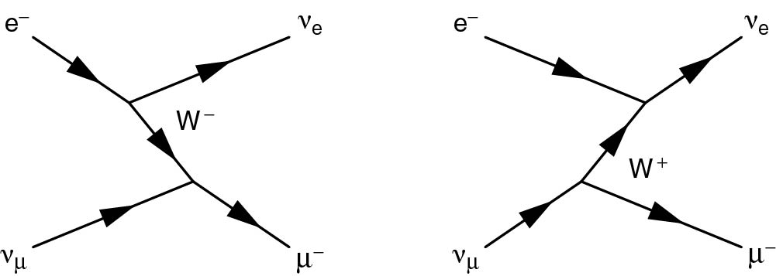
Thomson_5-1-3
© Cambridge University Press 2013

Slide 2
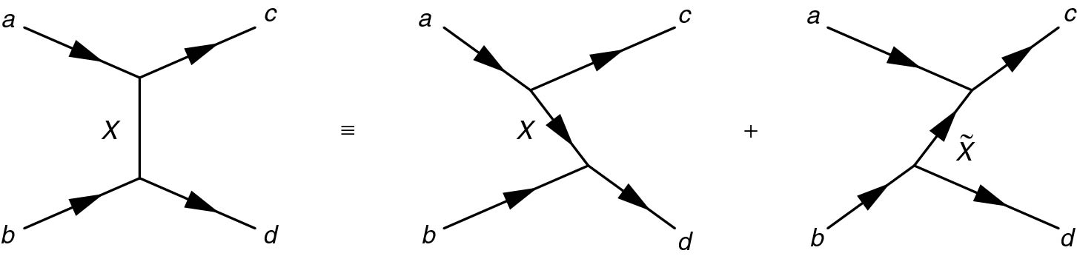
Thomson_5-2-1
© Cambridge University Press 2013

Slide 3
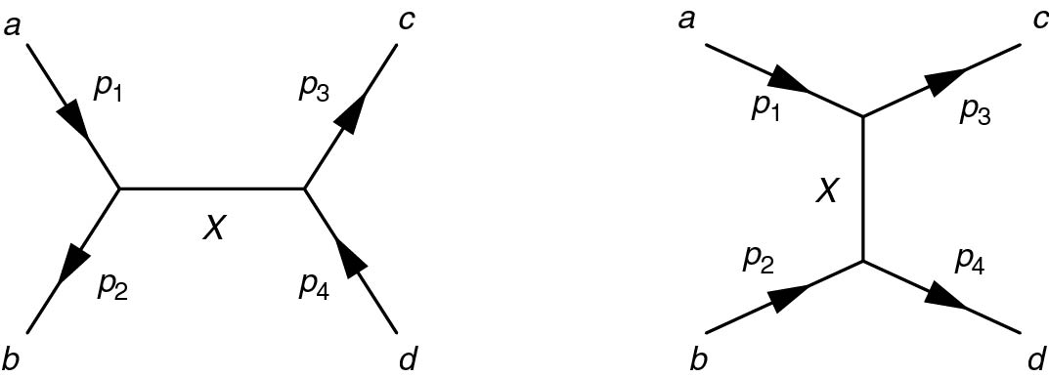
Thomson_5-2-2
© Cambridge University Press 2013

Slide 4
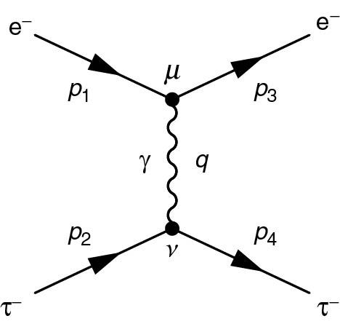
Thomson_5-3-1
© Cambridge University Press 2013

Slide 5
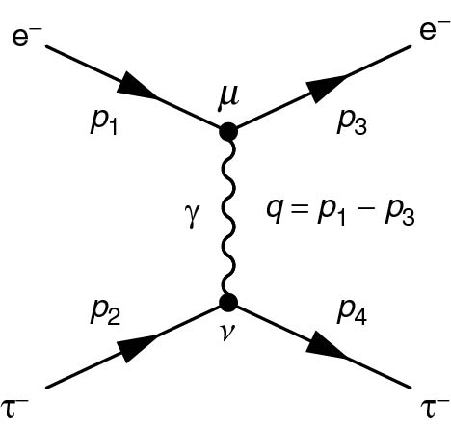
Thomson_5-4-1
© Cambridge University Press 2013

Slide 6
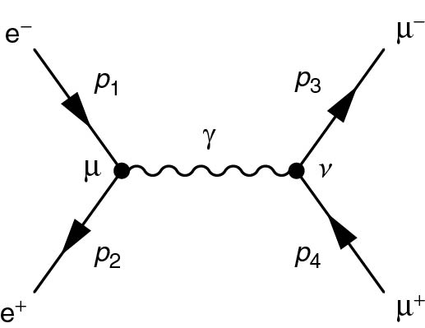
Thomson_5-4-2
© Cambridge University Press 2013

Slide 7
Thomson_inlineimage-1
© Cambridge University Press 2013

Slide 8
Thomson_inlineimage-2
© Cambridge University Press 2013

Slide 9
Thomson_inlineimage-3
© Cambridge University Press 2013

Slide 10
Thomson_inlineimage-4
© Cambridge University Press 2013

Slide 11
Thomson_inlineimage-5
© Cambridge University Press 2013

Slide 12
Thomson_inlineimage-6
© Cambridge University Press 2013

Slide 13
Thomson_inlineimage-7
© Cambridge University Press 2013

Slide 14
Thomson_inlineimage-8
© Cambridge University Press 2013

Slide 15

Thomson_inlineimage-9
© Cambridge University Press 2013

Slide 16
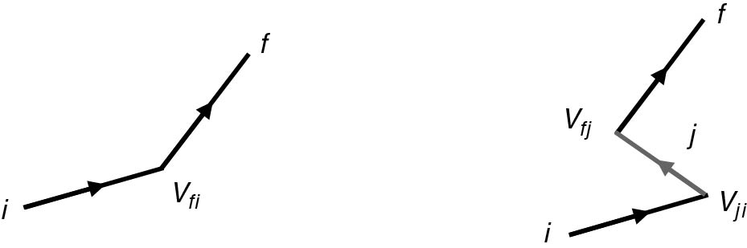
Thomson_Scattering1
© Cambridge University Press 2013

Slide 17
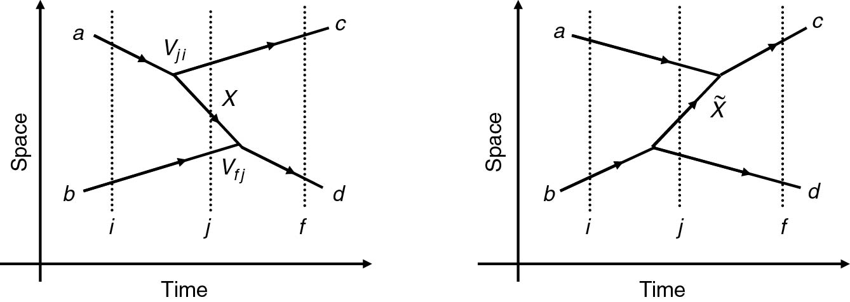
Thomson_TimeOrder12
© Cambridge University Press 2013

