Slide 1
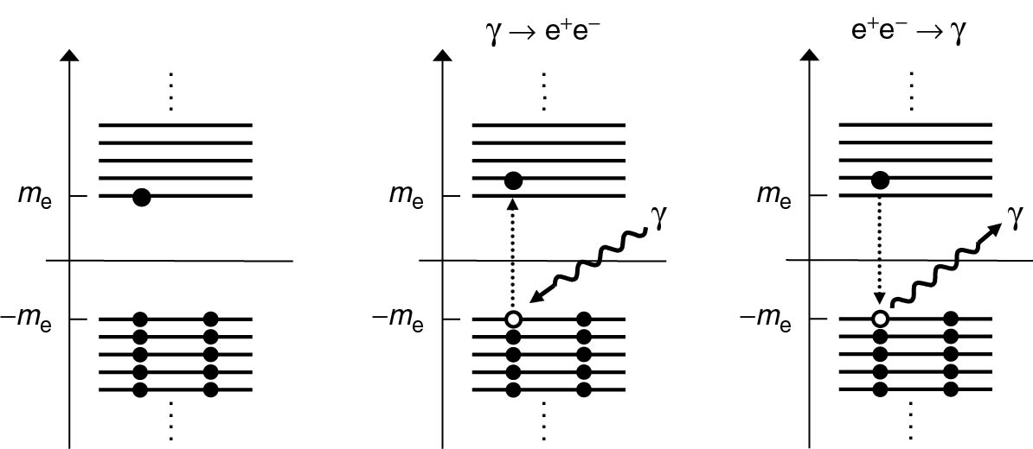
Thomson_Fig-4-7-1
© Cambridge University Press 2013

Slide 2
Thomson_Fig-4-7-2
© Cambridge University Press 2013

Slide 3
Thomson_Fig-4-8-1
© Cambridge University Press 2013

Slide 4
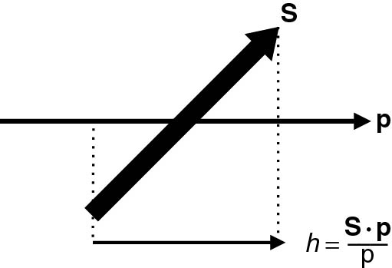
Thomson_Fig-4-8-2
© Cambridge University Press 2013

Slide 5
Thomson_Fig-4-8-3
© Cambridge University Press 2013

Slide 6
Thomson_Fig-4-8-4
© Cambridge University Press 2013

