Slide 1
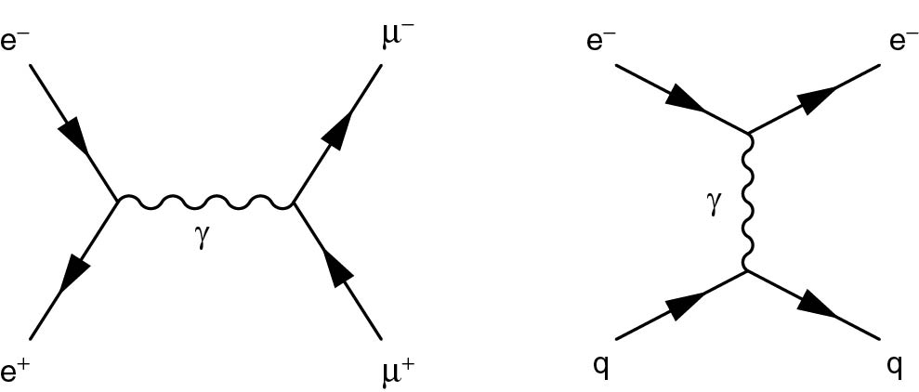
Thomson_Fig-3-1-1
© Cambridge University Press 2013

Slide 2
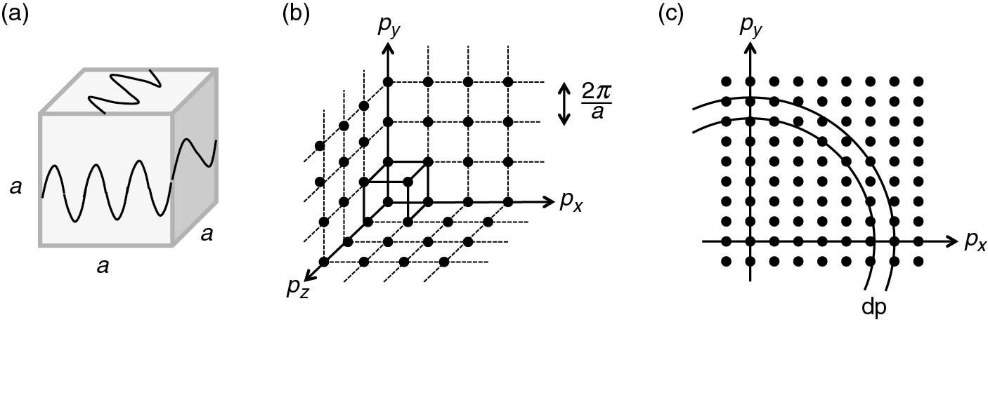
Thomson_Fig-3-2-1
© Cambridge University Press 2013

Slide 3
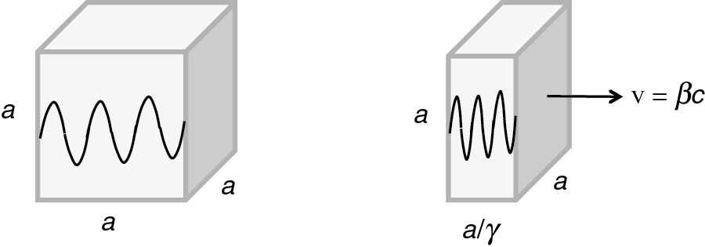
Thomson_Fig-3-2-2
© Cambridge University Press 2013

Slide 4
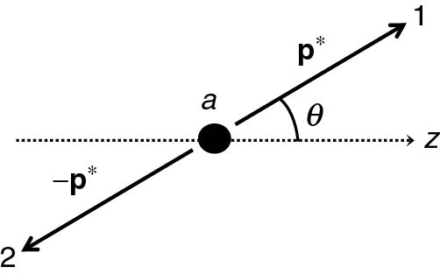
Thomson_Fig-3-3-1
© Cambridge University Press 2013

Slide 5
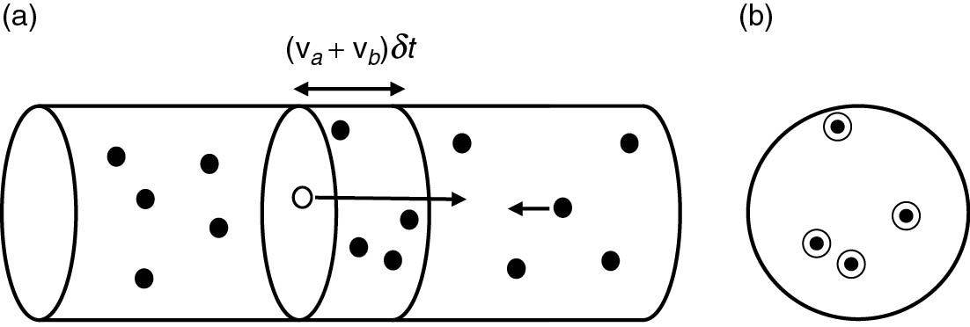
Thomson_Fig-3-4-1
© Cambridge University Press 2013

Slide 6
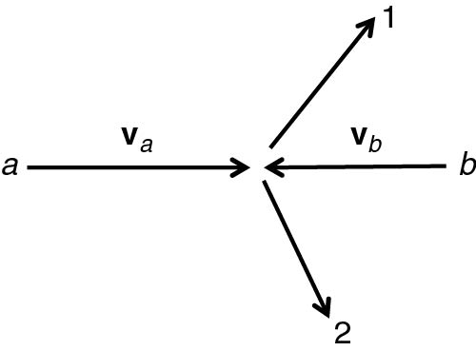
Thomson_Fig-3-4-2
© Cambridge University Press 2013

Slide 7
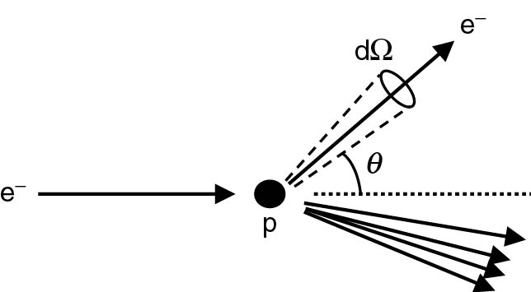
Thomson_Fig-3-5-1
© Cambridge University Press 2013

Slide 8
Thomson_Fig-3-5-2
© Cambridge University Press 2013

