Slide 1
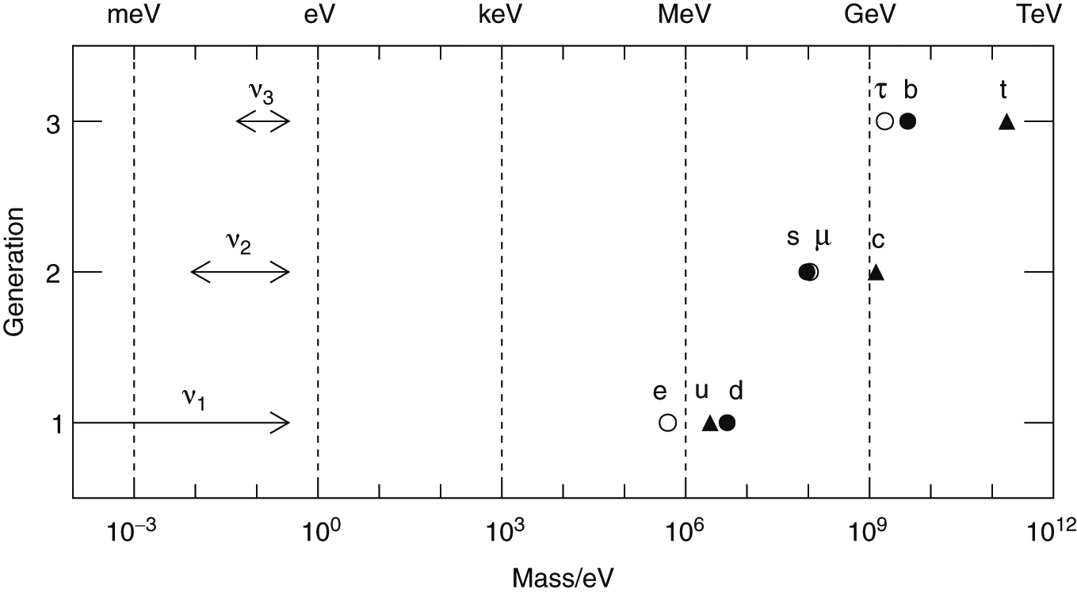
Thomson_FermionMasses
© Cambridge University Press 2013

Slide 2
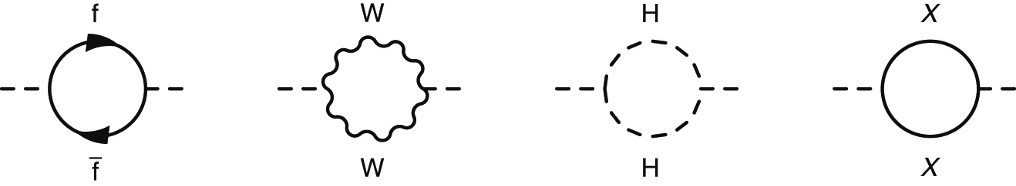
Thomson_Fig-18-2-1
© Cambridge University Press 2013

Slide 3
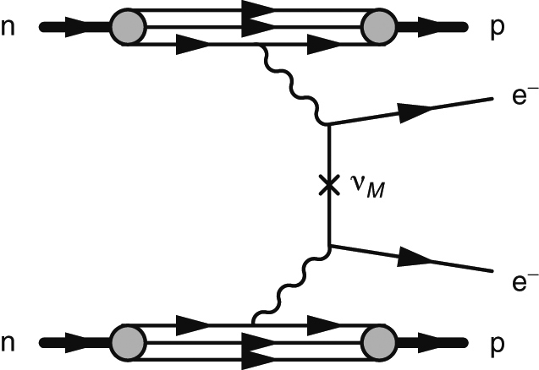
Thomson_Fig-18-2-3
© Cambridge University Press 2013

Slide 4
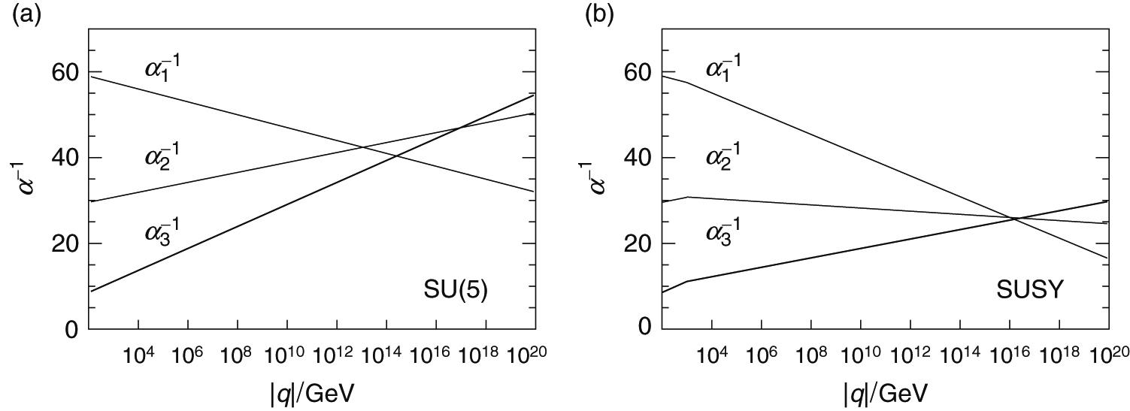
Thomson_GUTplot
© Cambridge University Press 2013

Slide 5
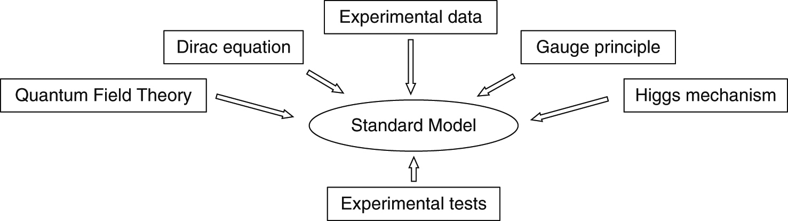
Thomson_SM
© Cambridge University Press 2013

