Slide 1
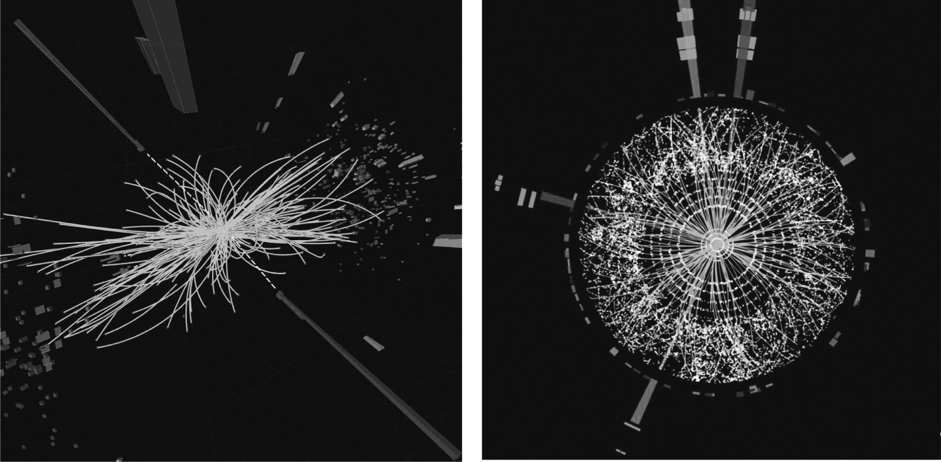
Thomson_atlascmsEventsAlt
© Cambridge University Press 2013

Slide 2
Thomson_Fig-17-1-1
© Cambridge University Press 2013

Slide 3
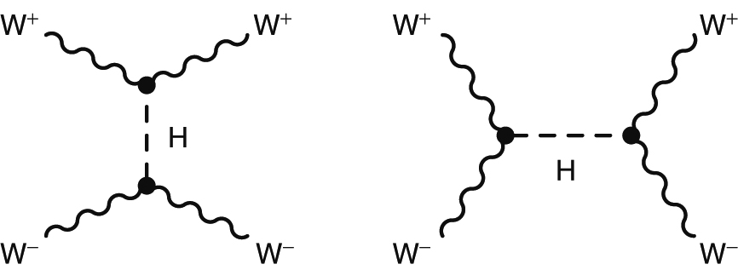
Thomson_Fig-17-1-2
© Cambridge University Press 2013

Slide 4
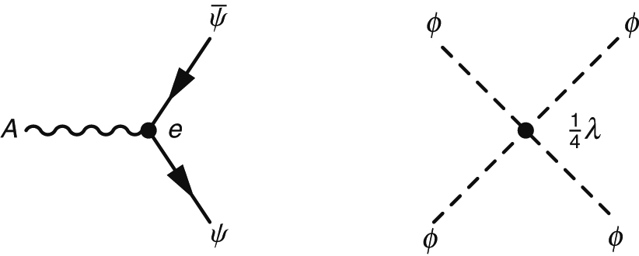
Thomson_Fig-17-5-1
© Cambridge University Press 2013

Slide 5
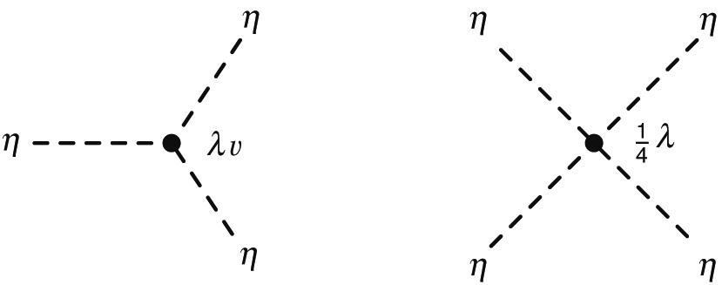
Thomson_Fig-17-5-3
© Cambridge University Press 2013

Slide 6
Thomson_Fig-17-5-5
© Cambridge University Press 2013

Slide 7
Thomson_Fig-17-5-7
© Cambridge University Press 2013

Slide 8
Thomson_Fig-17-5-8
© Cambridge University Press 2013

Slide 9
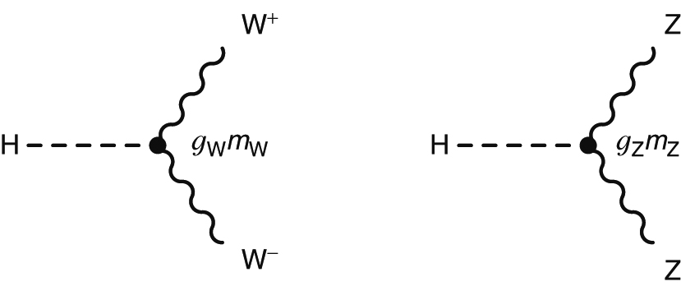
Thomson_Fig-17-5-9
© Cambridge University Press 2013

Slide 10
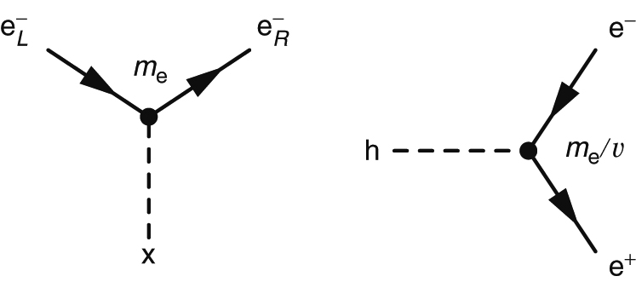
Thomson_Fig-17-5-10
© Cambridge University Press 2013

Slide 11
Thomson_Fig-17-6-1
© Cambridge University Press 2013

Slide 12
Thomson_Fig-17-6-3
© Cambridge University Press 2013

Slide 13
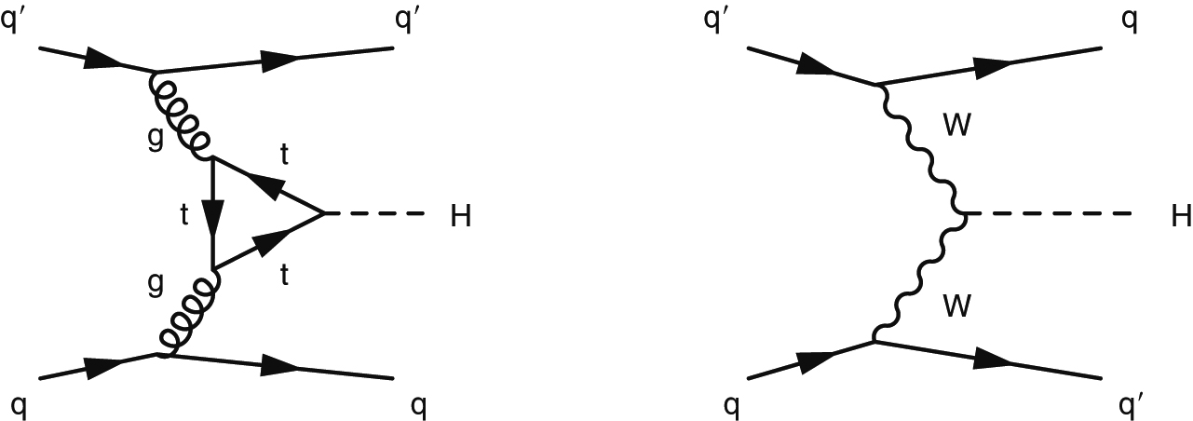
Thomson_Fig-17-7-1
© Cambridge University Press 2013

Slide 14
Thomson_Fig-17-8-1
© Cambridge University Press 2013

Slide 15
Thomson_hbb
© Cambridge University Press 2013

Slide 16
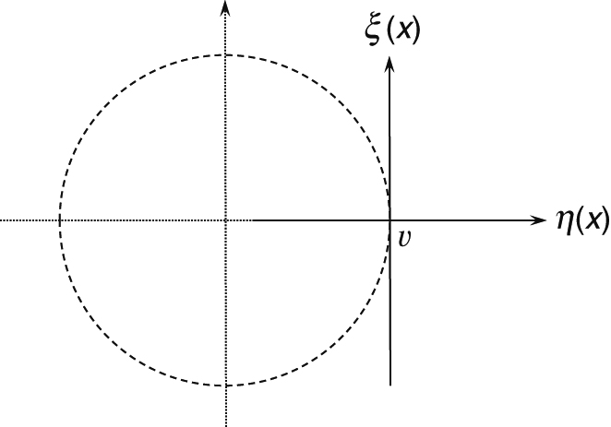
Thomson_higgsv
© Cambridge University Press 2013

Slide 17
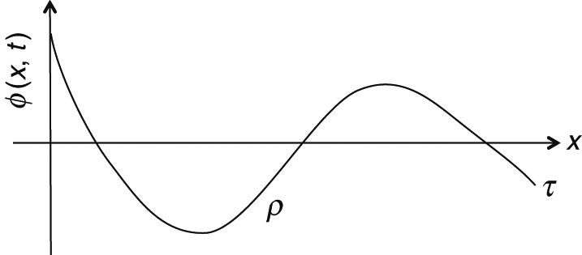
Thomson_String
© Cambridge University Press 2013

Slide 18
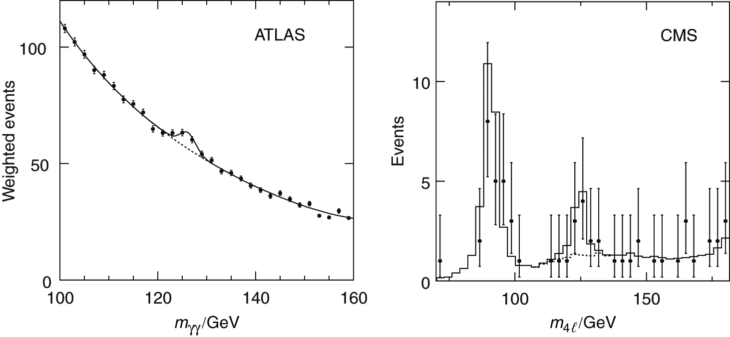
Thomson_tlascmsResultsAlt
© Cambridge University Press 2013

Slide 19
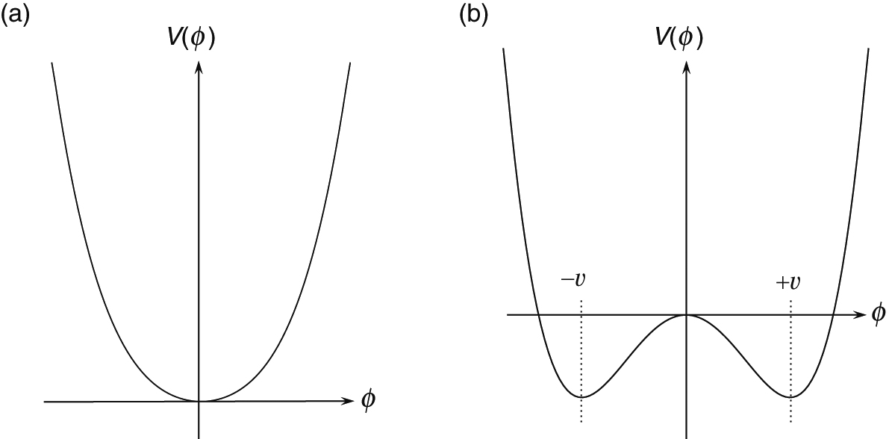
Thomson_vHiggs1D
© Cambridge University Press 2013

Slide 20
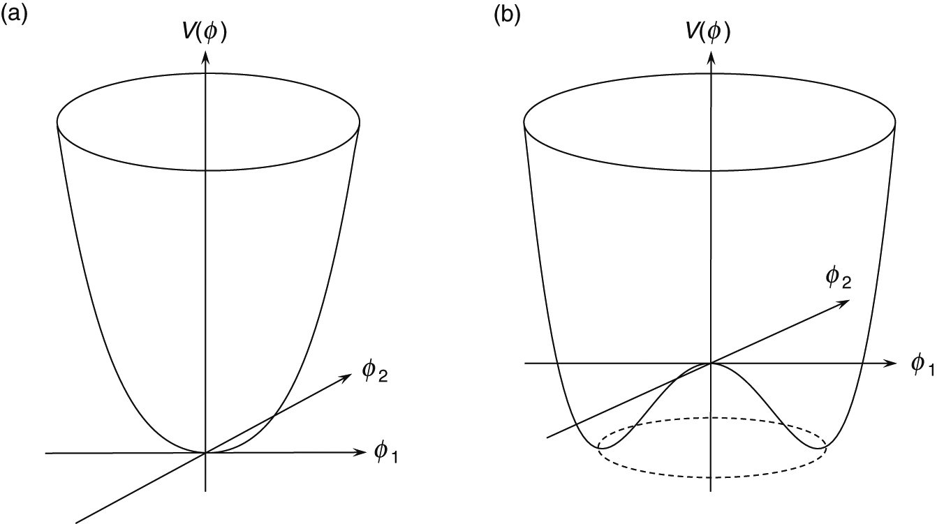
Thomson_vHiggs2D
© Cambridge University Press 2013

