Slide 1
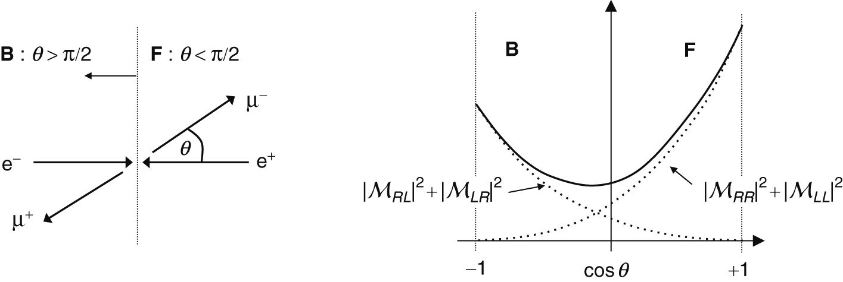
Thomson_AFBCartoon
© Cambridge University Press 2013

Slide 2
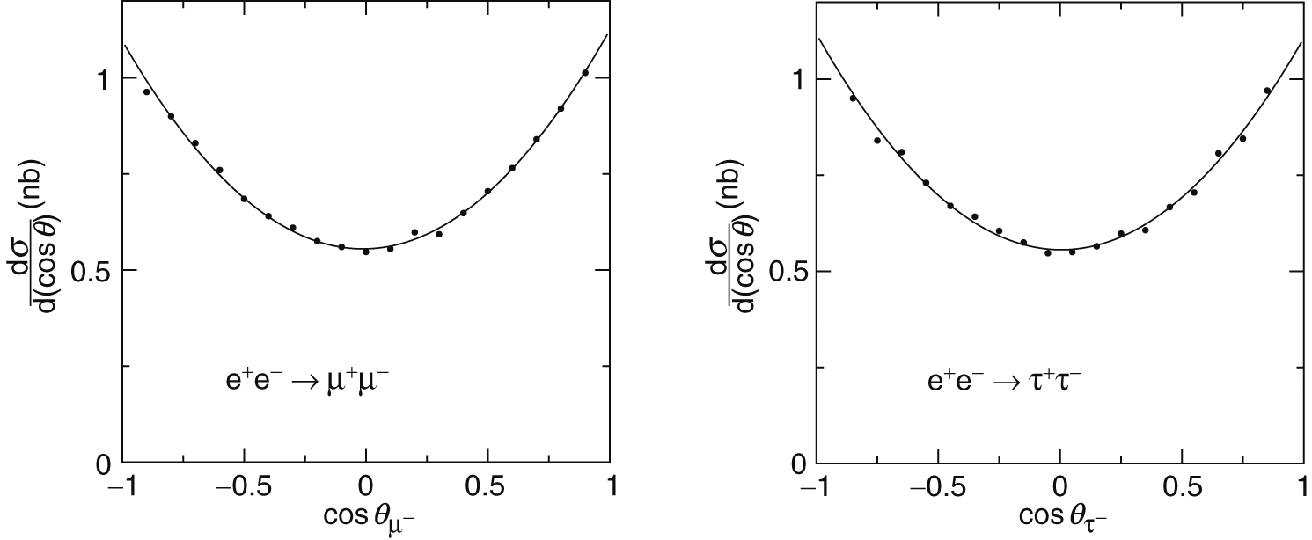
Thomson_AfbOPAL
© Cambridge University Press 2013

Slide 3
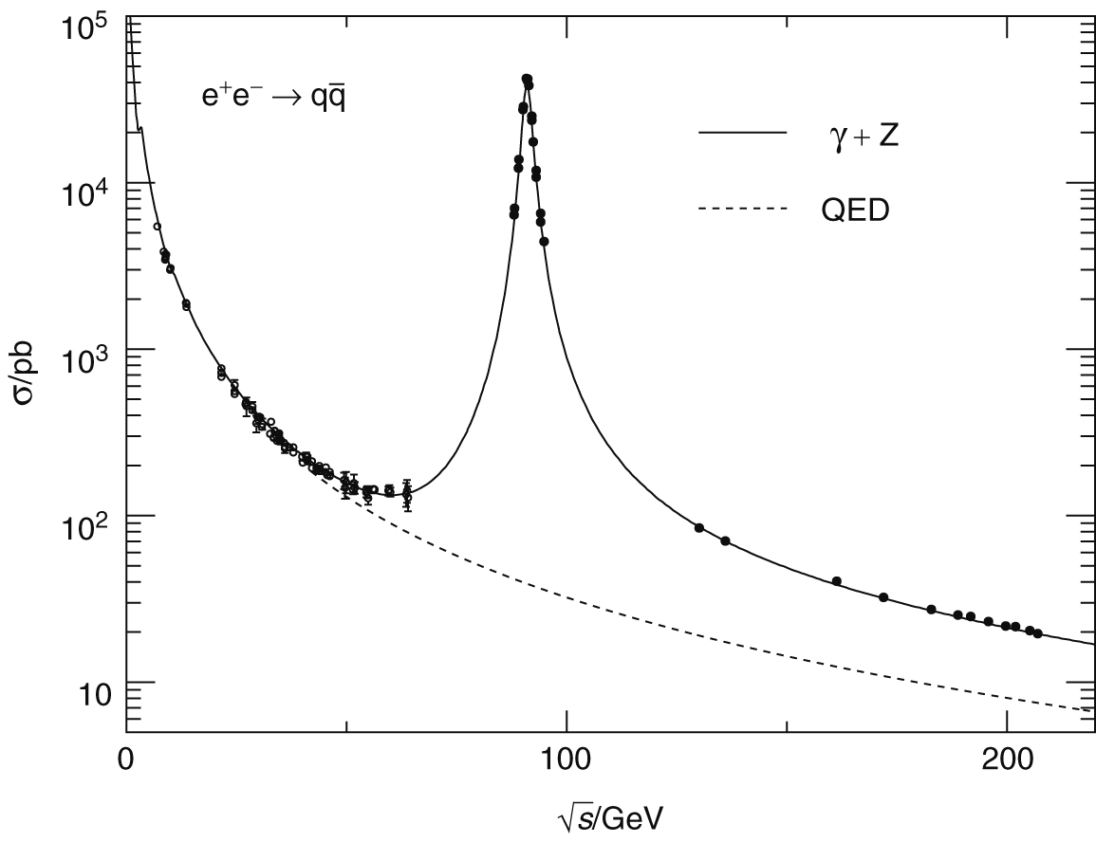
Thomson_eeqqData
© Cambridge University Press 2013

Slide 4
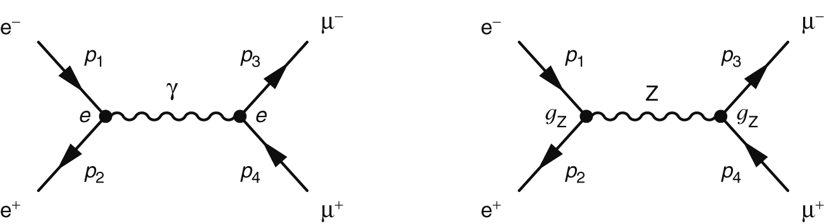
Thomson_Fig-16-1-1
© Cambridge University Press 2013

Slide 5
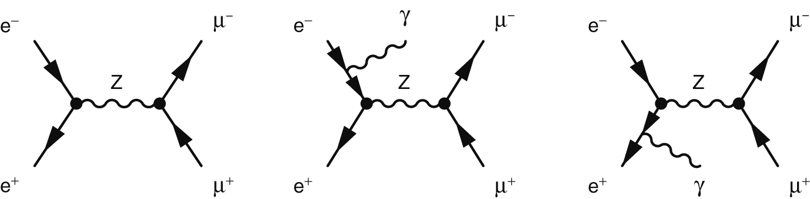
Thomson_Fig-16-2-1
© Cambridge University Press 2013

Slide 6
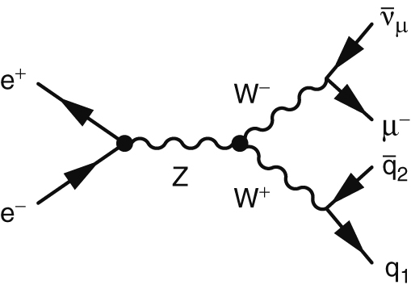
Thomson_Fig-16-3-3
© Cambridge University Press 2013

Slide 7
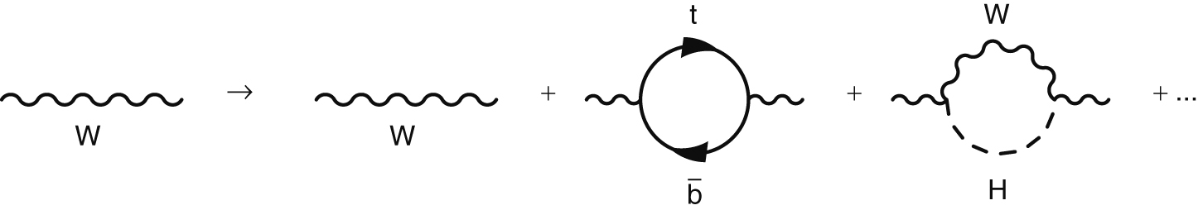
Thomson_Fig-16-4-1
© Cambridge University Press 2013

Slide 8
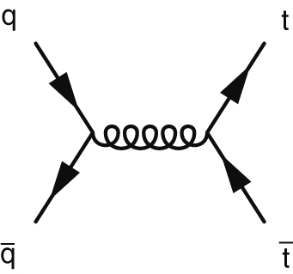
Thomson_Fig-16-5-1
© Cambridge University Press 2013

Slide 9
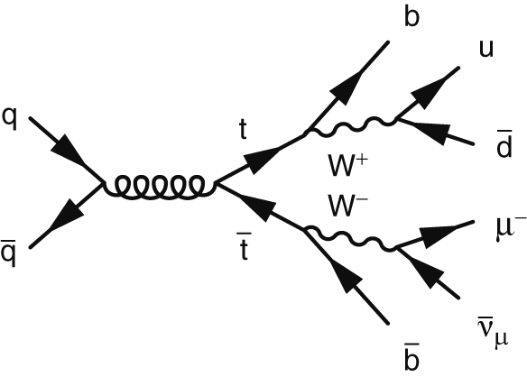
Thomson_Fig-16-5-2
© Cambridge University Press 2013

Slide 10
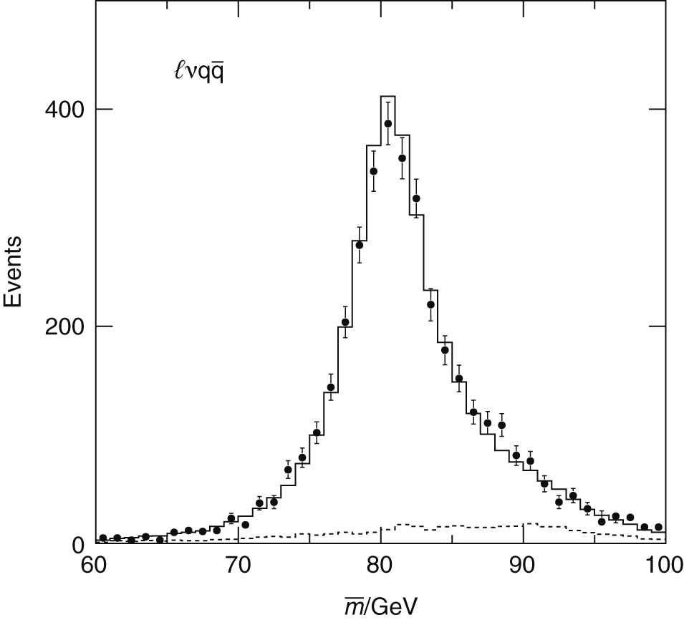
Thomson_l3mw
© Cambridge University Press 2013

Slide 11
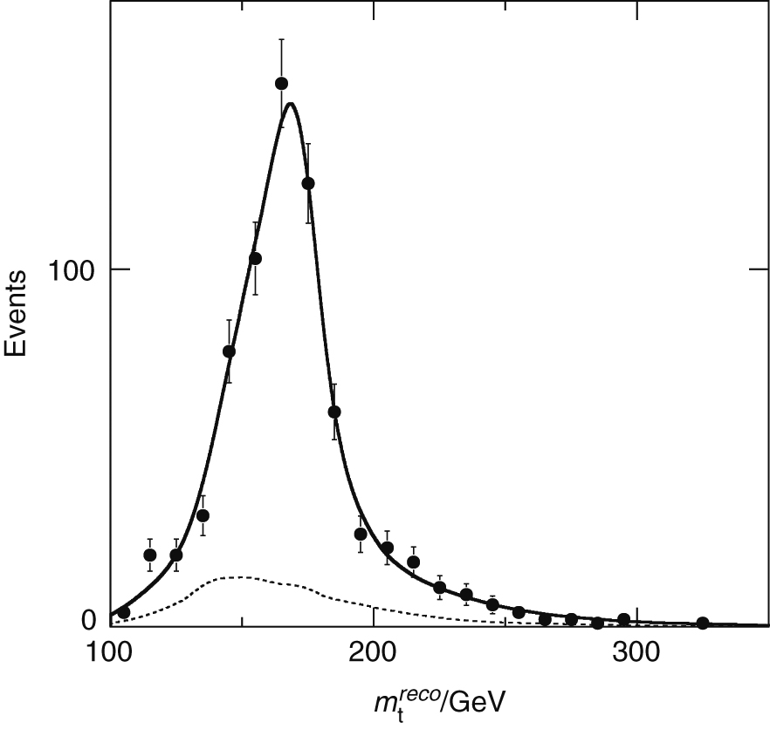
Thomson_mtopcdf
© Cambridge University Press 2013

Slide 12
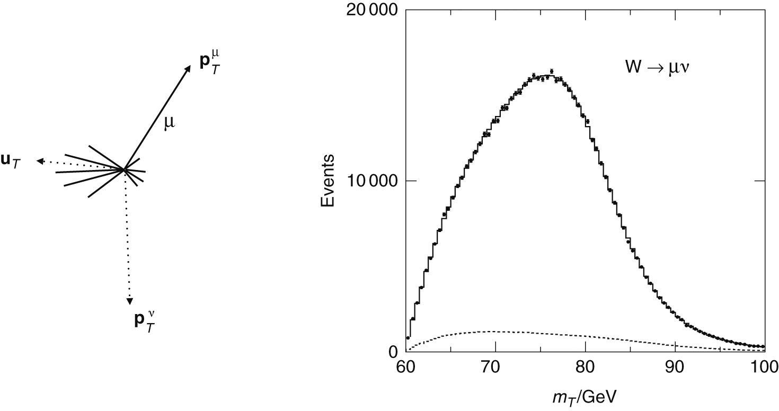
Thomson_mw_cdf
© Cambridge University Press 2013

Slide 13
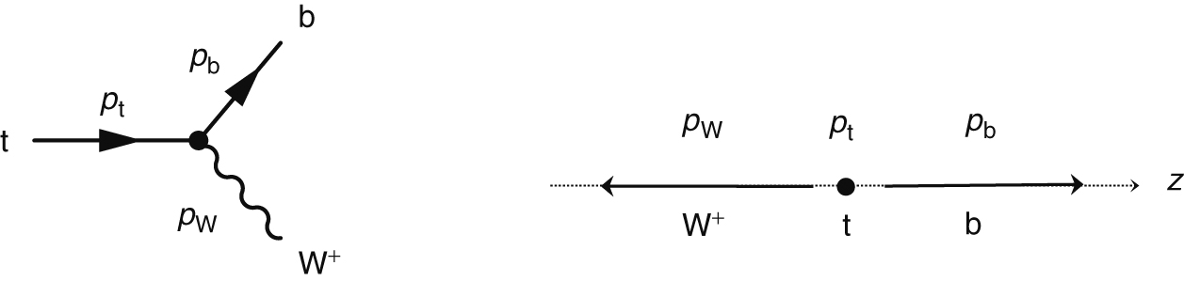
Thomson_tdecaydef
© Cambridge University Press 2013

Slide 14
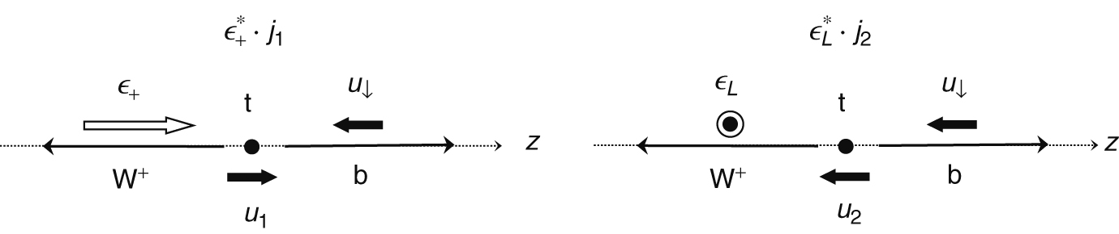
Thomson_topspins
© Cambridge University Press 2013

Slide 15
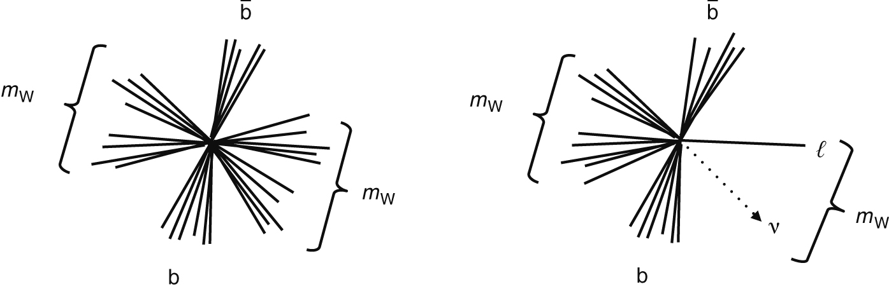
Thomson_toptopo
© Cambridge University Press 2013

Slide 16
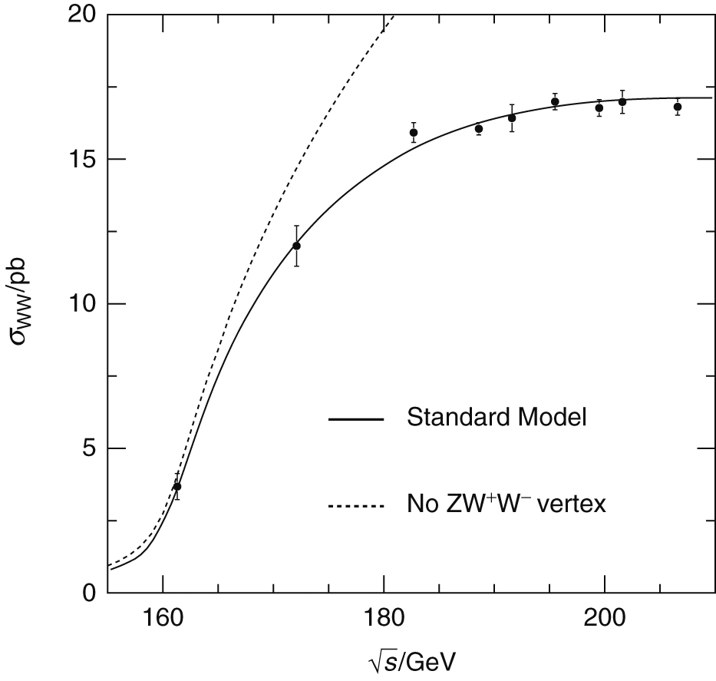
Thomson_wwcross
© Cambridge University Press 2013

Slide 17
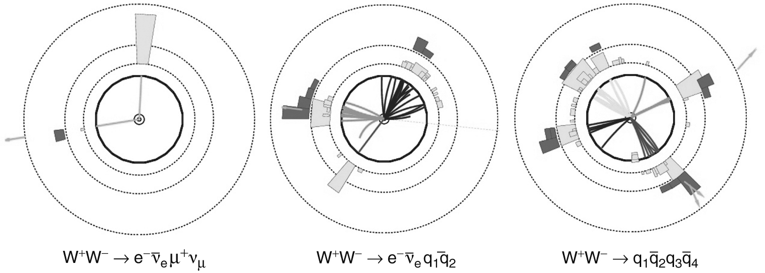
Thomson_WWEvents
© Cambridge University Press 2013

Slide 18
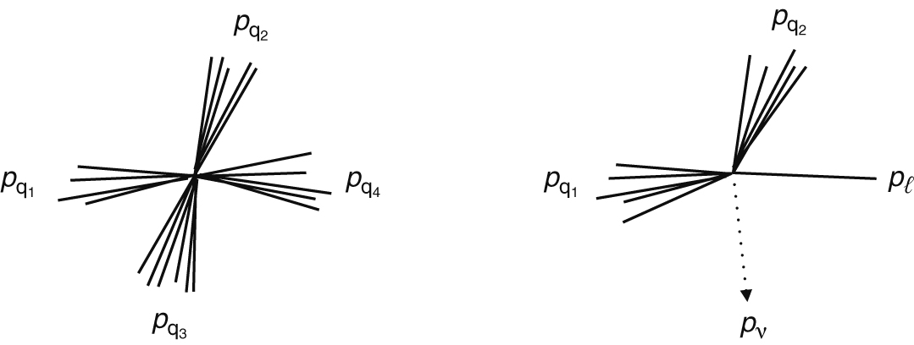
Thomson_AFBCartoon
© Cambridge University Press 2013

Slide 19
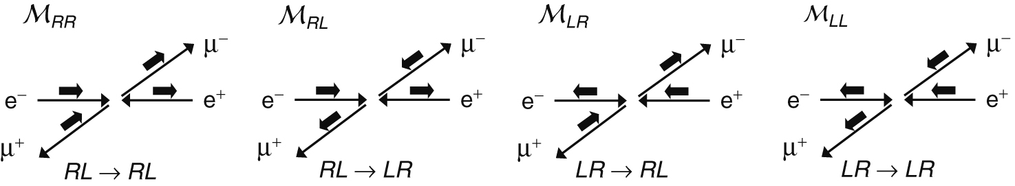
Thomson_Zhelicity
© Cambridge University Press 2013

Slide 20
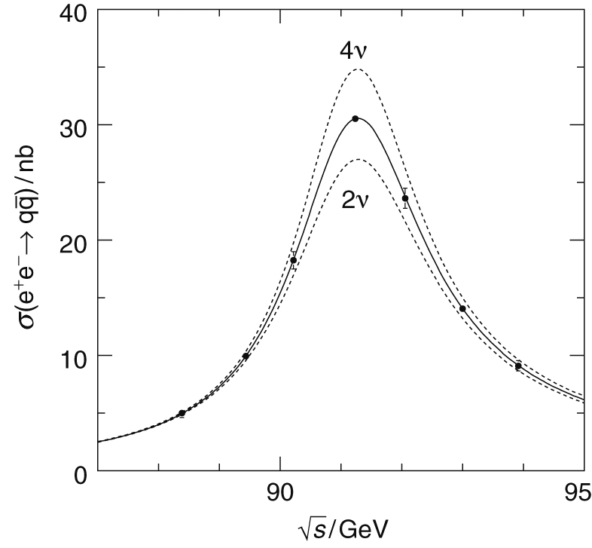
Thomson_ZNnu
© Cambridge University Press 2013

Slide 21
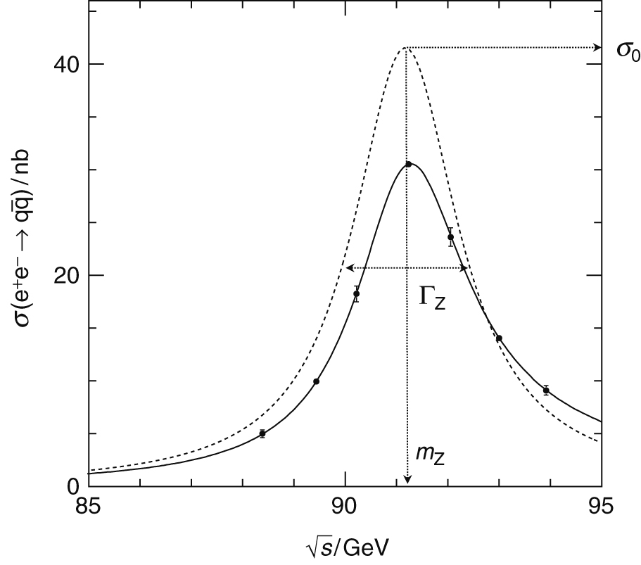
Thomson_ZResonance
© Cambridge University Press 2013

