Slide 1
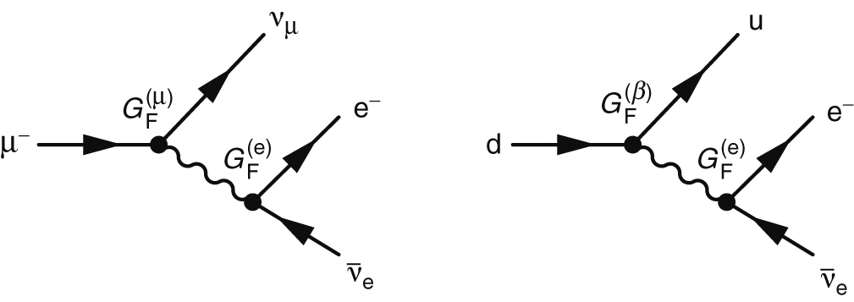
Thomson_Fig-14-2-1
© Cambridge University Press 2013

Slide 2
Thomson_Fig-14-2-2
© Cambridge University Press 2013

Slide 3
Thomson_Fig-14-2-3
© Cambridge University Press 2013

Slide 4
Thomson_Fig-14-2-4
© Cambridge University Press 2013

Slide 5
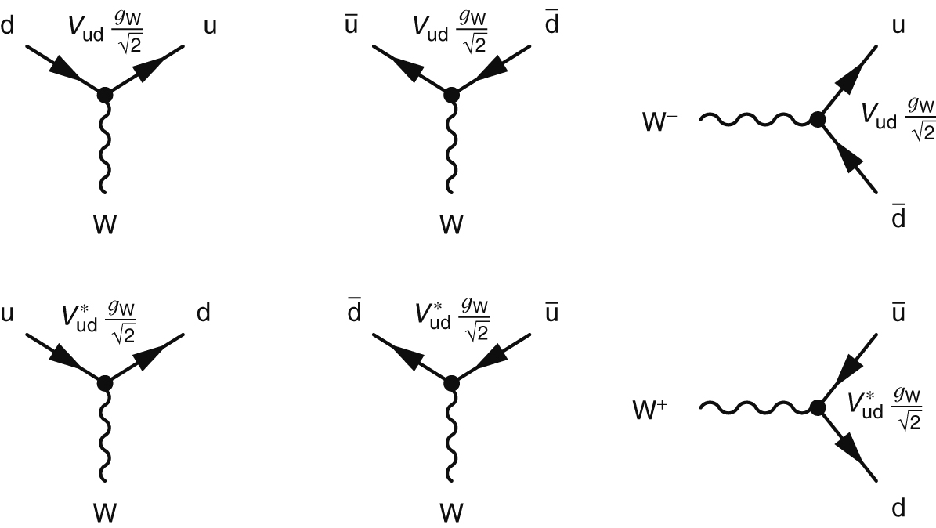
Thomson_Fig-14-3-1
© Cambridge University Press 2013

Slide 6
Thomson_Fig-14-3-2
© Cambridge University Press 2013

Slide 7
Thomson_Fig-14-4-1
© Cambridge University Press 2013

Slide 8
Thomson_Fig-14-4-2
© Cambridge University Press 2013

Slide 9
Thomson_Fig-14-4-3
© Cambridge University Press 2013

Slide 10
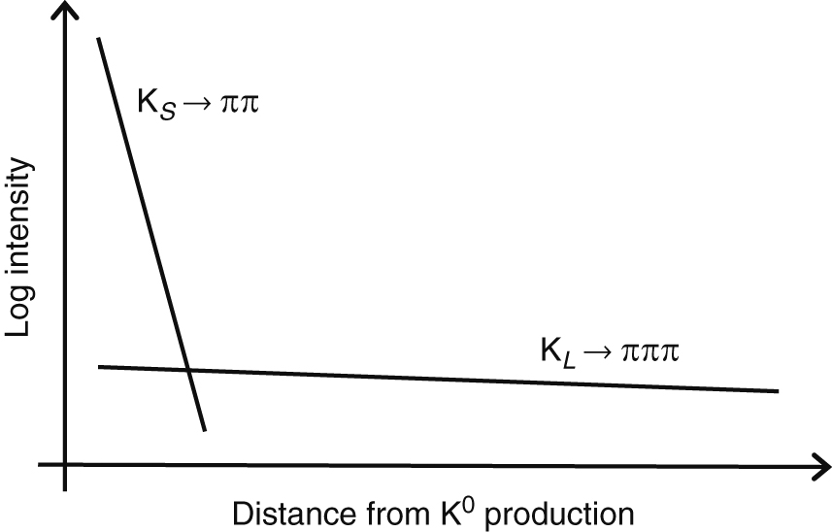
Thomson_Fig-14-4-4
© Cambridge University Press 2013

Slide 11
Thomson_Fig-14-4-5
© Cambridge University Press 2013

Slide 12
Thomson_Fig-14-5-1
© Cambridge University Press 2013

Slide 13
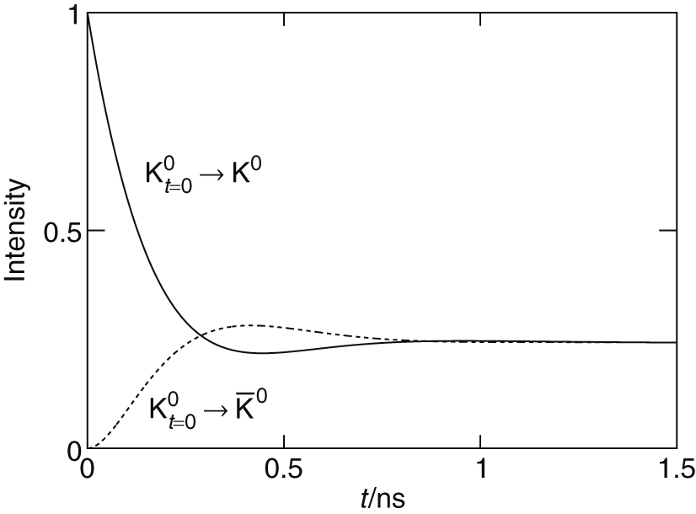
Thomson_Fig-14-5-2
© Cambridge University Press 2013

Slide 14
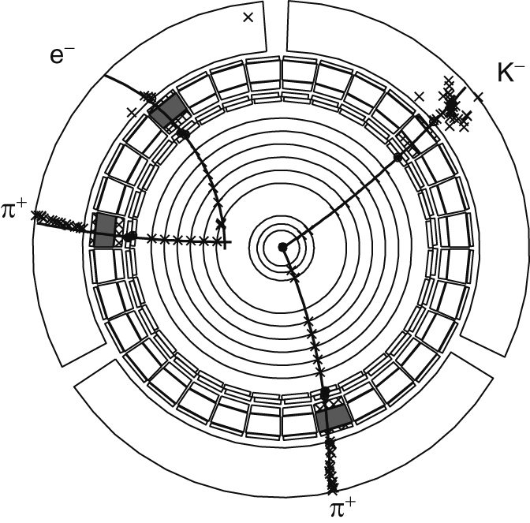
Thomson_Fig-14-5-3
© Cambridge University Press 2013

Slide 15
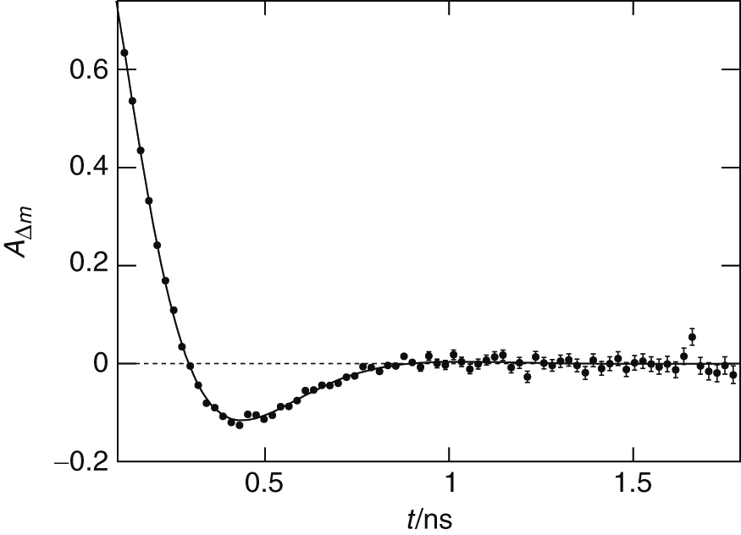
Thomson_Fig-14-5-4
© Cambridge University Press 2013

Slide 16
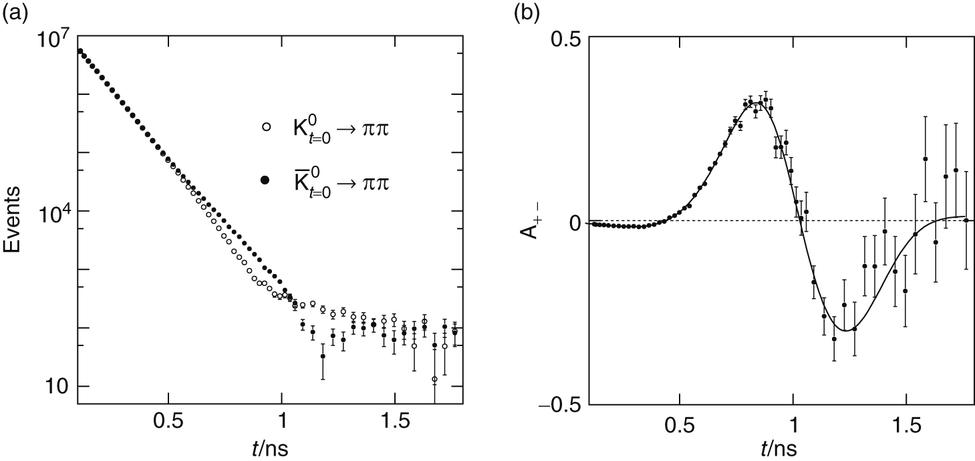
Thomson_Fig-14-5-5
© Cambridge University Press 2013

Slide 17
Thomson_Fig-14-5-6
© Cambridge University Press 2013

Slide 18
Thomson_Fig-14-5-7
© Cambridge University Press 2013

Slide 19
Thomson_Fig-14-6-1
© Cambridge University Press 2013

Slide 20
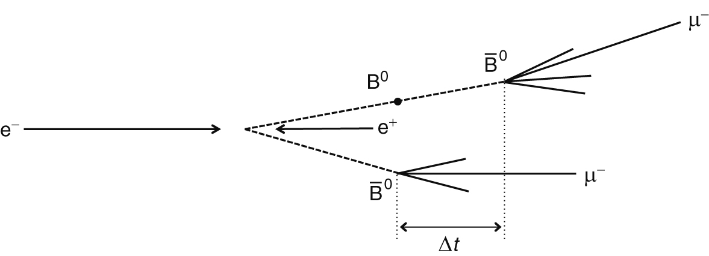
Thomson_Fig-14-6-2
© Cambridge University Press 2013

Slide 21
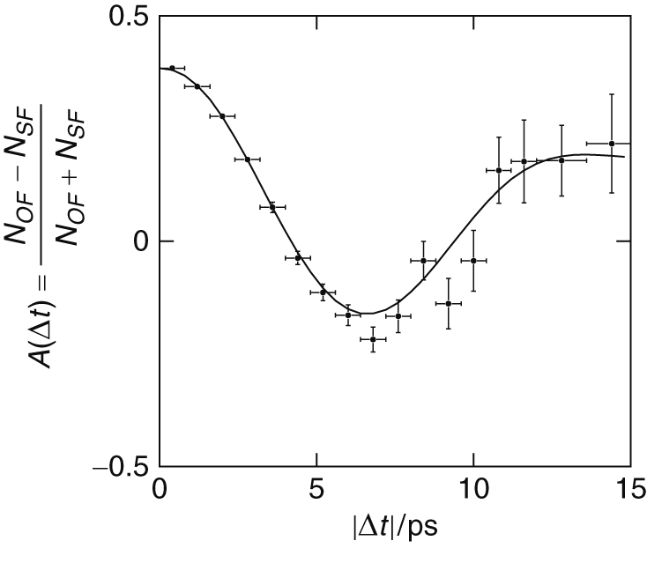
Thomson_Fig-14-6-3
© Cambridge University Press 2013

Slide 22
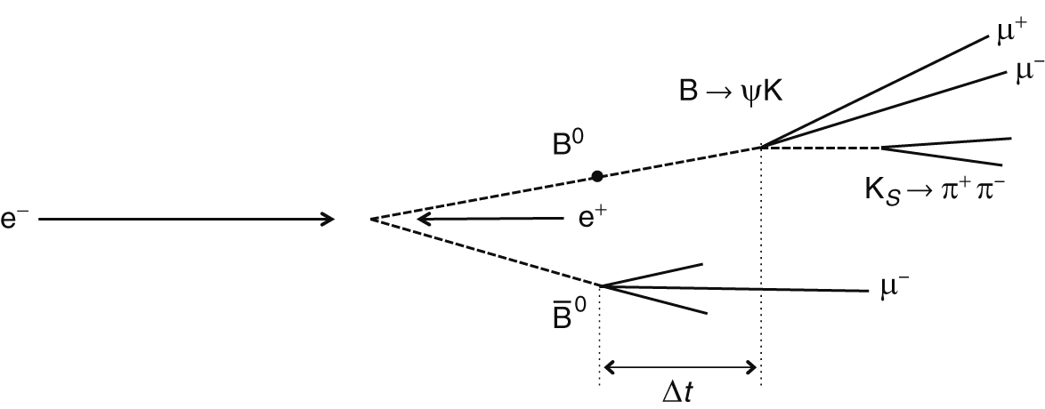
Thomson_Fig-14-6-4
© Cambridge University Press 2013

Slide 23
Thomson_Fig-14-6-5
© Cambridge University Press 2013

Slide 24
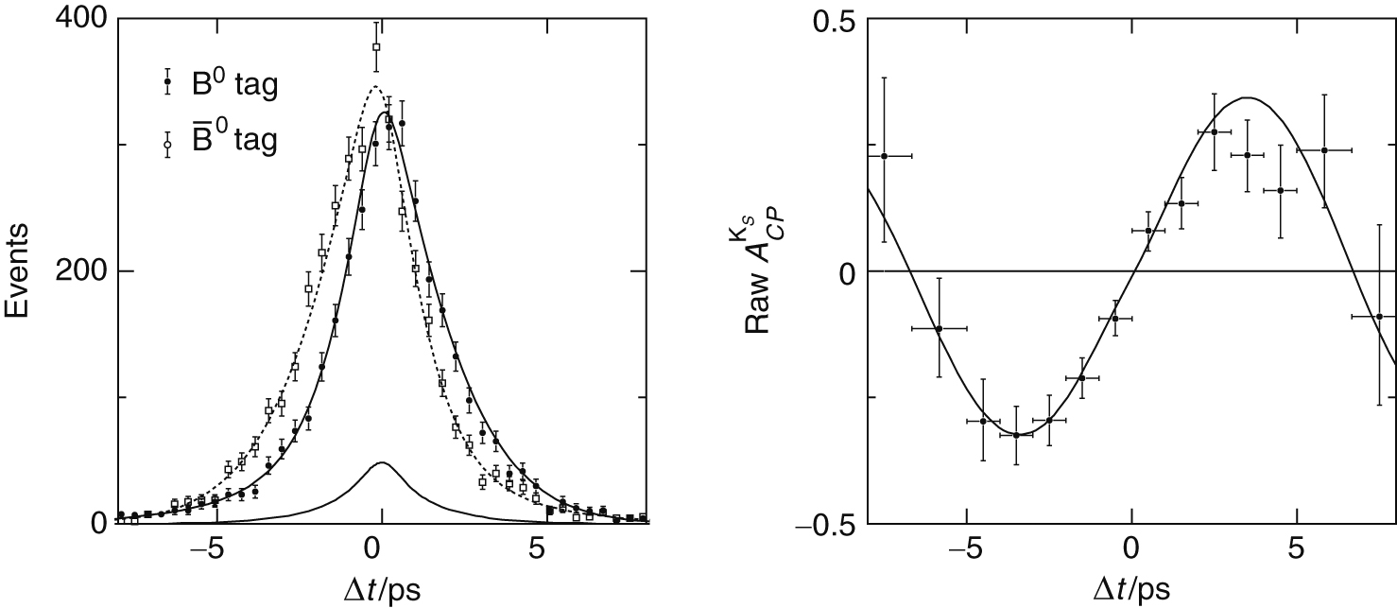
Thomson_Fig-14-6-6
© Cambridge University Press 2013

Slide 25
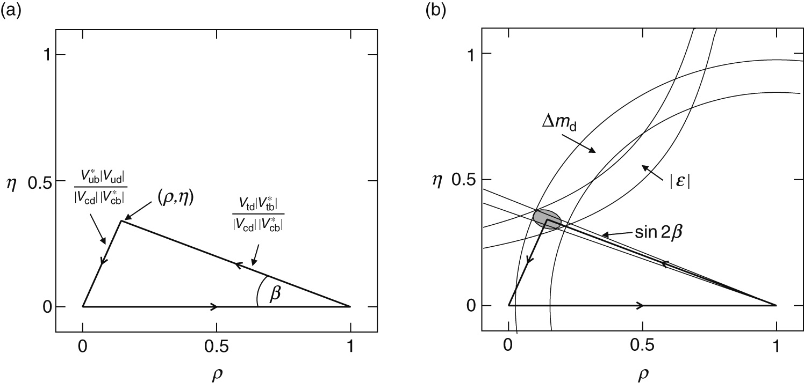
Thomson_Fig-14-7-1
© Cambridge University Press 2013

