Slide 1
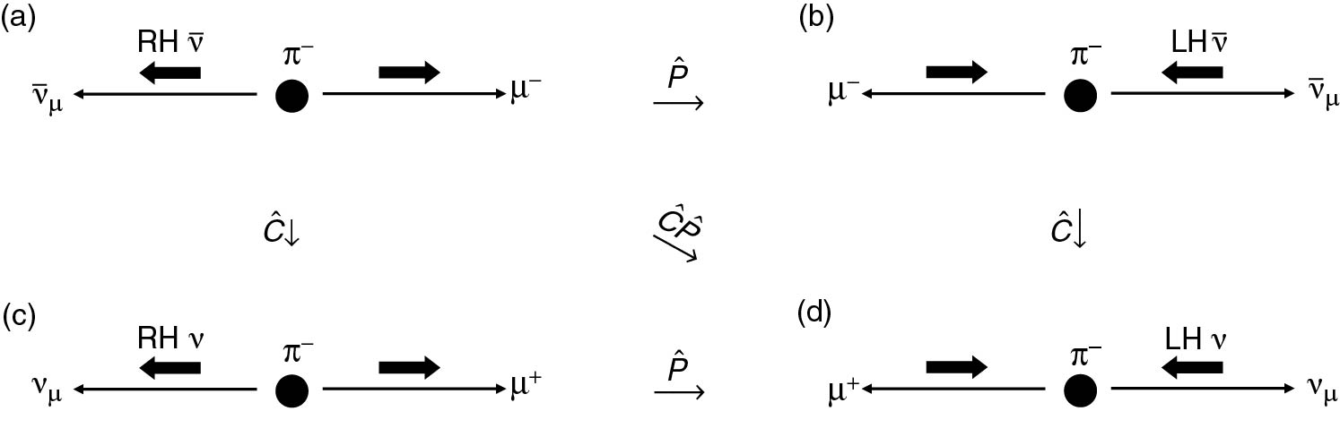
Thomson_CandP
© Cambridge University Press 2013

Slide 2
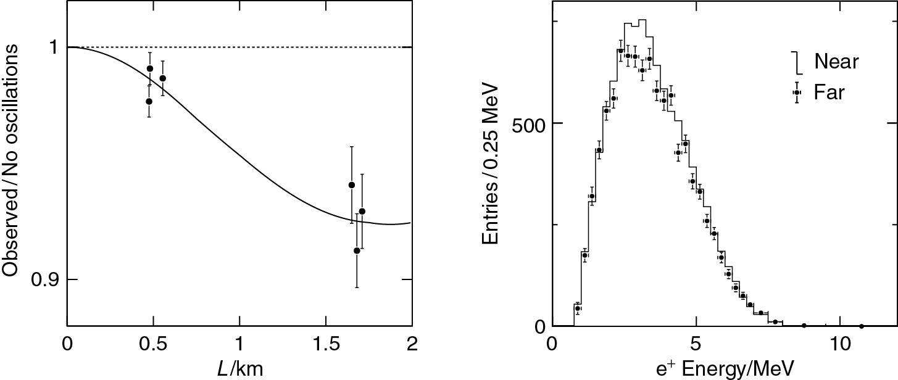
Thomson_DayaBay
© Cambridge University Press 2013

Slide 3
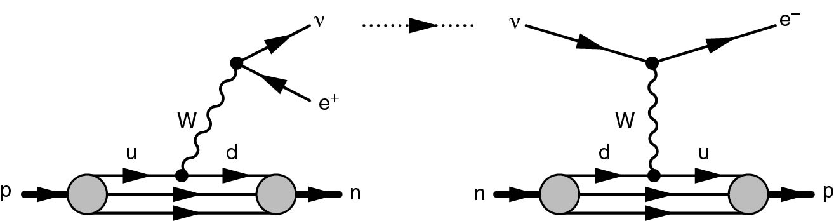
Thomson_Fig-13-1-1
© Cambridge University Press 2013

Slide 4
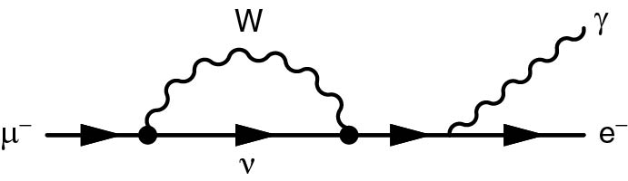
Thomson_Fig-13-1-2
© Cambridge University Press 2013

Slide 5
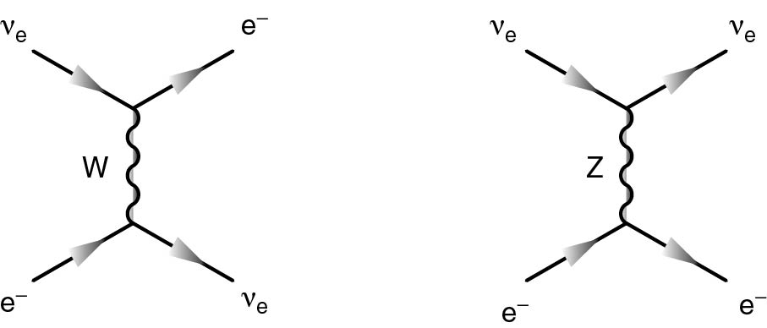
Thomson_Fig-13-2-3
© Cambridge University Press 2013

Slide 6
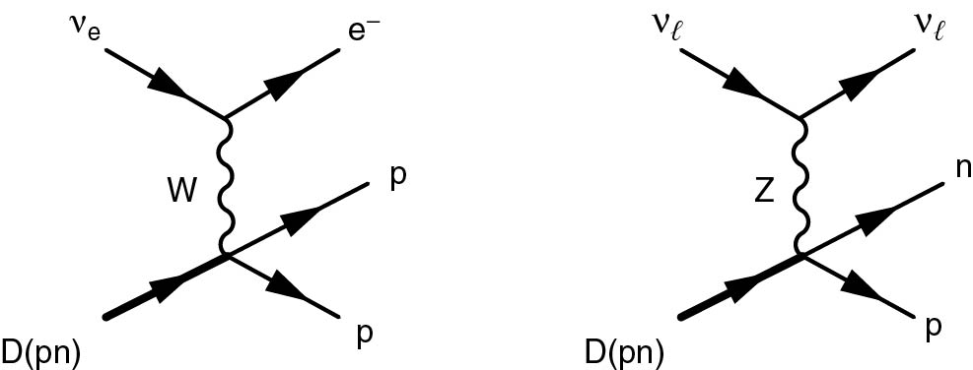
Thomson_Fig-13-2-5
© Cambridge University Press 2013

Slide 7
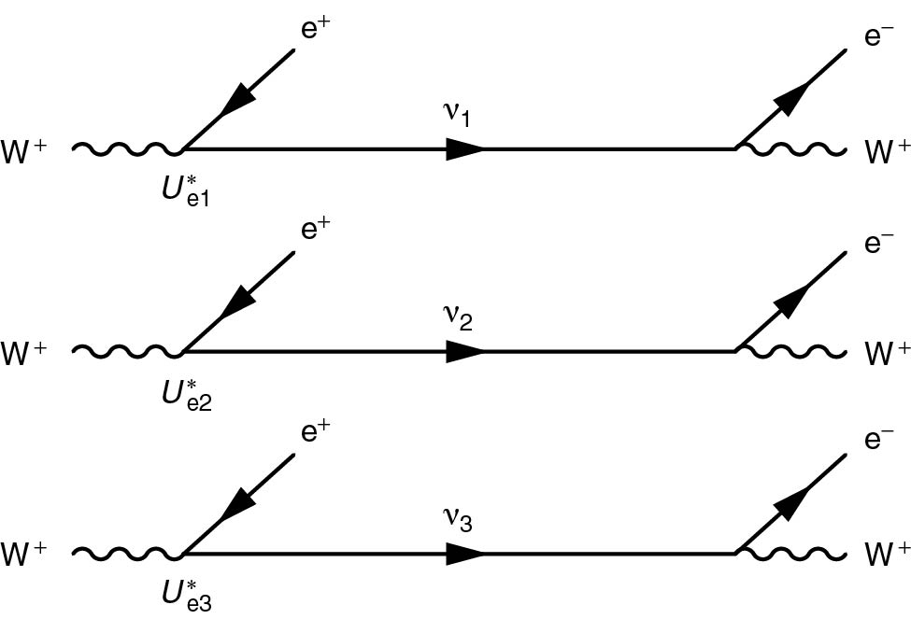
Thomson_Fig-13-3-1
© Cambridge University Press 2013

Slide 8
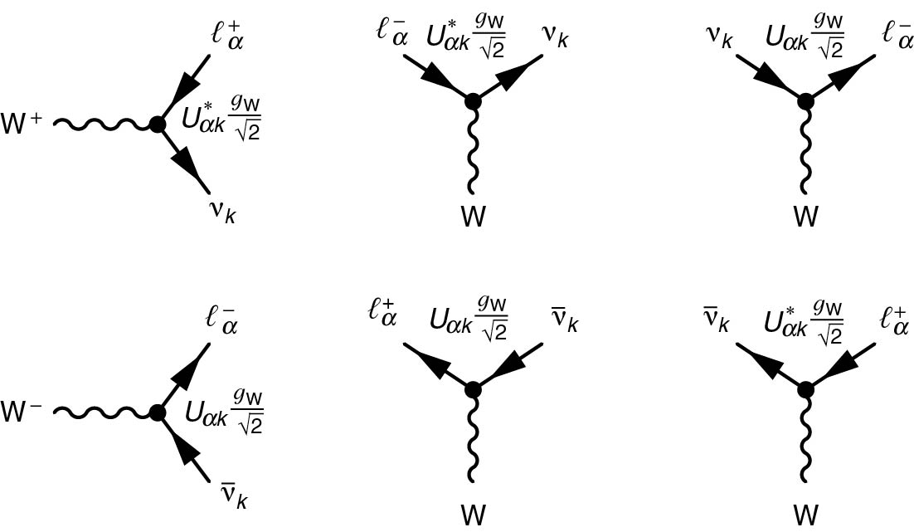
Thomson_Fig-13-3-2
© Cambridge University Press 2013

Slide 9
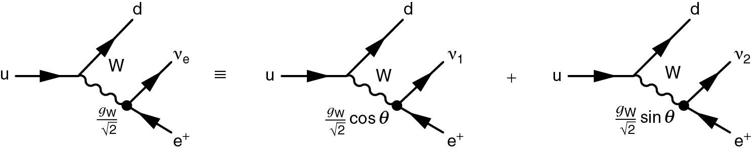
Thomson_Fig-13-4-1
© Cambridge University Press 2013

Slide 10
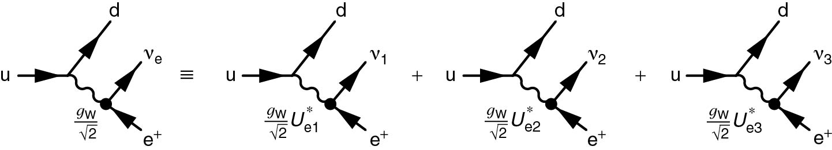
Thomson_Fig-13-5-1
© Cambridge University Press 2013

Slide 11
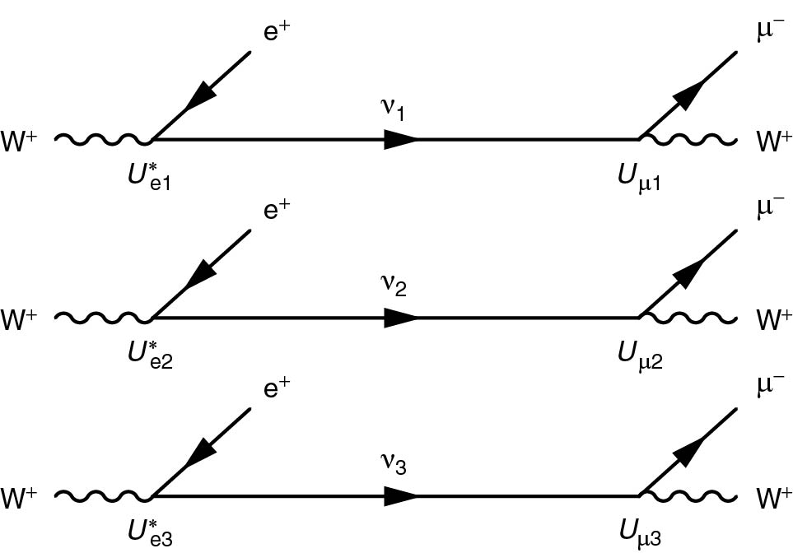
Thomson_Fig-13-5-2
© Cambridge University Press 2013

Slide 12
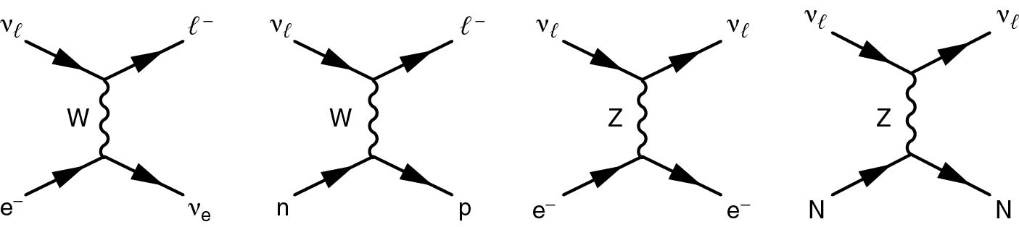
Thomson_Fig-13-6-1
© Cambridge University Press 2013

Slide 13
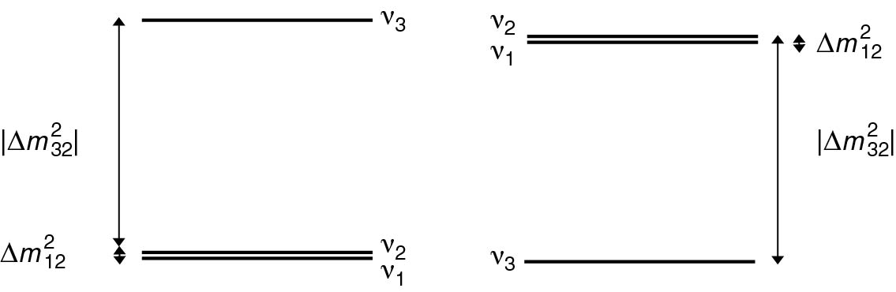
Thomson_Hierarchy
© Cambridge University Press 2013

Slide 14
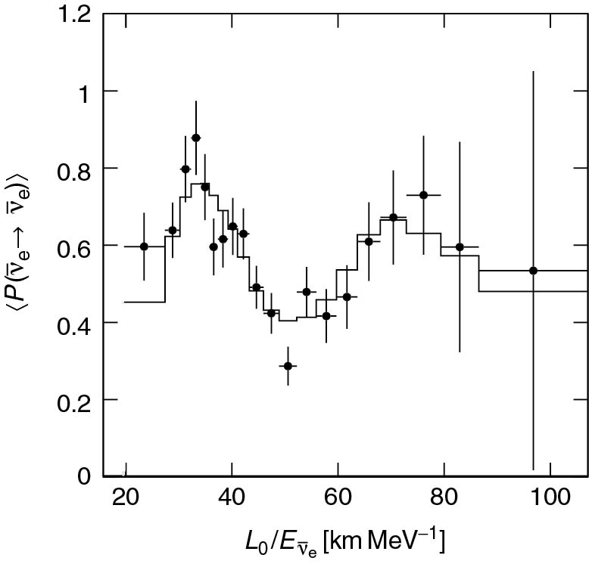
Thomson_KamLANDdata
© Cambridge University Press 2013

Slide 15
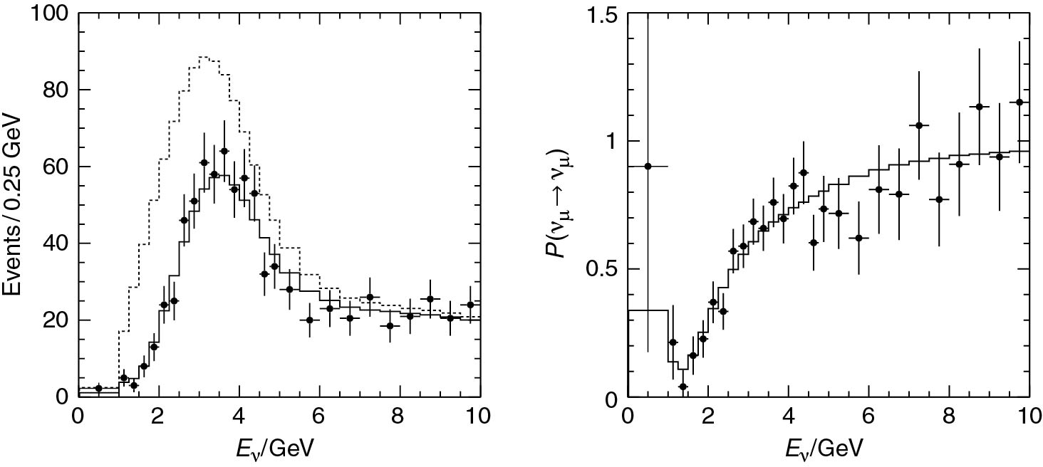
Thomson_MINOS
© Cambridge University Press 2013

Slide 16
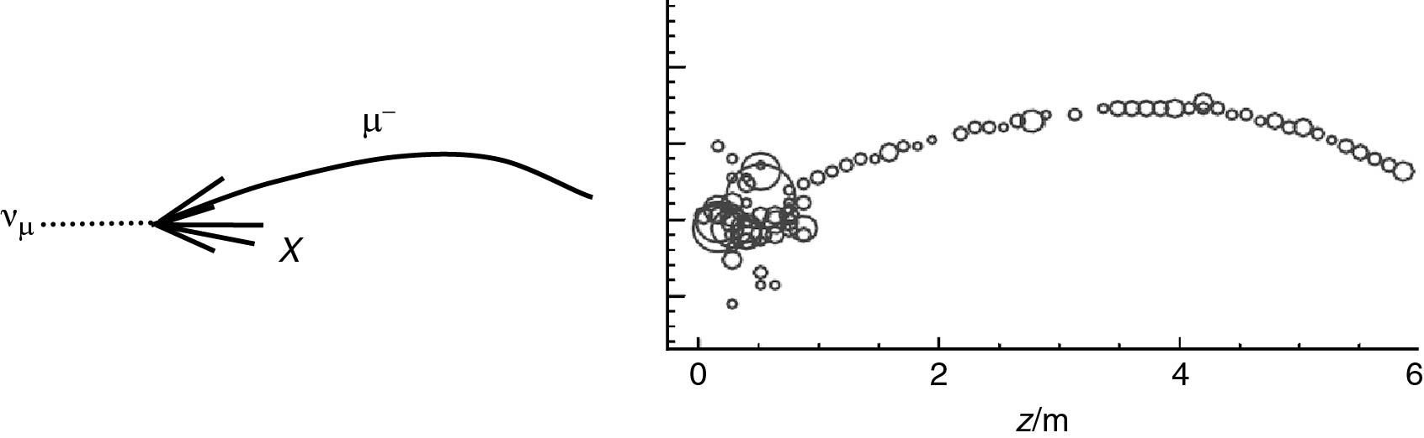
Thomson_MinosEvent
© Cambridge University Press 2013

Slide 17
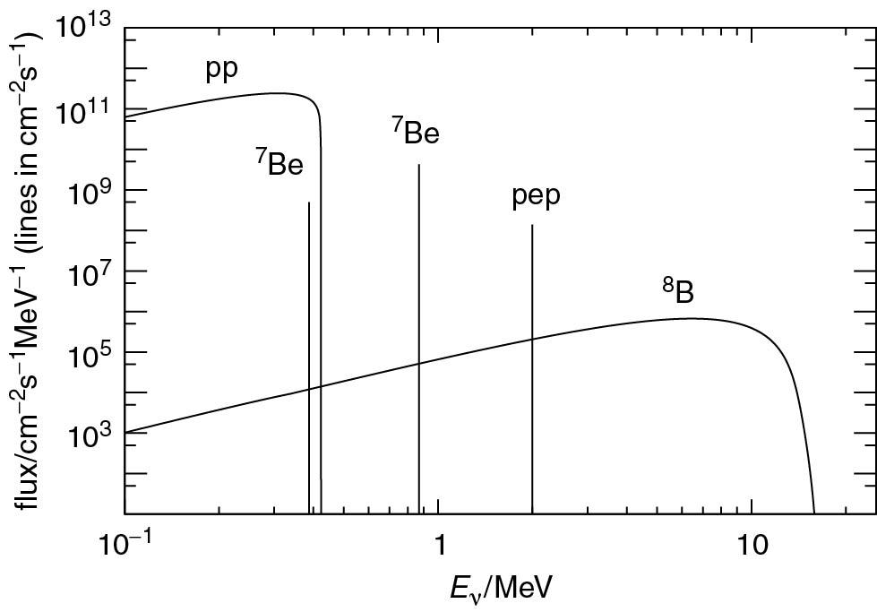
Thomson_nuspect
© Cambridge University Press 2013

Slide 18
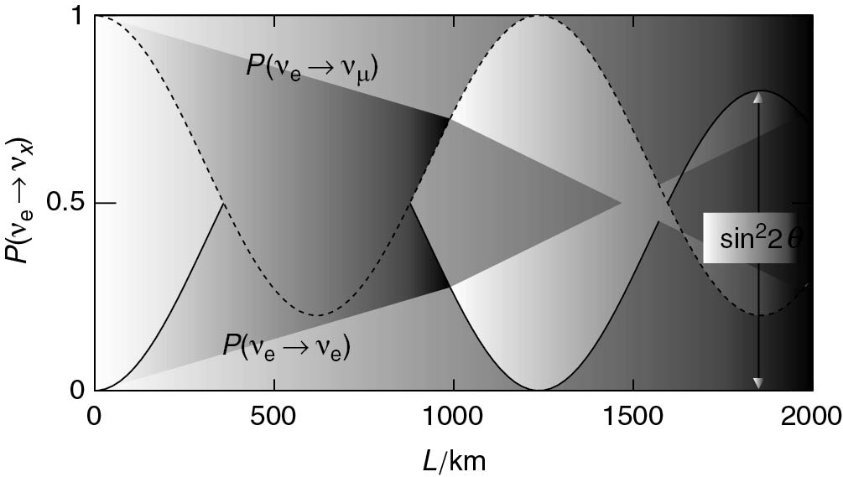
Thomson_Posc
© Cambridge University Press 2013

Slide 19
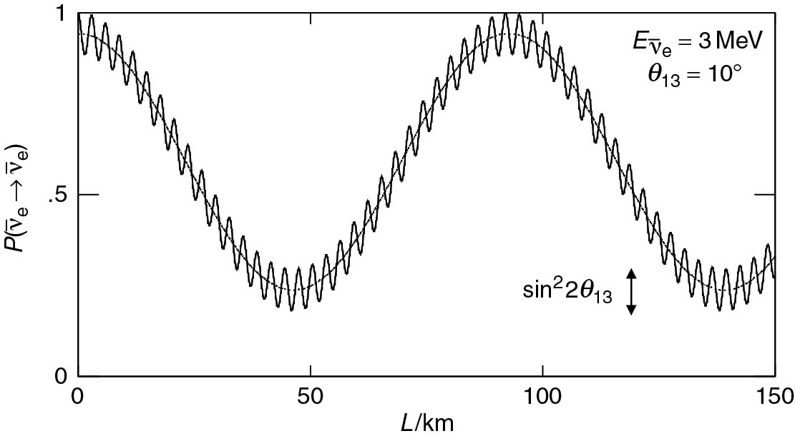
Thomson_reactoroscprob
© Cambridge University Press 2013

Slide 20
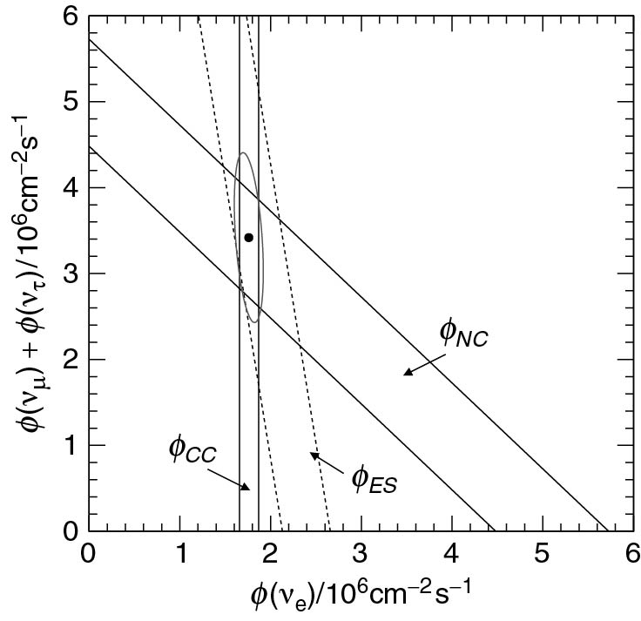
Thomson_snonew
© Cambridge University Press 2013

Slide 21
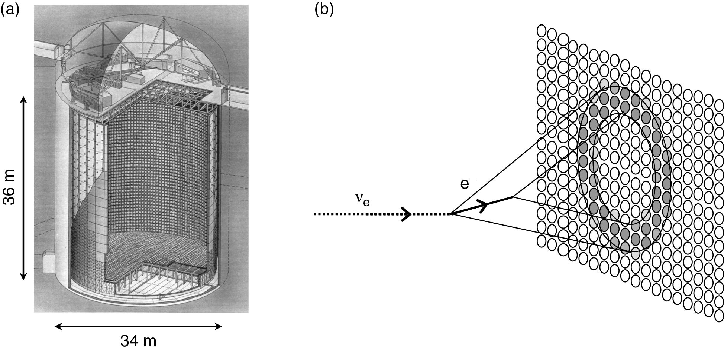
Thomson_SuperKNew
© Cambridge University Press 2013

Slide 22
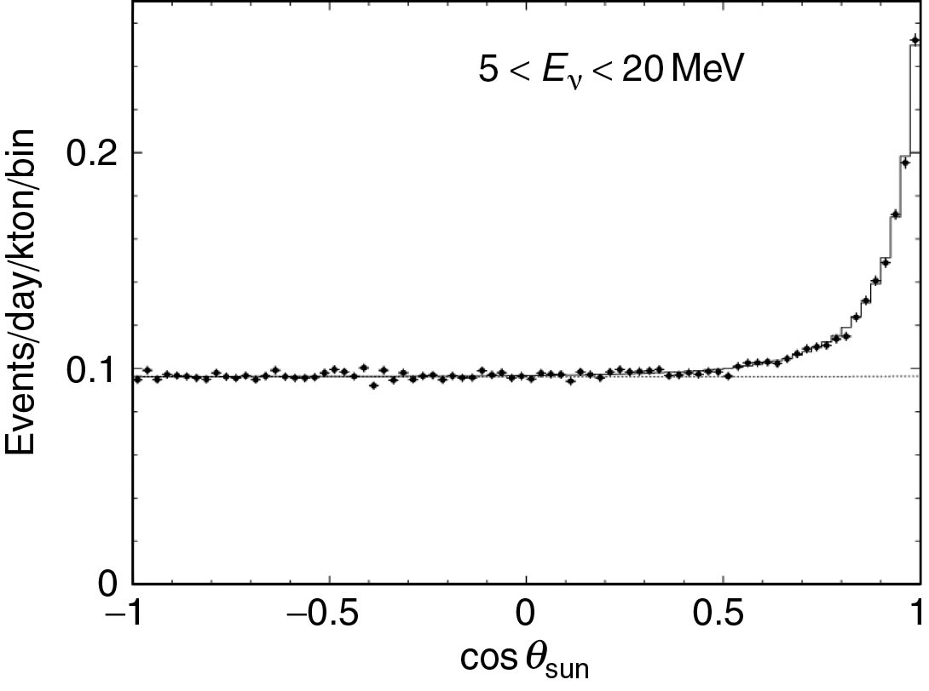
Thomson_SuperKX
© Cambridge University Press 2013

