Slide 1
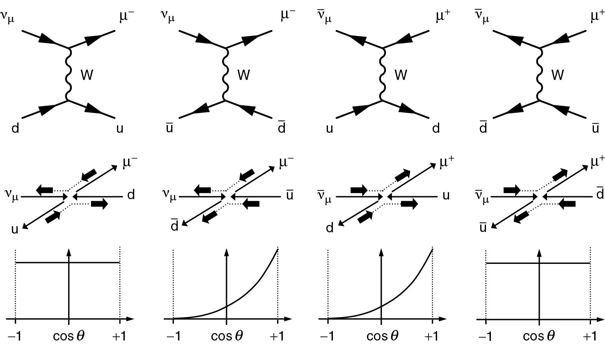
Thomson_allDiags
© Cambridge University Press 2013

Slide 2
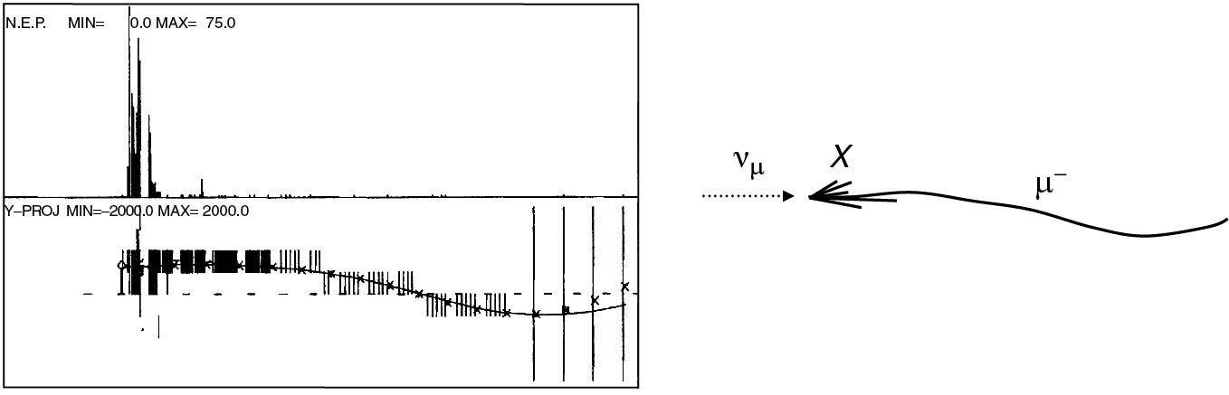
Thomson_cdhs
© Cambridge University Press 2013

Slide 3
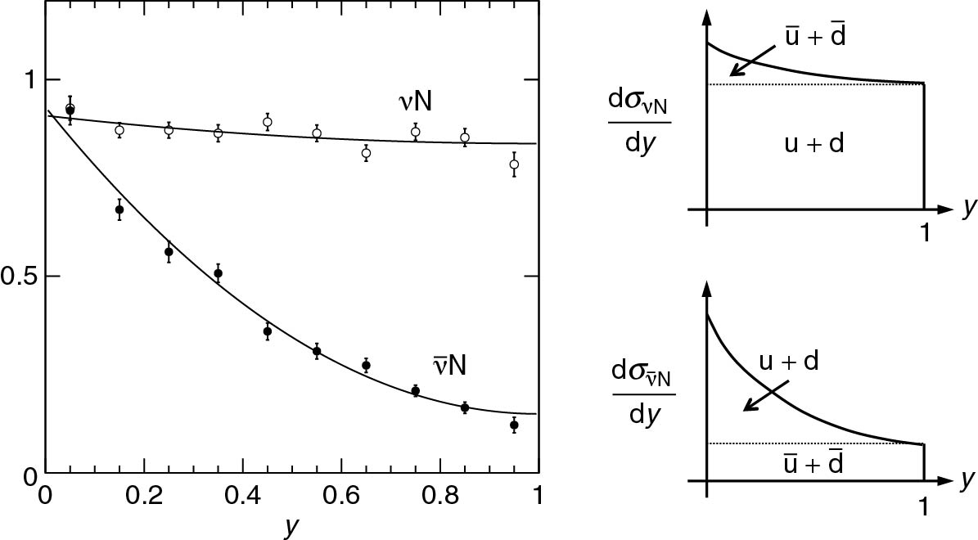
Thomson_cdhsData
© Cambridge University Press 2013

Slide 4
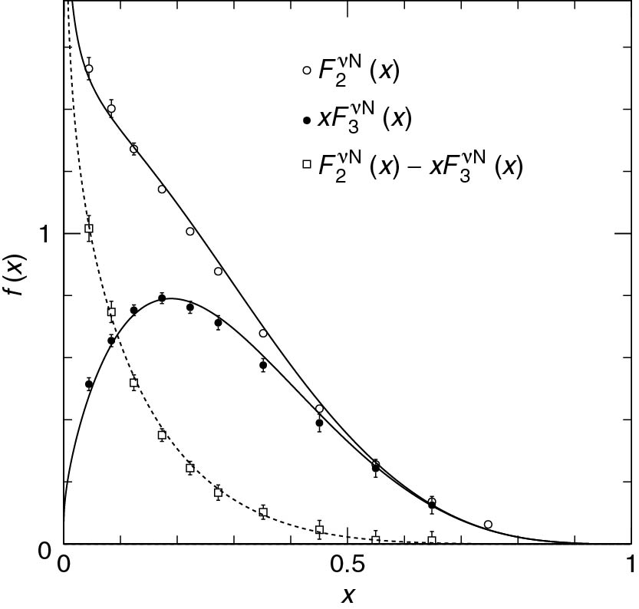
Thomson_F2F3
© Cambridge University Press 2013

Slide 5
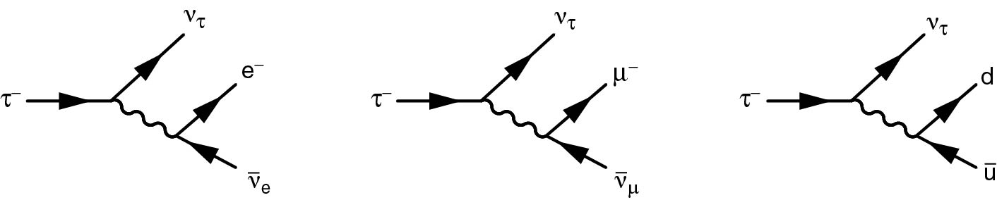
Thomson_Fig12-2
© Cambridge University Press 2013

Slide 6
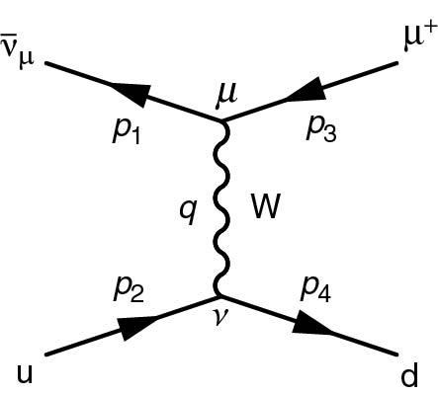
Thomson_Fig12-6
© Cambridge University Press 2013

Slide 7
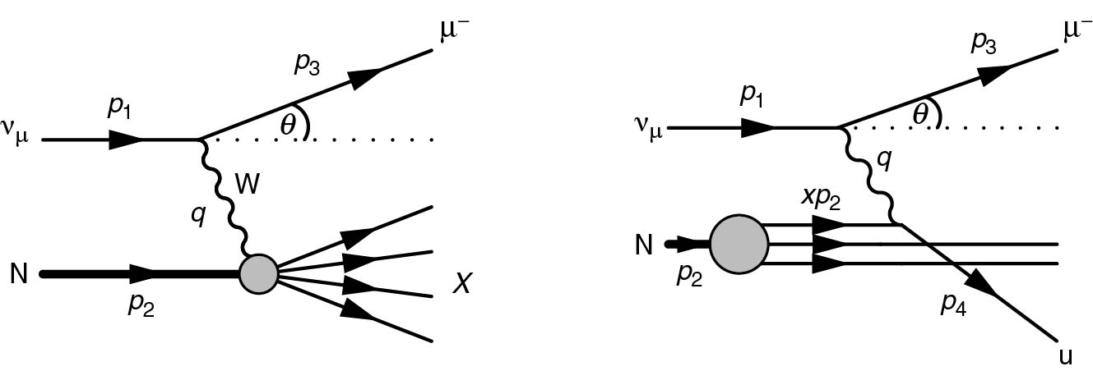
Thomson_Fig12-8
© Cambridge University Press 2013

Slide 8
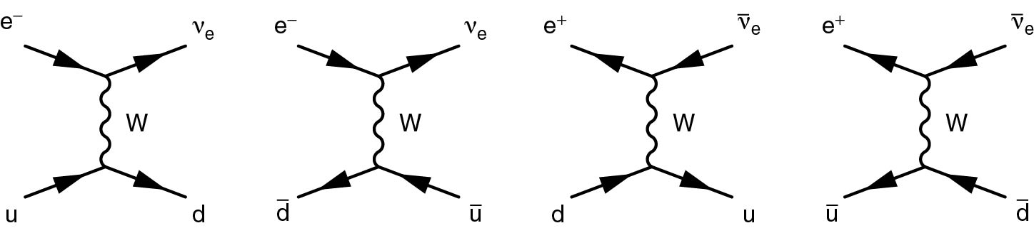
Thomson_Fig12-13
© Cambridge University Press 2013

Slide 9
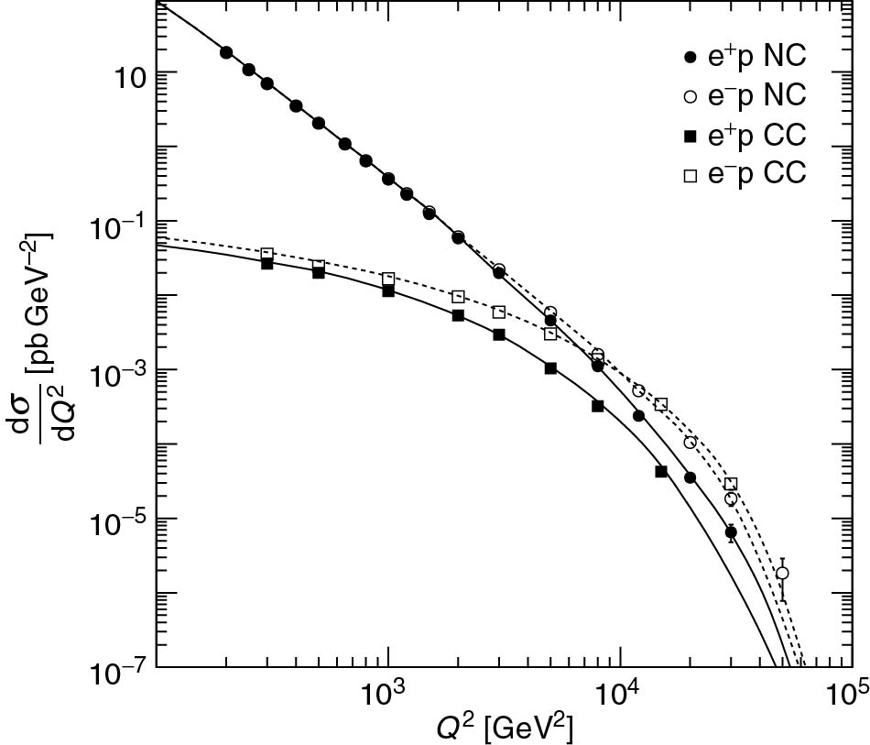
Thomson_h1CCNCnew
© Cambridge University Press 2013

Slide 10
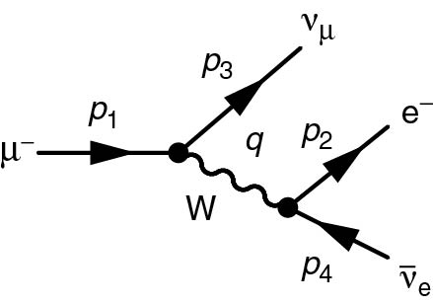
Thomson_mudecay1
© Cambridge University Press 2013

Slide 11
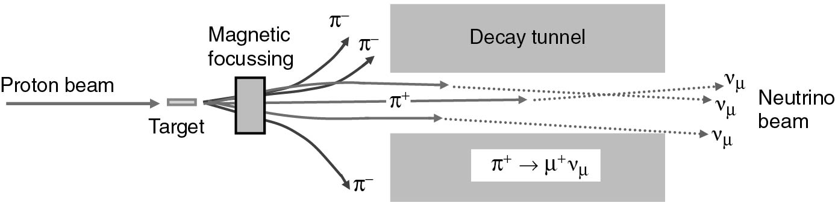
Thomson_neutrinoBeam
© Cambridge University Press 2013

Slide 12
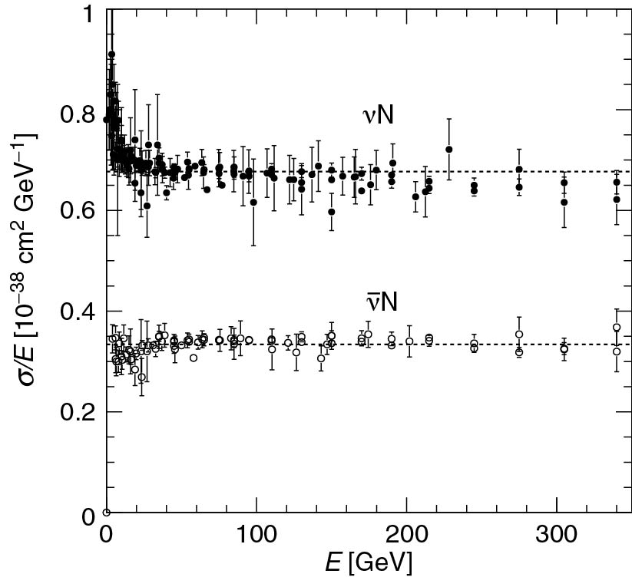
Thomson_nuCross
© Cambridge University Press 2013

Slide 13
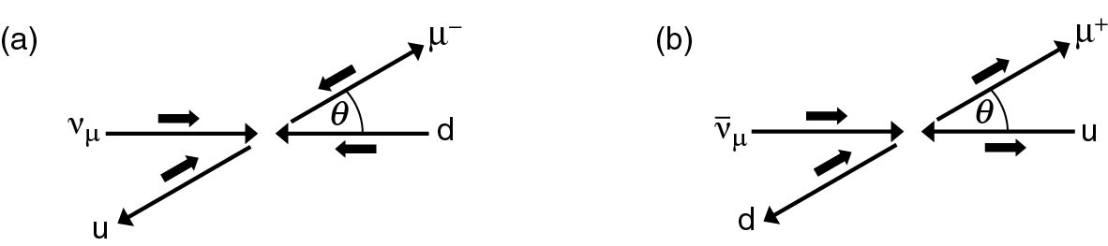
Thomson_nudisSpins
© Cambridge University Press 2013

Slide 14
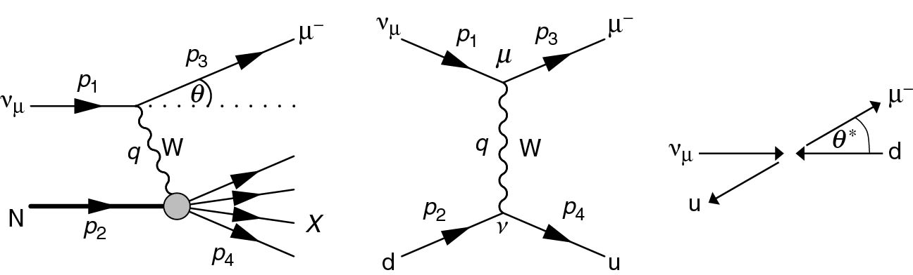
Thomson_thetaStar
© Cambridge University Press 2013

