Slide 1
Thomson_cobalt
© Cambridge University Press 2013

Slide 2
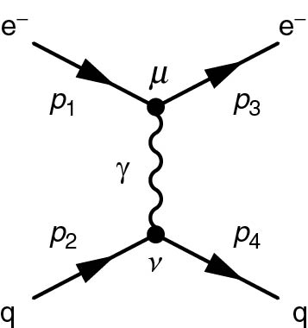
Thomson_eqeq
© Cambridge University Press 2013

Slide 3
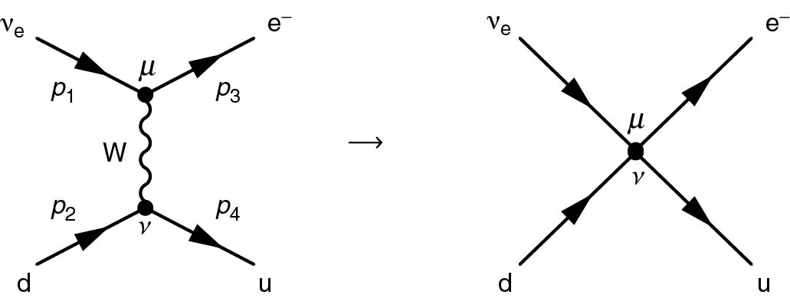
Thomson_Fig11-6
© Cambridge University Press 2013

Slide 4
Thomson_Fig11-7
© Cambridge University Press 2013

Slide 5
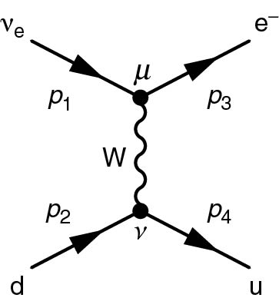
Thomson_ndeu
© Cambridge University Press 2013

Slide 6
Thomson_piDecayHelicity
© Cambridge University Press 2013

Slide 7
Thomson_piDecayZ
© Cambridge University Press 2013

Slide 8
Thomson_wev
© Cambridge University Press 2013

Slide 9
Thomson_wevParity
© Cambridge University Press 2013

