Slide 1
Thomson_Fig-1-1-1
© Cambridge University Press 2013

Slide 2
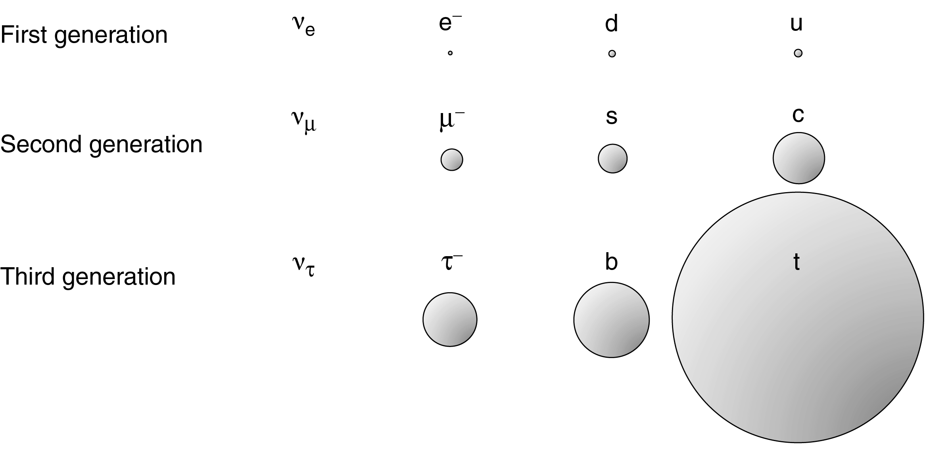
Thomson_Fig-1-1-2
© Cambridge University Press 2013

Slide 3
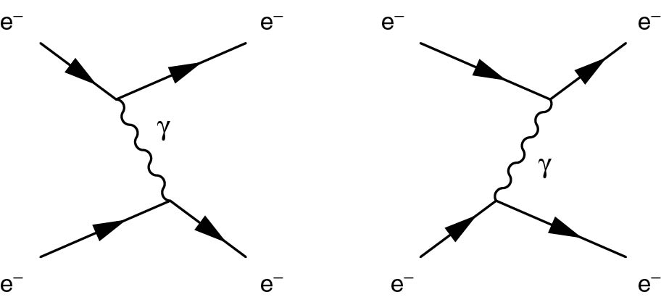
Thomson_Fig-1-1-3
© Cambridge University Press 2013

Slide 4
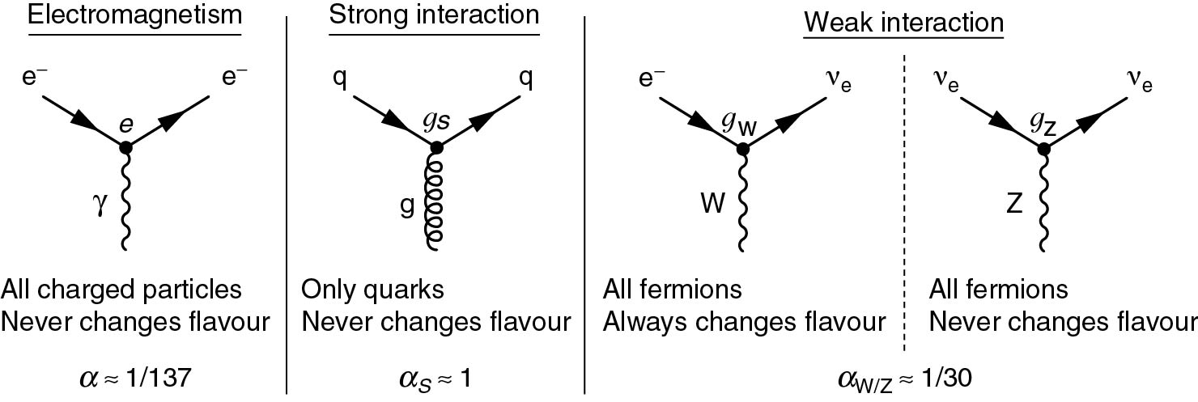
Thomson_Fig-1-1-4
© Cambridge University Press 2013

Slide 5
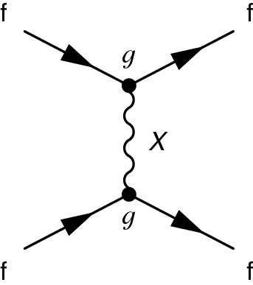
Thomson_Fig-1-1-5
© Cambridge University Press 2013

Slide 6
Thomson_Fig-1-1-6
© Cambridge University Press 2013

Slide 7
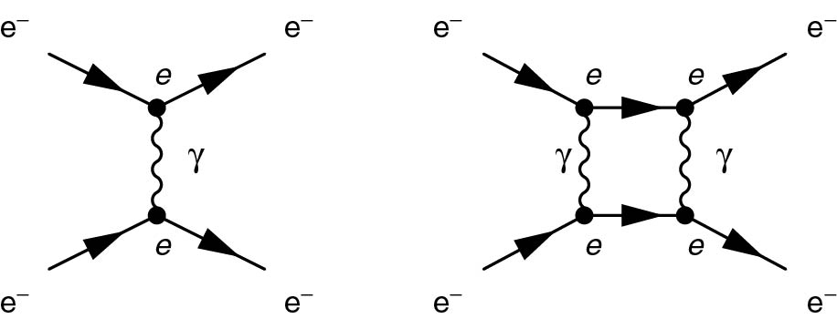
Thomson_Fig-1-1-7
© Cambridge University Press 2013

Slide 8
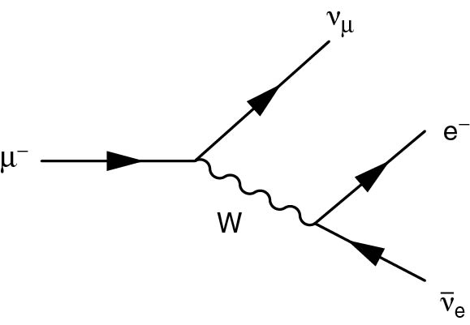
Thomson_Fig-1-1-8
© Cambridge University Press 2013

Slide 9
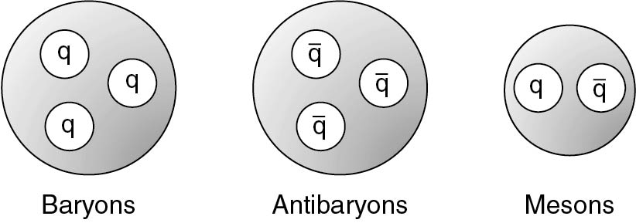
Thomson_Fig-1-1-9
© Cambridge University Press 2013

Slide 10
Thomson_Fig-1-1-10
© Cambridge University Press 2013

Slide 11
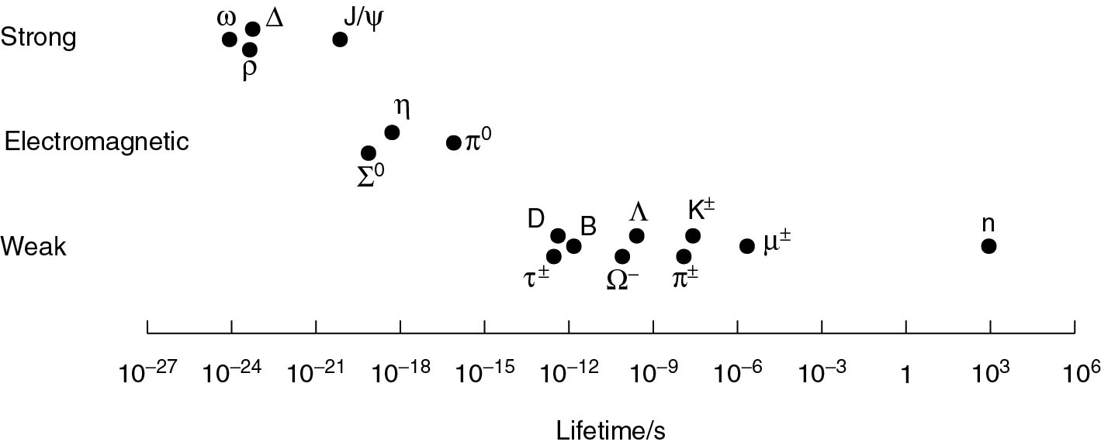
Thomson_Fig-1-1-11
© Cambridge University Press 2013

Slide 12
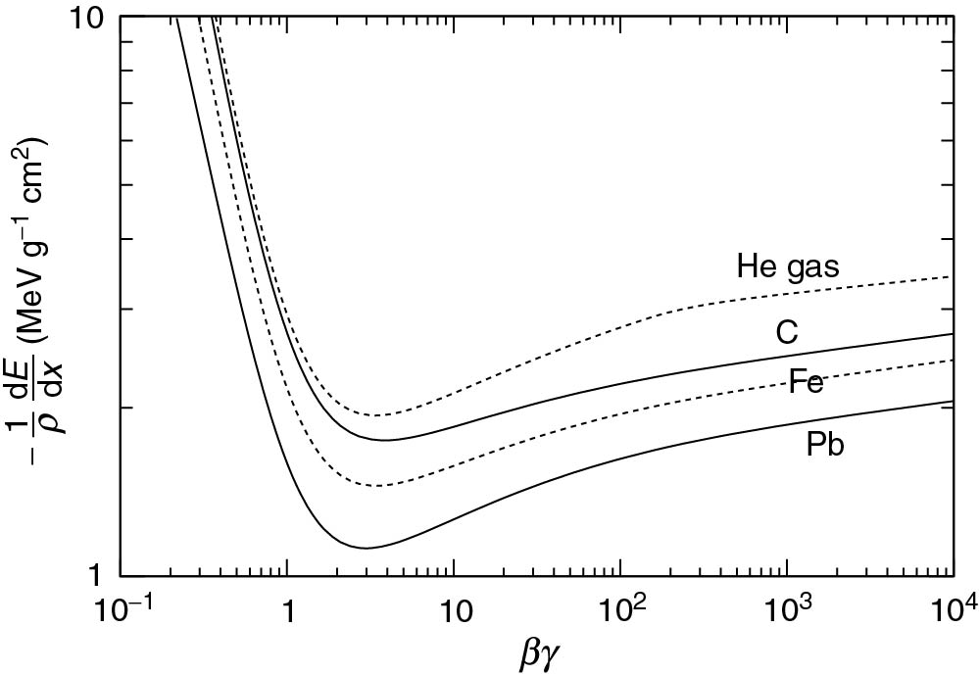
Thomson_Fig-1-2-1
© Cambridge University Press 2013

Slide 13
Thomson_Fig-1-2-2
© Cambridge University Press 2013

Slide 14
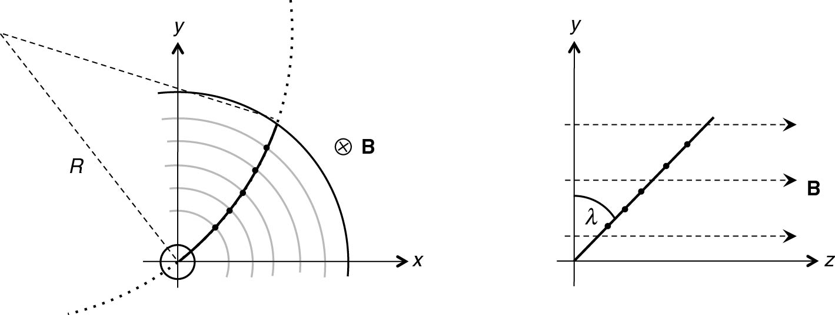
Thomson_Fig-1-2-3
© Cambridge University Press 2013

Slide 15
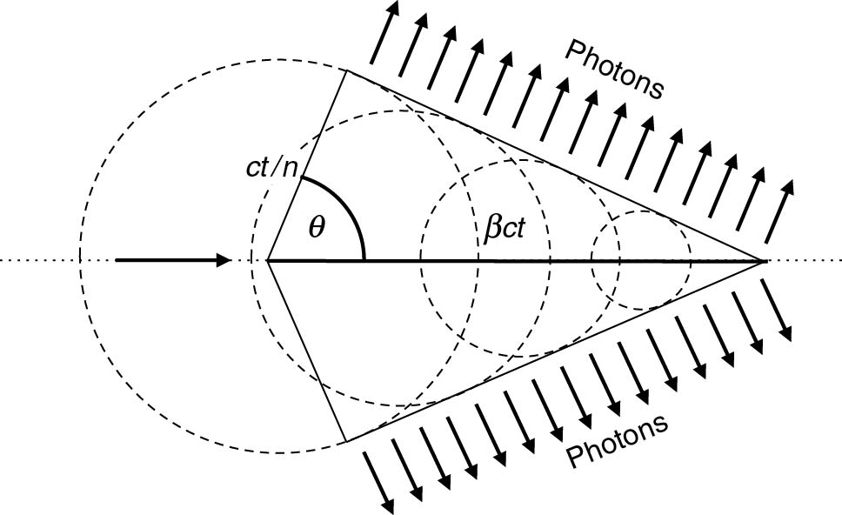
Thomson_Fig-1-2-4
© Cambridge University Press 2013

Slide 16
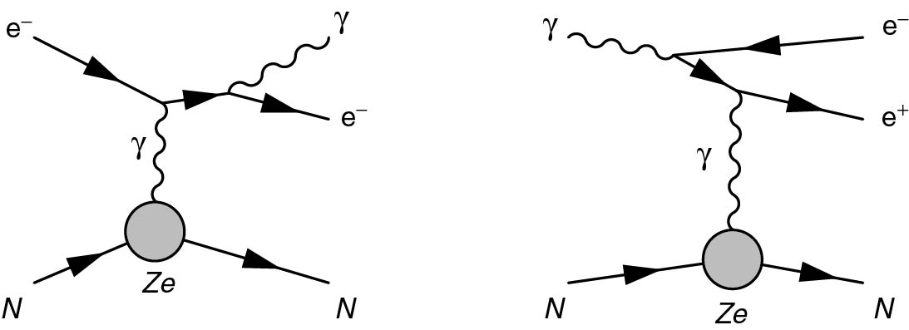
Thomson_Fig-1-2-5
© Cambridge University Press 2013

Slide 17
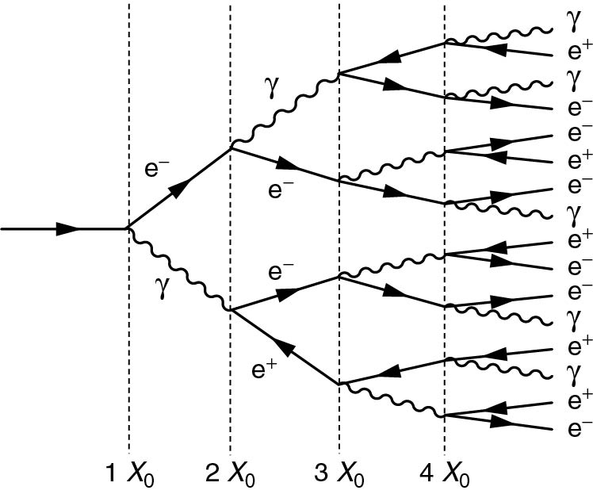
Thomson_Fig-1-2-6
© Cambridge University Press 2013

Slide 18
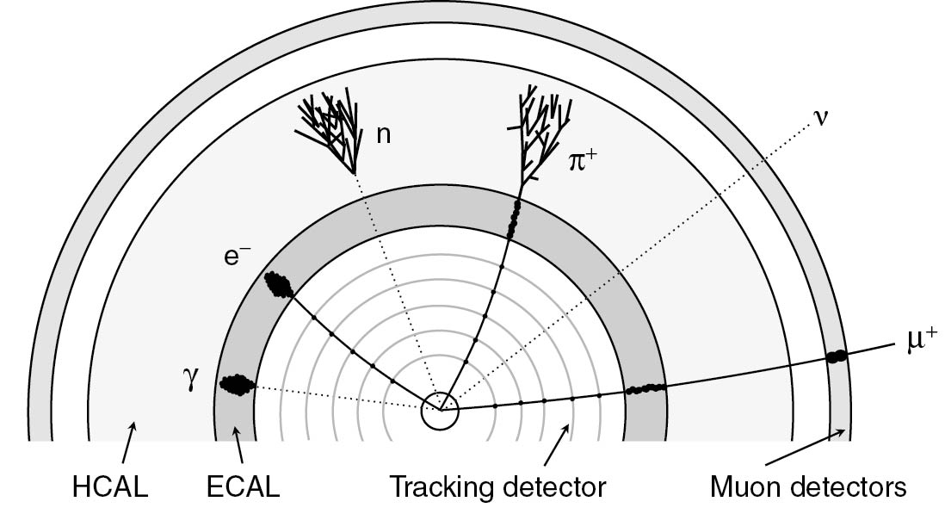
Thomson_Fig-1-3-1
© Cambridge University Press 2013

Slide 19
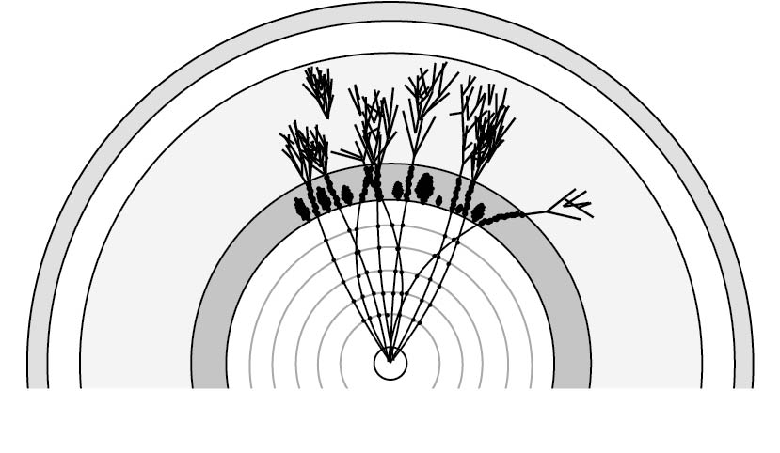
Thomson_Fig-1-3-2
© Cambridge University Press 2013

Slide 20
Thomson_Fig-1-3-3
© Cambridge University Press 2013

Slide 21
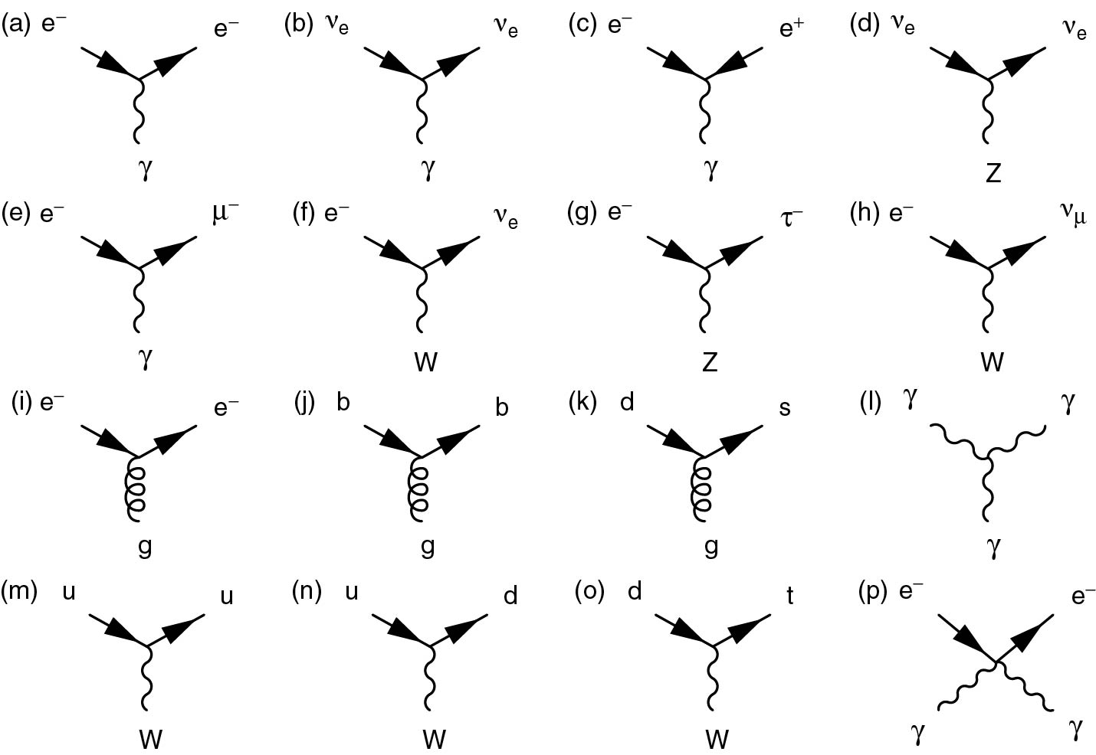
Thomson_UnnumberFig-1
© Cambridge University Press 2013

Slide 22
Thomson_UnnumberFig-2
© Cambridge University Press 2013

