Slide 1
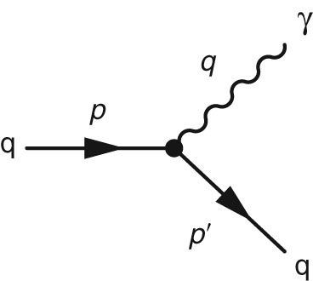
Thomson_Fig-D-1
© Cambridge University Press 2013

Slide 2
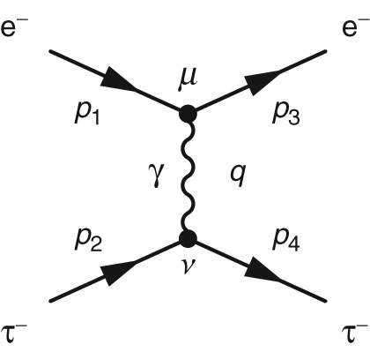
Thomson_Fig-D-2
© Cambridge University Press 2013

