Slide 1
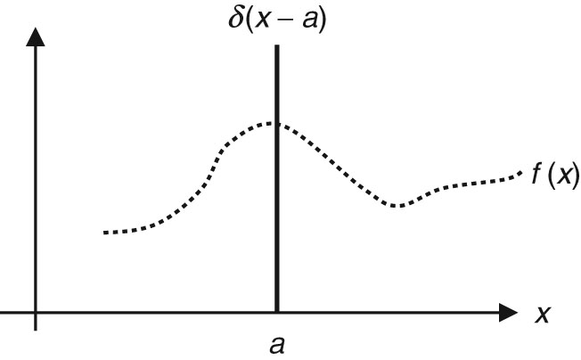
Thomson_deltadef
© Cambridge University Press 2013

Slide 2
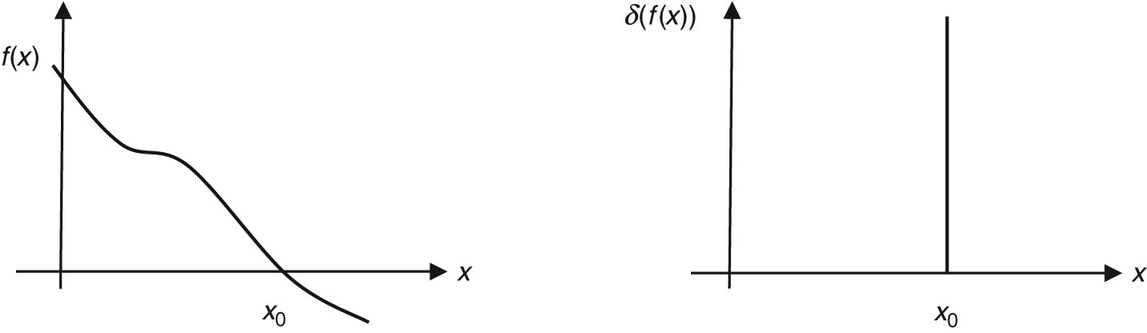
Thomson_deltaf
© Cambridge University Press 2013

