Slide 1
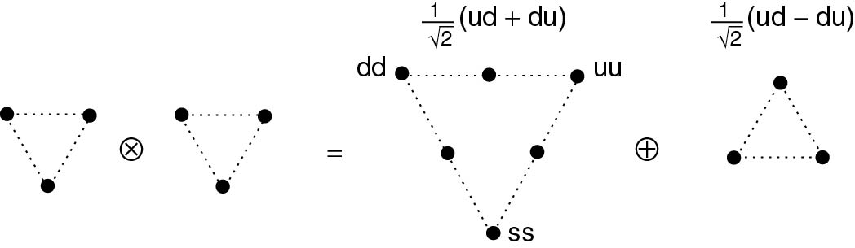
Thomson_Baryonqq1
© Cambridge University Press 2013

Slide 2
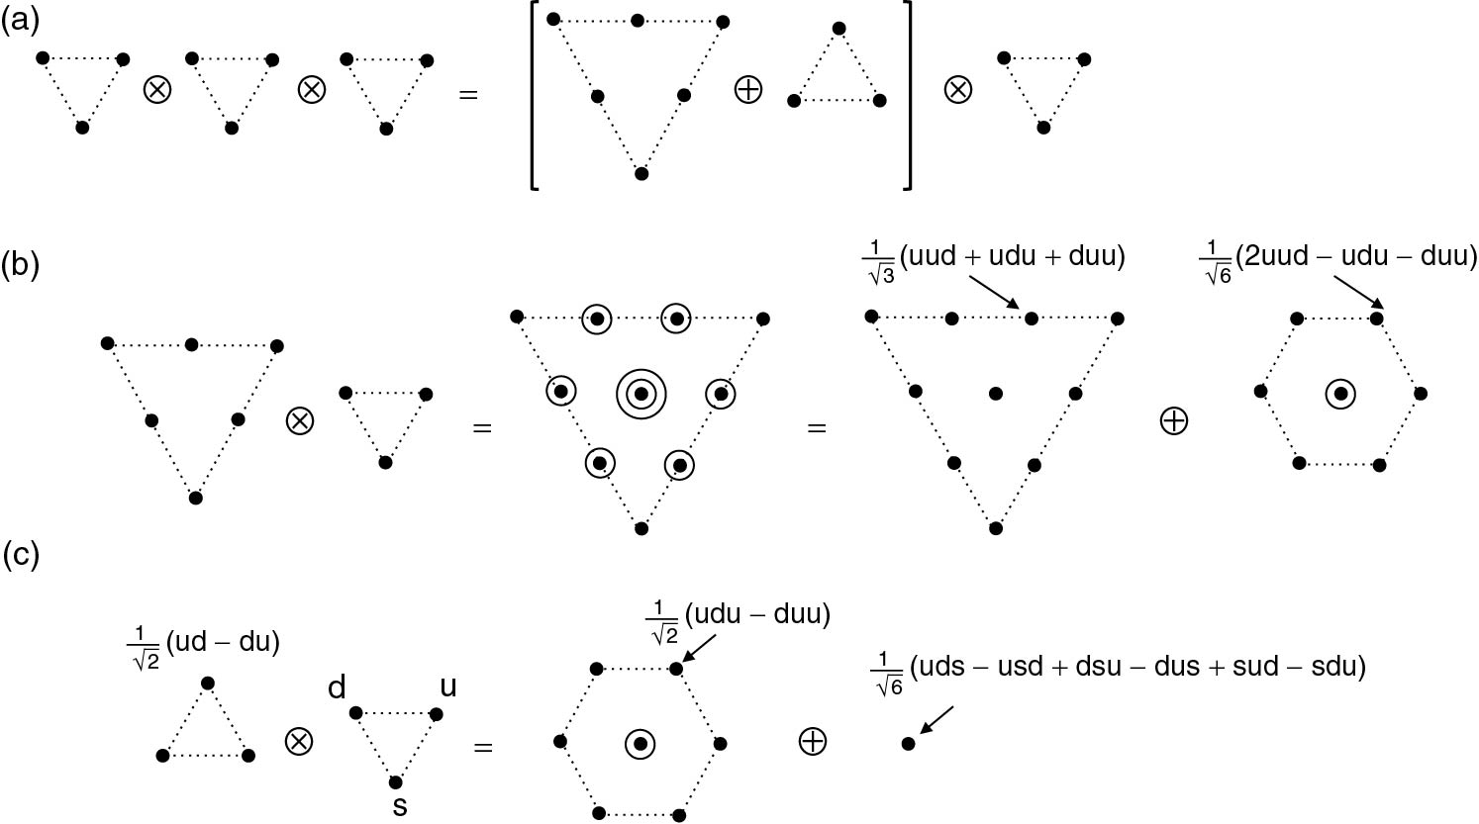
Thomson_BaryonQQQ
© Cambridge University Press 2013

Slide 3
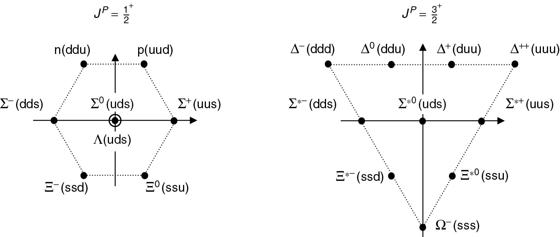
Thomson_BaryonUDS
© Cambridge University Press 2013

Slide 4
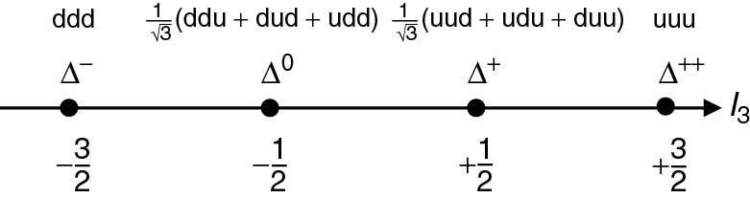
Thomson_deltas
© Cambridge University Press 2013

Slide 5
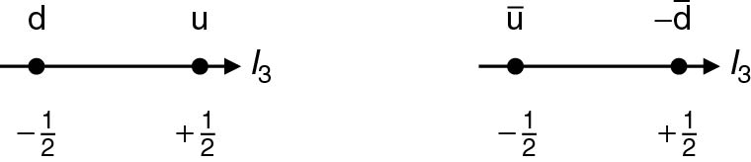
Thomson_isoAq
© Cambridge University Press 2013

Slide 6
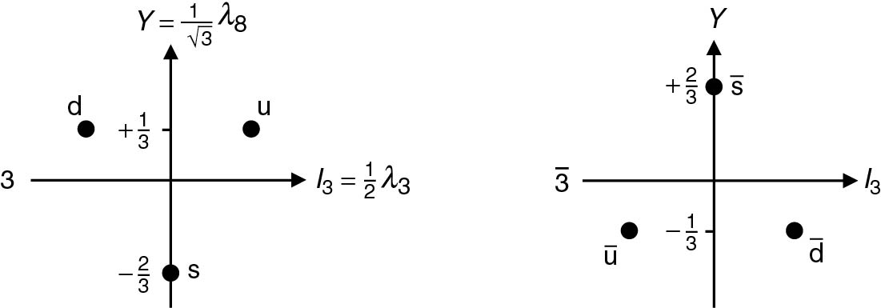
Thomson_iy
© Cambridge University Press 2013

Slide 7
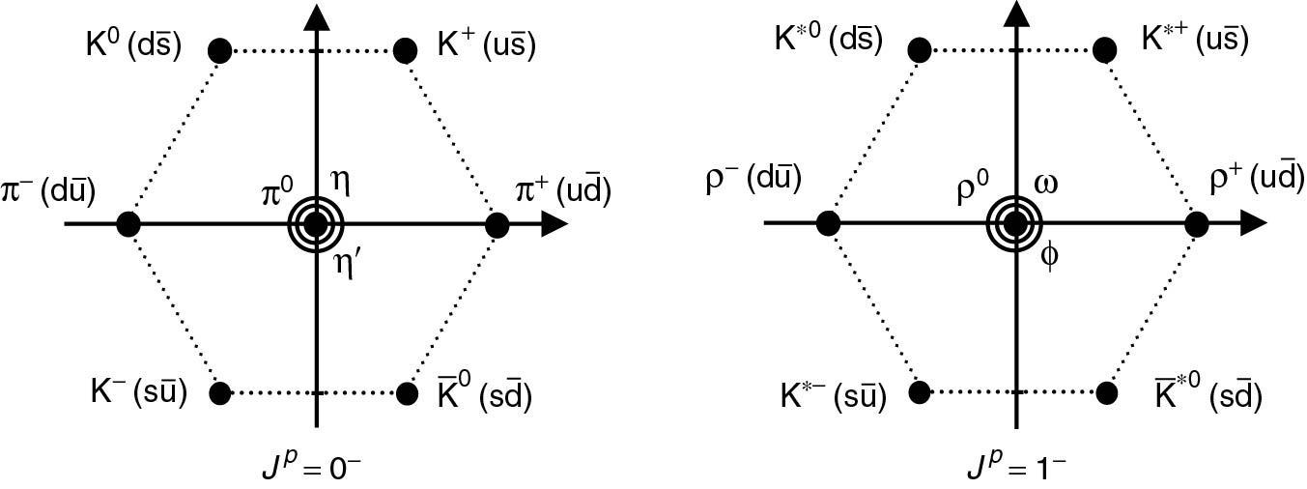
Thomson_mesons
© Cambridge University Press 2013

Slide 8
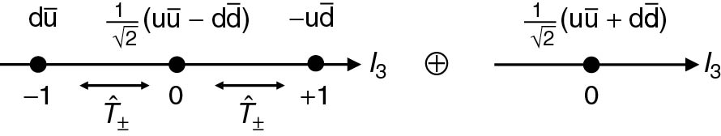
Thomson_qAq
© Cambridge University Press 2013

Slide 9
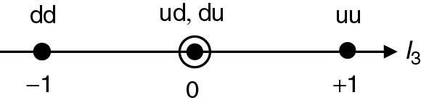
Thomson_qq
© Cambridge University Press 2013

Slide 10
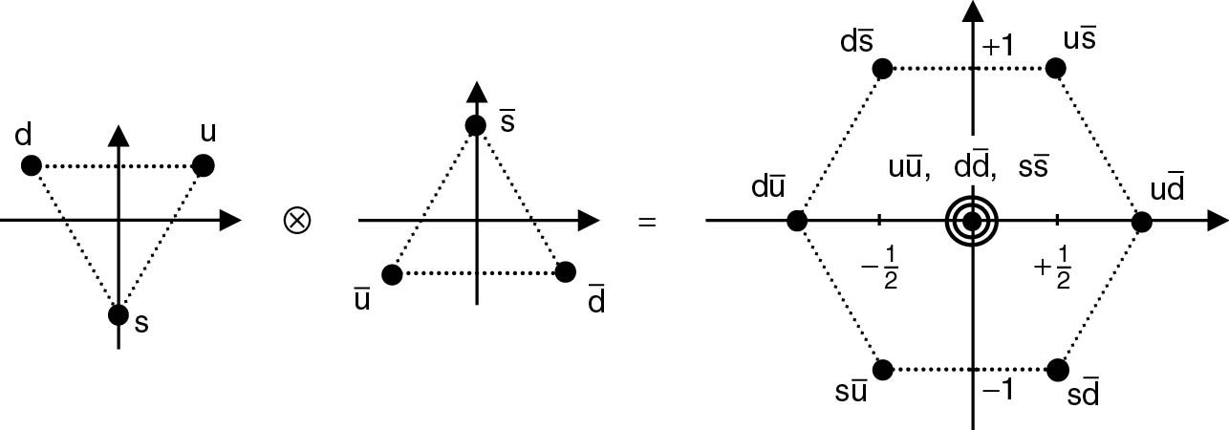
Thomson_qqbar
© Cambridge University Press 2013

Slide 11
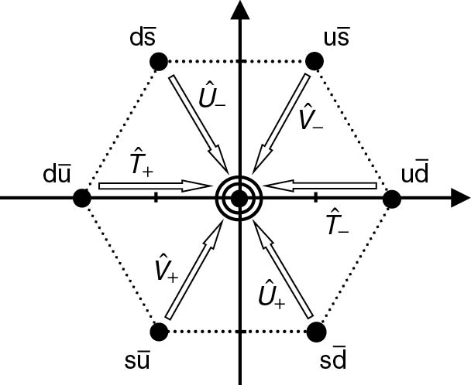
Thomson_qqbarLadder
© Cambridge University Press 2013

Slide 12
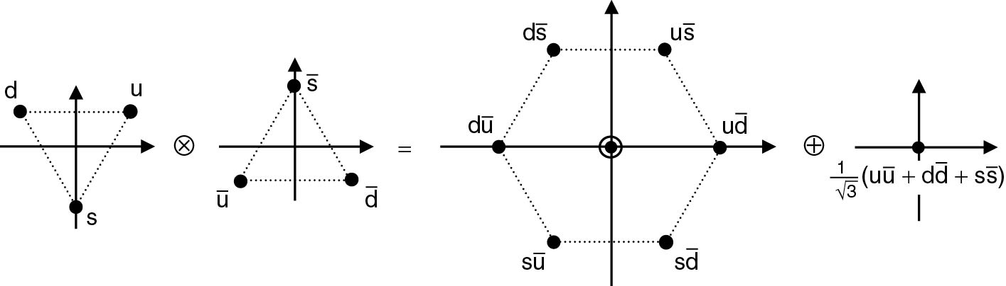
Thomson_qqbarMultiplets
© Cambridge University Press 2013

Slide 13
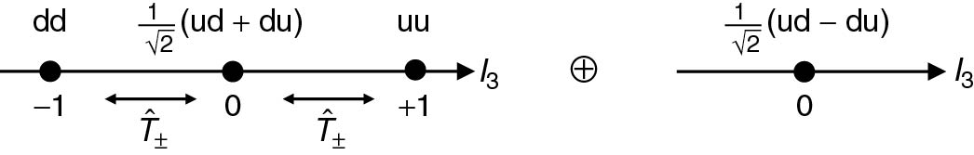
Thomson_qqcomb
© Cambridge University Press 2013

Slide 14
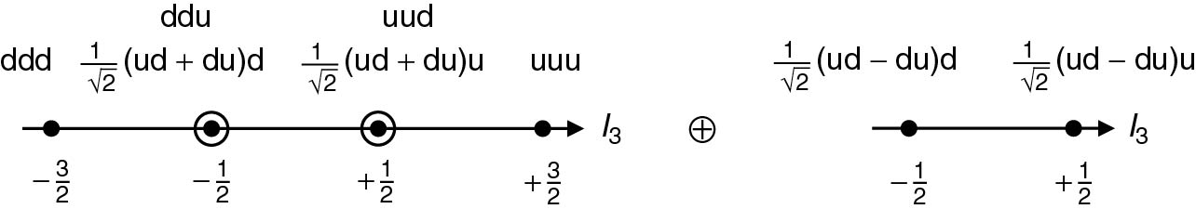
Thomson_qqq
© Cambridge University Press 2013

Slide 15
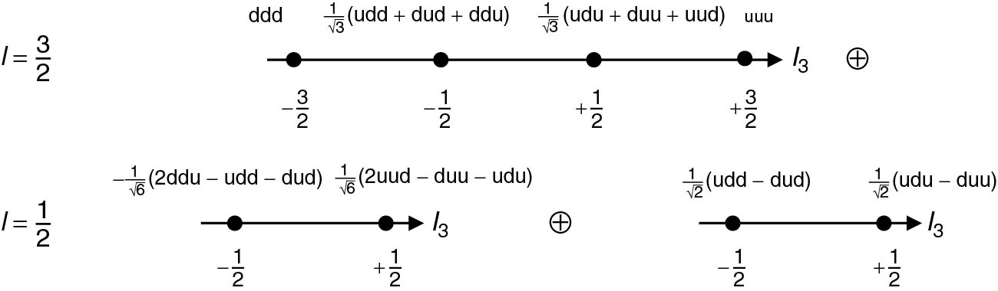
Thomson_qqq422
© Cambridge University Press 2013

Slide 16
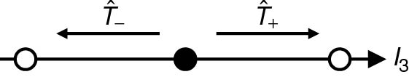
Thomson_Tpm
© Cambridge University Press 2013

Slide 17
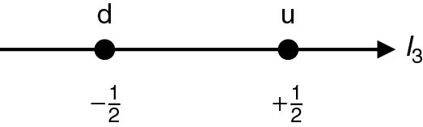
Thomson_ud
© Cambridge University Press 2013

