Slide 1
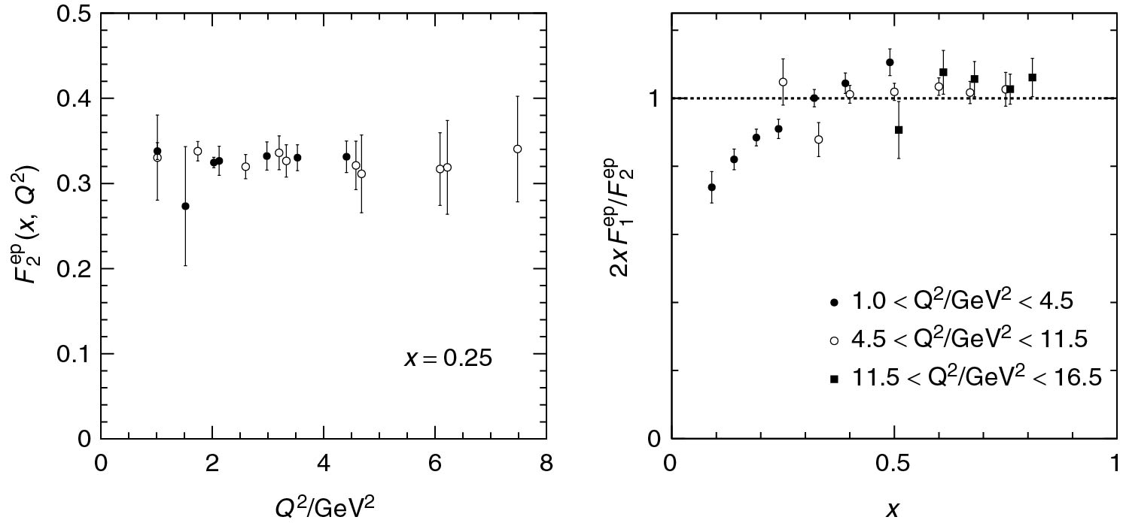
Thomson_BjorkenCG
© Cambridge University Press 2013

Slide 2
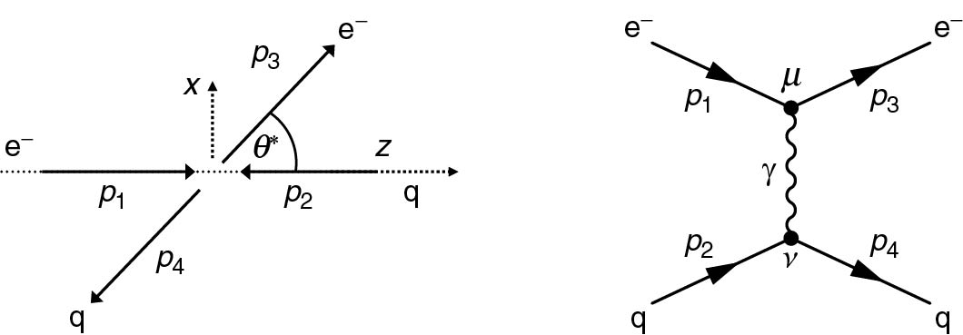
Thomson_eqeqCoM
© Cambridge University Press 2013

Slide 3
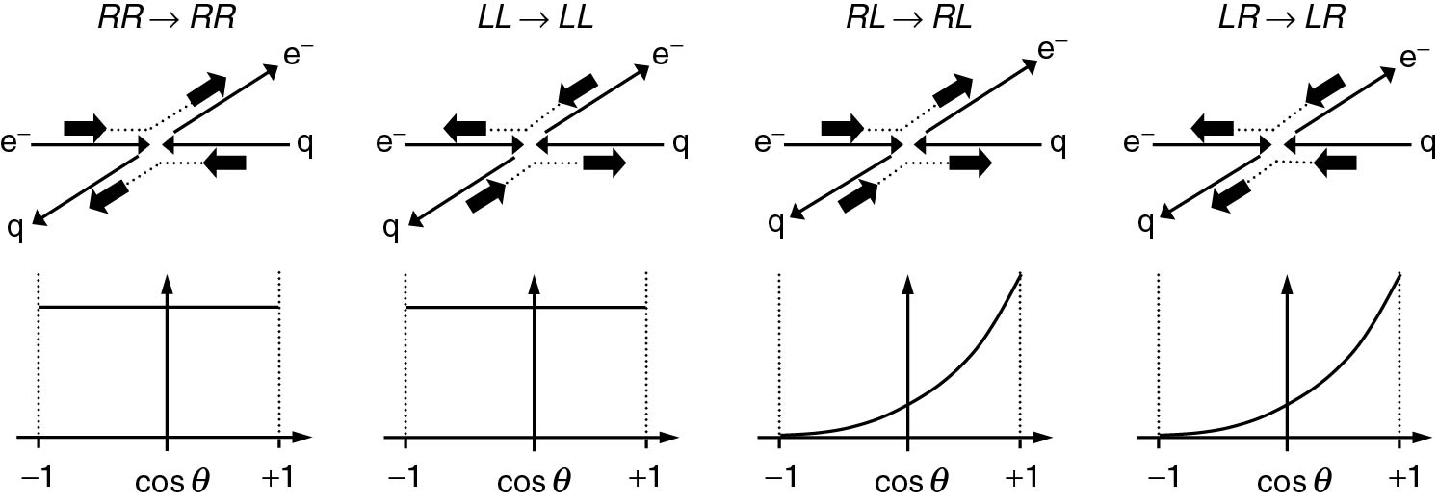
Thomson_eqeqHelicity
© Cambridge University Press 2013

Slide 4
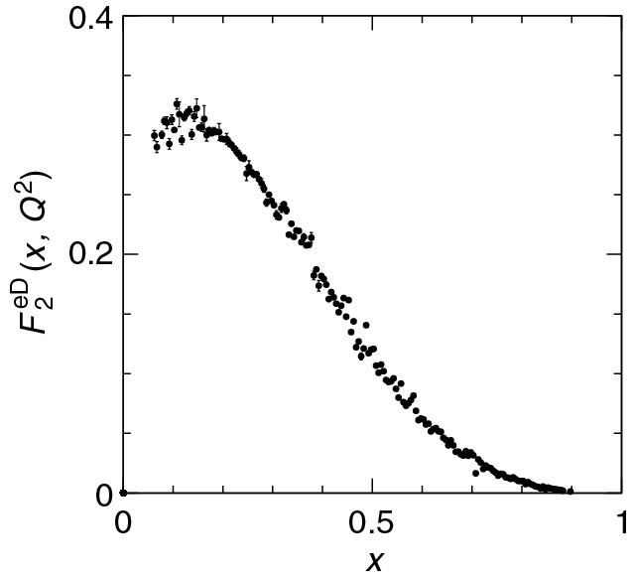
Thomson_F2ed
© Cambridge University Press 2013

Slide 5
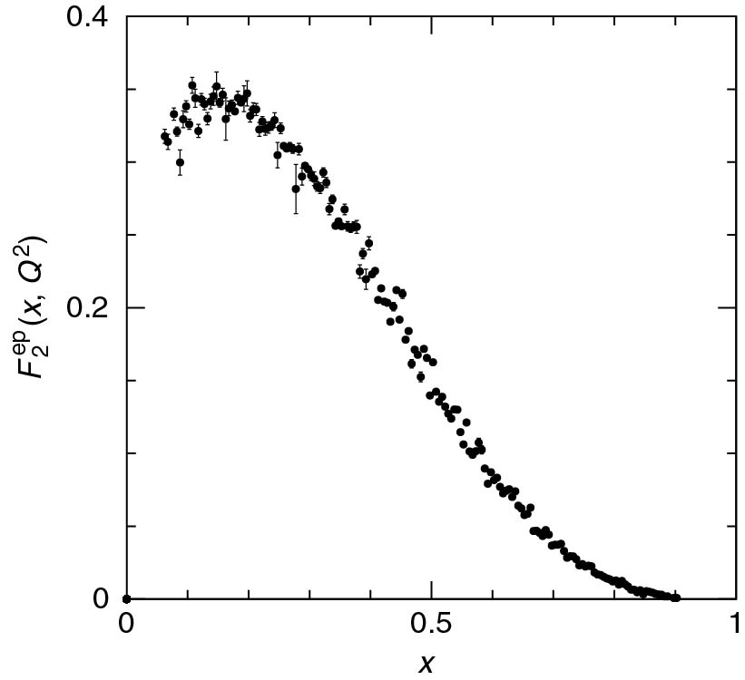
Thomson_f2Measurement
© Cambridge University Press 2013

Slide 6
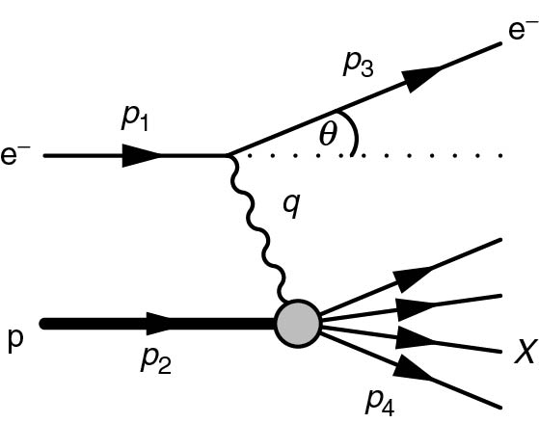
Thomson_Fig-8-1-1
© Cambridge University Press 2013

Slide 7
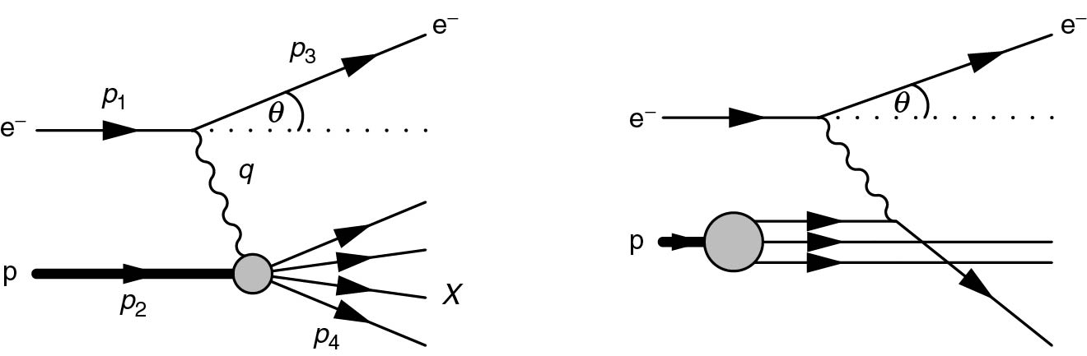
Thomson_Fig-8-4-1
© Cambridge University Press 2013

Slide 8
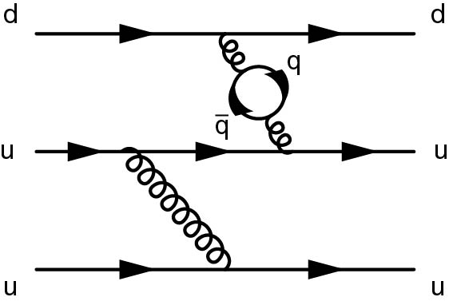
Thomson_Fig-8-4-4
© Cambridge University Press 2013

Slide 9
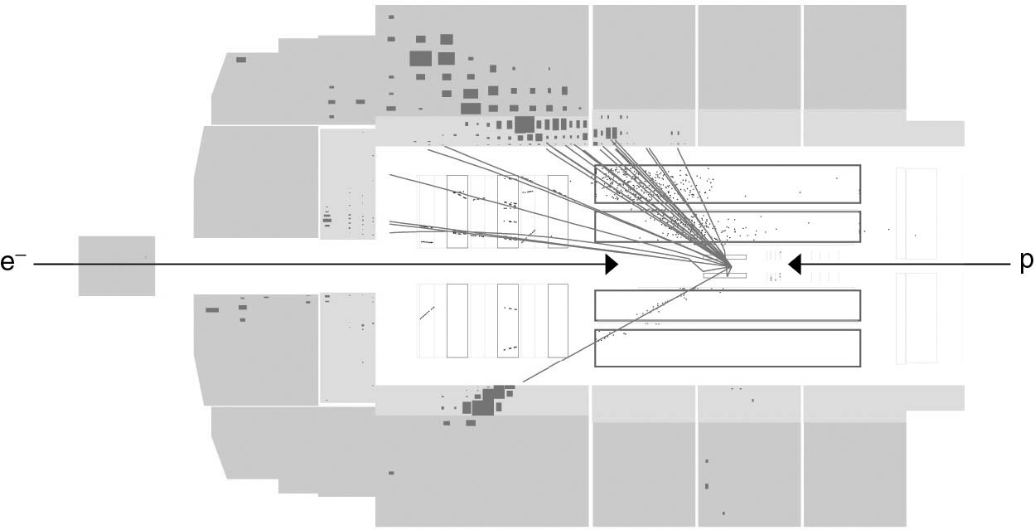
Thomson_H1X
© Cambridge University Press 2013

Slide 10
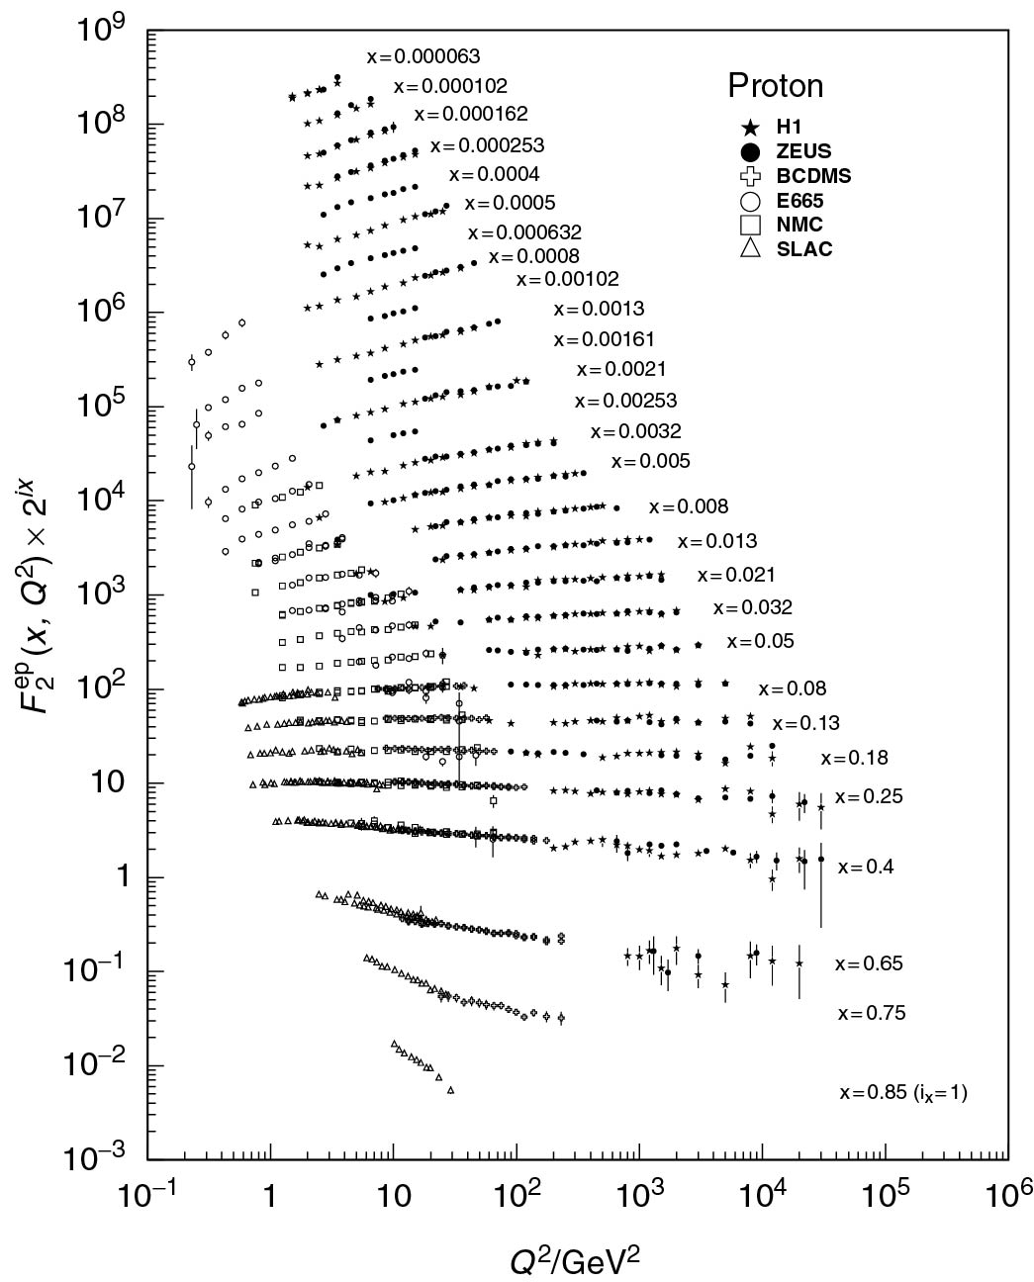
Thomson_HeraF2X
© Cambridge University Press 2013

Slide 11
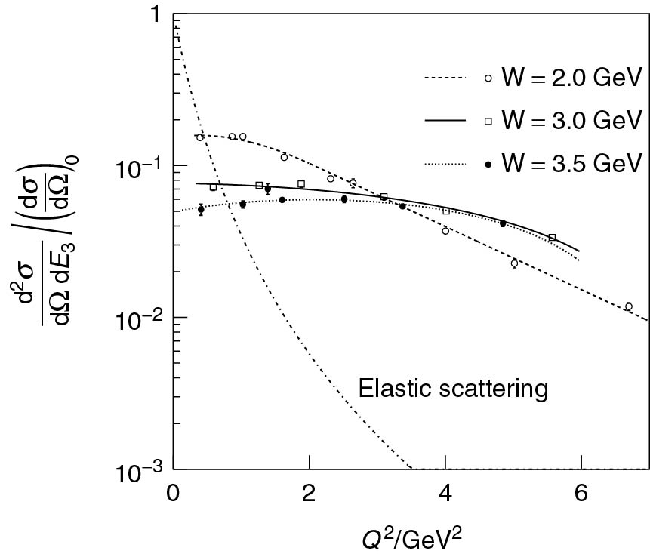
Thomson_InelasticCrossSectionNew
© Cambridge University Press 2013

Slide 12
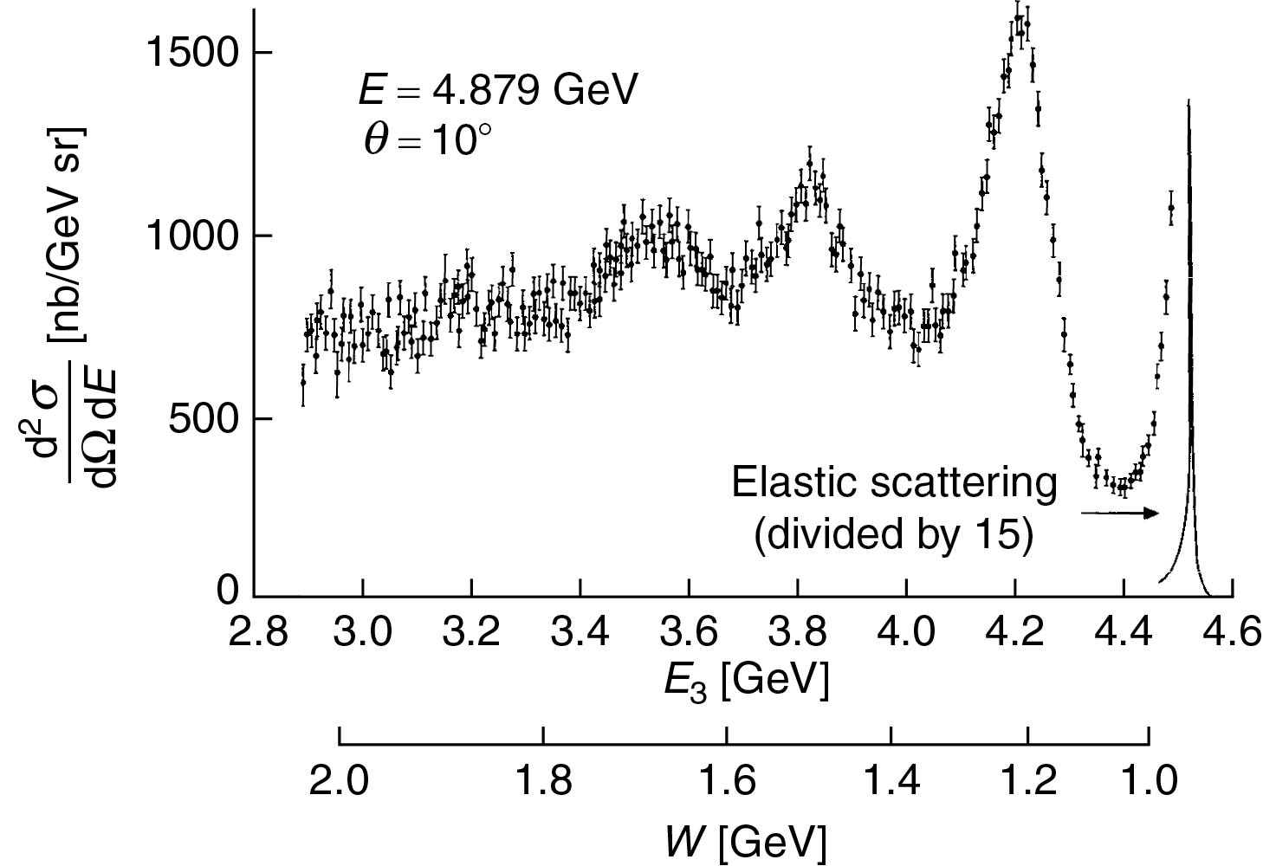
Thomson_InelasticNew
© Cambridge University Press 2013

Slide 13
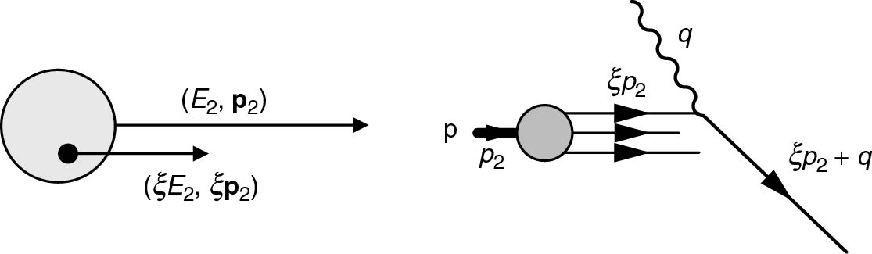
Thomson_partonX
© Cambridge University Press 2013

Slide 14
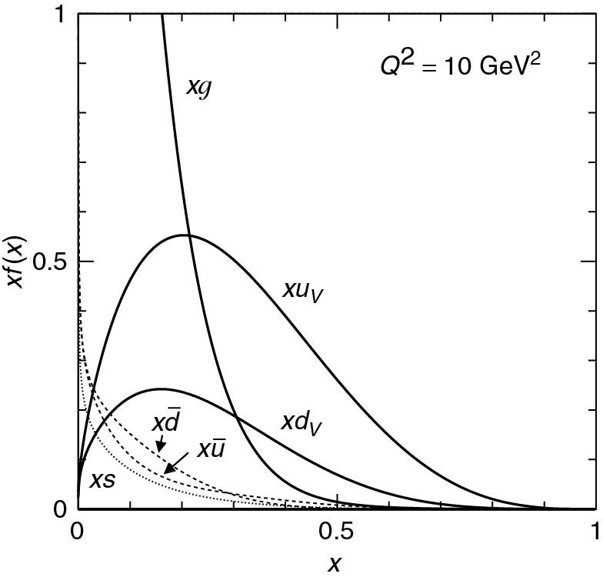
Thomson_pdf10
© Cambridge University Press 2013

Slide 15
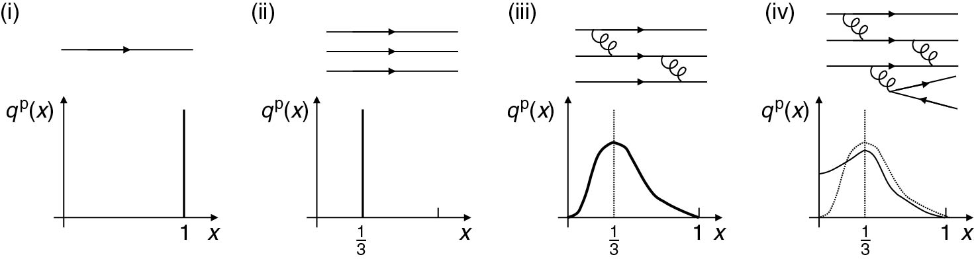
Thomson_PDFCartoon
© Cambridge University Press 2013

Slide 16
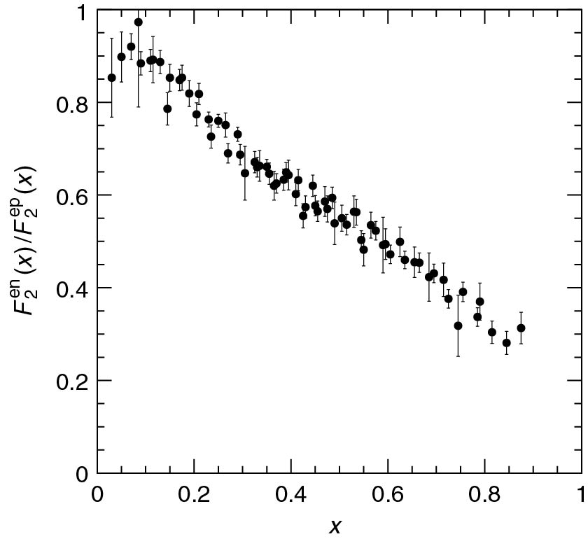
Thomson_ratenpn
© Cambridge University Press 2013

Slide 17
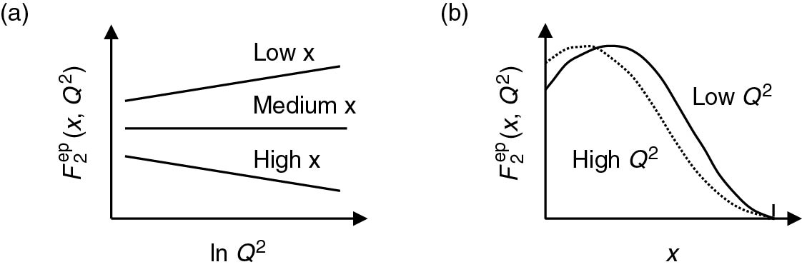
Thomson_ScalingCartoon
© Cambridge University Press 2013

Slide 18
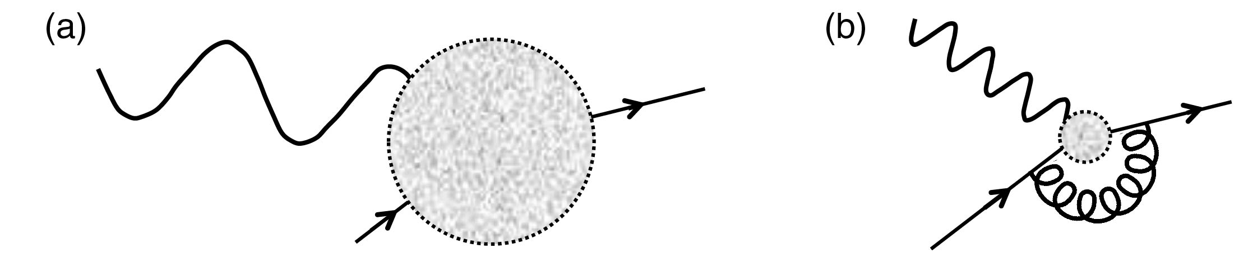
Thomson_ScalingCartoon1
© Cambridge University Press 2013

