Slide 1
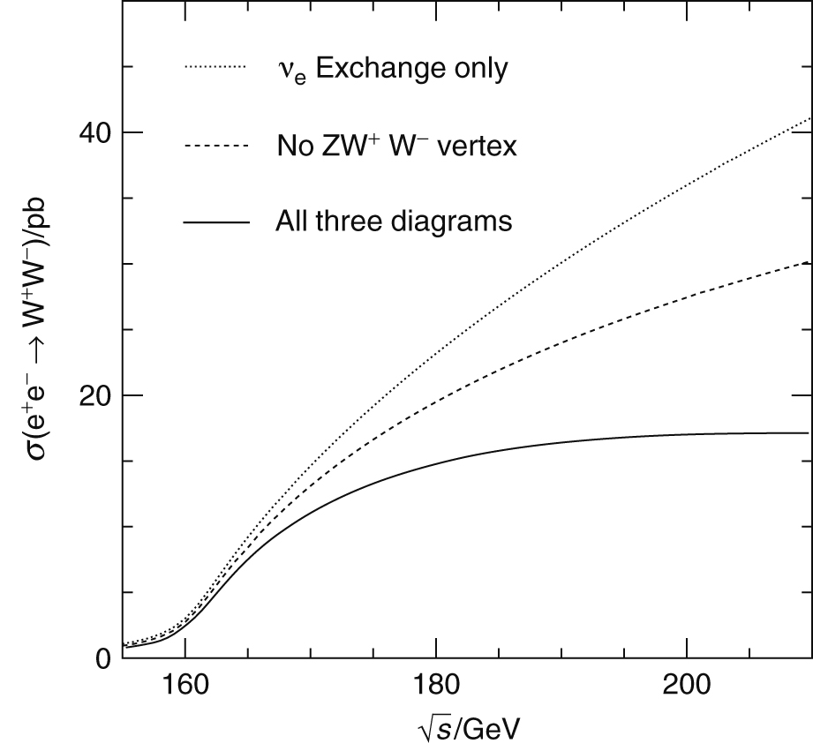
Thomson_eeWWtgc
© Cambridge University Press 2013

Slide 2
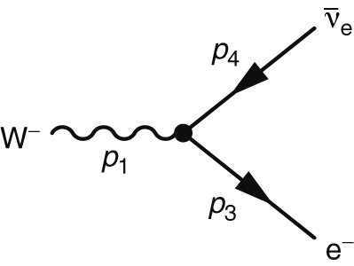
Thomson_Fig15-1
© Cambridge University Press 2013

Slide 3
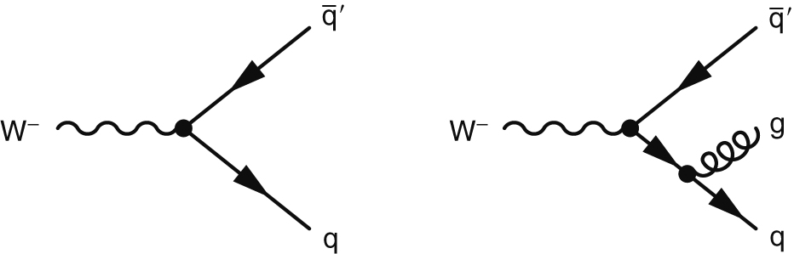
Thomson_Fig15-4
© Cambridge University Press 2013

Slide 4
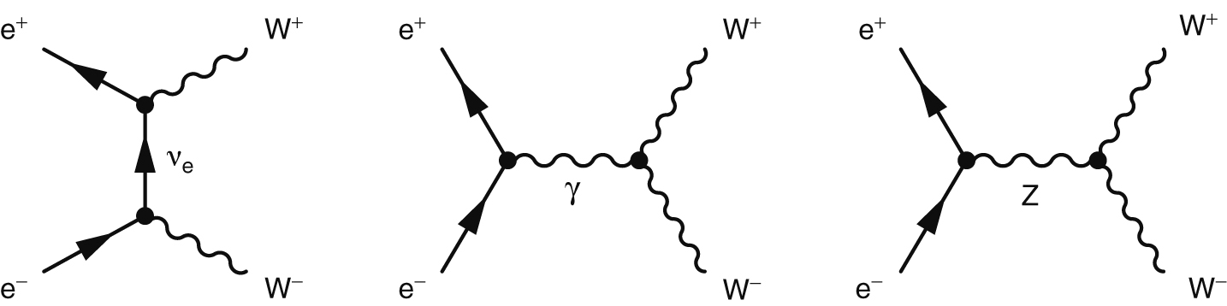
Thomson_Fig15-5
© Cambridge University Press 2013

Slide 5
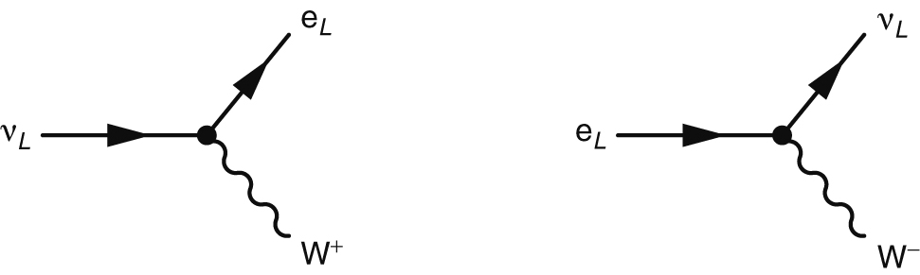
Thomson_Fig15-7
© Cambridge University Press 2013

Slide 6
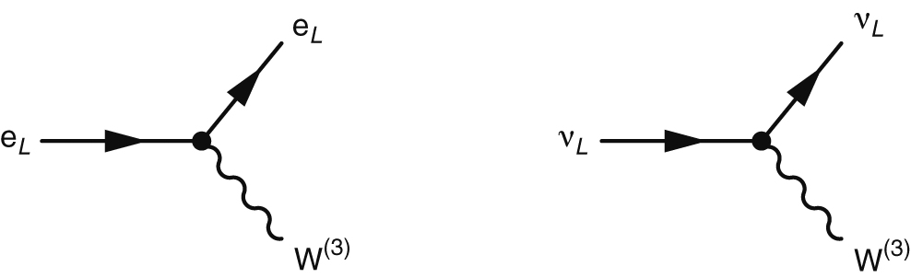
Thomson_Fig15-8
© Cambridge University Press 2013

Slide 7
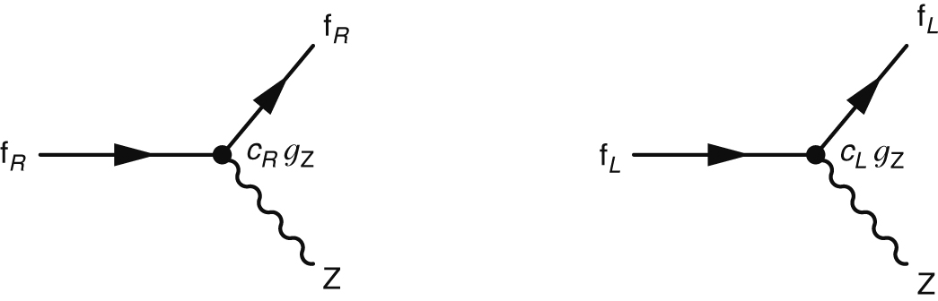
Thomson_Fig15-9
© Cambridge University Press 2013

Slide 8
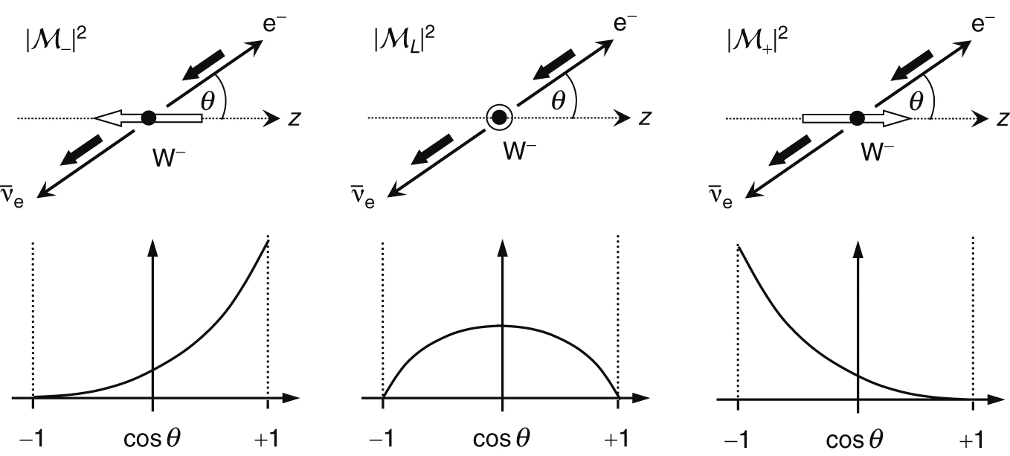
Thomson_wdecayspins
© Cambridge University Press 2013

Slide 9
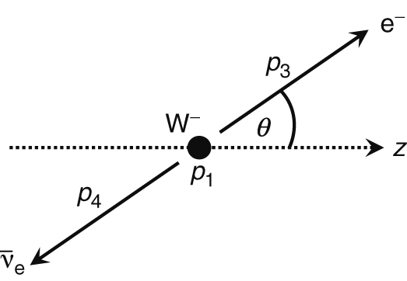
Thomson_wenu
© Cambridge University Press 2013

Slide 10
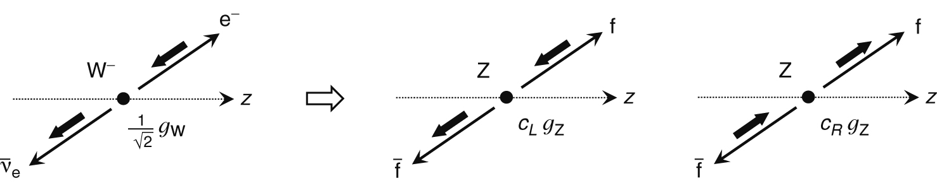
Thomson_wzdecay
© Cambridge University Press 2013

