Slide 1

Departamento de Física Teórica. Universidad Complutense de Madrid
K-π scattering
: the dispersive and analytic approach
J. R. Peláez,
In collaboration with
A. Rodas, J. Ruiz de Elvira
Phys.Rev. D93 (2016) no.7, 074025
Eur.Phys.J. C77 (2017) no.2, 91
Workshop on multibody charmless B-decays. LPNHE, Paris
June 6-7th, 2018

Slide 2

Motivation to study πK scattering
π,K appear as final products of almost all hadronic strange processes:
Examples: B,D, decays, CP violation studies, etc…
π,K are Goldstone Bosons of QCD → Test Chiral Symmetry Breaking
Many light resonances appear → Strange SPECTROSCOPY
Particularly interesting for this workshop on Bound States:
${κ/K}_{0}^{∗}(800)$ light scalar meson. “needs confirmation”@PDG.
Light scalar mesons longstanding candidates for non-ordinary mesons.
But still some controversy

Slide 3
The light scalar controversy. The theory side... classification
Scalar SU(3) multiplets identification controversial
Too many resonances for many years….
But there is an emerging picture
σ
a₀
A Light scalar nonet:
κ(800)
f₀
Non-strange heavier!!
Inverted hierarchy problem
For quark-antiquark
f₀(500) and f₀(980) are
really octet/singlet mixtures
Singlet
f₀(980)
a₀(980)
+ Another
heavier scalar nonet:
K(1430)
+ glueball
f₀ singlet
f₀
f₀
a₀(1450)
Enough f₀ states have been observed: f₀(1370), f₀(1500), f₀(1700).
The whole picture is complicated by mixture between them (lots of works here)
Only the κ(800) or K0*(800) “Needs Conformation” @ PDG

Slide 4
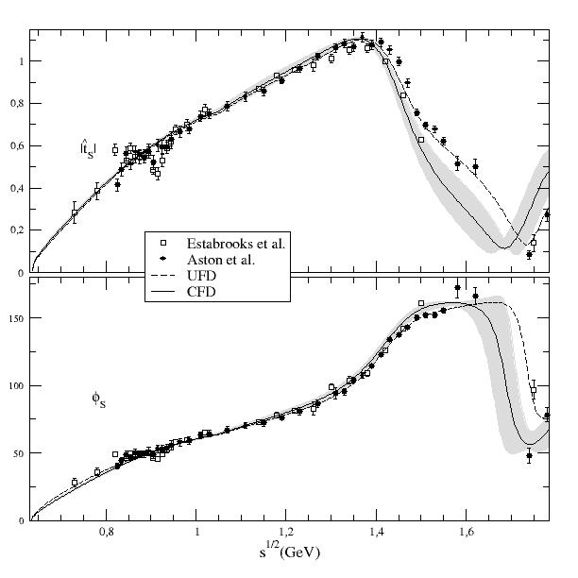

Data on πK scattering:
Most reliable sets:
Estabrooks et al. 78 (SLAC)
Aston et al.88 (SLAC-LASS)
I=1/2 and 3/2 combination
No clear “peak” or phase movement
of ${κ/K}_{0}^{∗}(800)$ resonance
Definitely NO BREIT-WIGNER shape
Mathematically correct to use POLES
Strong support for K0*(800) from decays of heavier mesons, but rigorous
model-independent extractions absent. Often inadequate Breit-Wigner formalism

Slide 5
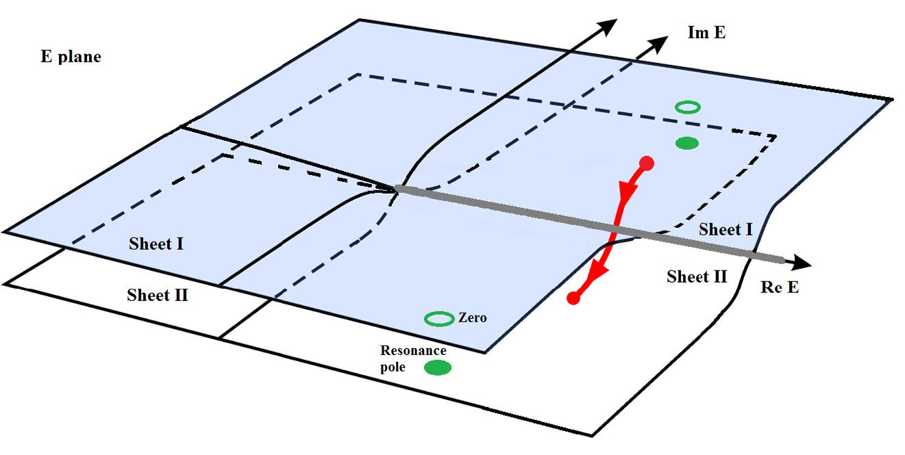

Resonances as poles
The Breit-Wigner shape is just an approximation for narrow and isolated resonances
The universal features of resonances are their
pole positions and residues *
$\sqrt{s_{pole}}≈$M-i Γ/2
*in the Riemann sheet obtained from an analytic continuation through the physical cut
Im s
s-plane
Re s

Slide 6
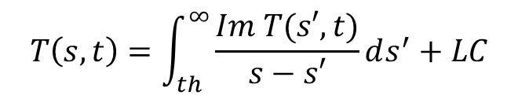
Why use dispersion relations?
CAUSALITY:
Amplitudes T(s,t) are ANALYTIC in
complex s plane but for cuts for thresholds.
Crossing implies left cut from u-channel threshold
Cauchy Theorem determines T(s,t) at ANY s,
from an INTEGRAL on the contour
If T->0 fast enough at high s, curved part vanishes
$$T\left(s,t\right)=\int_{th}^{∞}{\frac{Im T(s′,t)}{s−s′}}ds^{′}+LC$$
Otherwise, determined up to polynomial
(subtractions)
Left cut usually a problem
Good for:
1) Calculating T(s,t) where there is not data
2) Constraining data analysis
3) ONLY MODEL INDEPENDENT extrapolation to complex s-plane
without extra assumptions

Slide 7
Why so much worries about low energy and CORRECT ANALYTIC STRUCTURE?
Analyticity is expressed in the s-variable, not in $\sqrt{s}$

Slide 8












Why so much worries about low energy and CORRECT ANALYTIC STRUCTURE?
Analyticity is expressed in the s-variable, not in $\sqrt{s}$
$$s−plane$$
(MeV²)
|s|=$m_{K}^{2}−m_{π}^{2}$
$$Adler$$
zero
$$0$$
$${(m_{K}−m_{π} )}^{2}$$
$$πK$$
$$7002$$
$$8002$$
$$8902$$
$$ηK$$
$$K^{∗}(890)$$
$$κ/K_{0}^{∗}(800)$$
Important for
the $κ/K_{0}^{∗}(800)$
Threshold behavior (chiral symmetry)
Subthreshold behavior (chiral symmetry →Adler zeros)
Other cuts (Left & circular)
Problem shared by lattice!
Avoid spurious singularities
Less important for other resonances…

Slide 9
Partial—wave vs. fixed-variable Dispersion Relations
So, we need to get rid of ONE VARIABLE to write CAUCHY THEOREM in terms of the other one
TWO MAIN APPROACHES
1) Integrate one variable and keep the other
(partial wave dispersion relations)

Slide 10



Partial Wave Dispersion Relations: General
Analytic structure complicated if unequal masses (Circular cuts)
For elastic region second Riemann sheet is easy to obtain.
Due to elastic unitarity:
$$S^{II}(s)=\frac{1}{S^{I}(s)}$$
Recalling
S$\left(s\right)=1+2iσ t\left(s\right), σ\left(s\right)=\frac{k}{2\sqrt{s}}$
$$t^{II}(s)=\frac{t^{I}(s)}{1+2iσ t^{I}(s)}$$
The second sheet is then:
Looking for resonance poles
is nothing but looking for a zero in that denominator
on the first Riemann sheet accesible with the pw DR
The problem is the left (and circular) cut

Slide 11
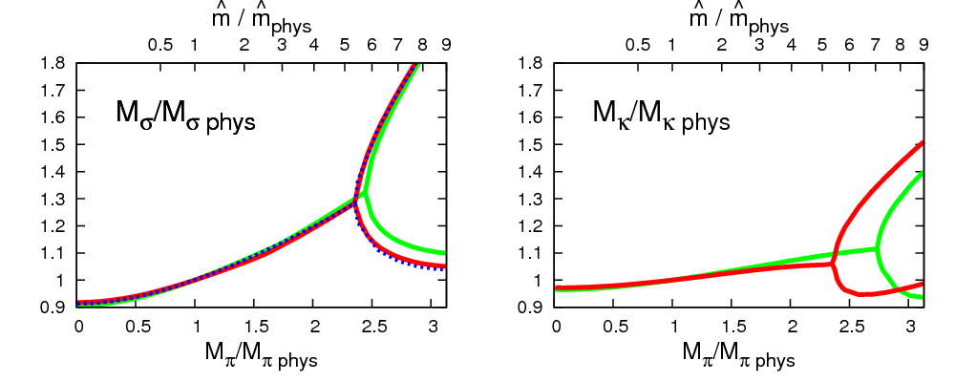

Partial Wave Dispersion Relations: Unitarized ChPT
Unitarized ChPT 90’s Truong, Dobado, Herrero, JRP, Oset, Oller, Ruiz Arriola, Nieves, Meissner,…
Uses Chiral Perturbation Theory amplitudes inside dispersion relation.
Relatively simple, although different levels of rigour. Generates all scalars
LEFT CUT APPROXIMATED, not so good for precision:
$(753±52$)-i(235 $±33$)MeV
But good for connecting with QCD. Strong hints of non-ordinary nature:
Nc behavior
JRP, PRL. 92:102001,2004
m_{q} dependence
Nebreda, JRP, PRD81 (2010) 054035
becomes virtual state
- i Γ/2
M_{N}/M₃
At odds
with q-qbar
Nc behavior
Correct behavior obtained for vectors
Γ_{N}/Γ₃
N_{c}
Virtual state recently found on lattice
Dudek,Edwards, Thomas, Wilson, PRL. 113 (2014) 18, 182001
Both suggest important “molecular” component

Slide 12
Partial Wave Dispersion Relations: Partial Wave DR -3
Roy-like equations. 70’s Roy, Basdevant, Pennington, Petersen…
00’s Ananthanarayan, Caprini, Colangelo, Gasser, Leutwyler, Moussallam, Decotes Genon, Lesniak, Kaminski, JRP, Ruiz de Elvira, Yndurain…
LEFT CUT WITH PRECISION.
PRICE: Infinite set of coupled integral equations. VALIDITY LIMITED at ~1.1 GeV
Use data on all waves + high energy . Optional: ChPT predictions for subtraction constants
The most precise and model independent pole determinations
f₀(500) and K₀*(800) existence, mass and width
firmly established with precision
(658±13)-i(278.5±12) MeV
Descotes-Genon, B. Moussallam
Listed @PDG, but not enough for PDG
We have been asked for an independent
dispersive analysisto trigger the PDG revision

Slide 13
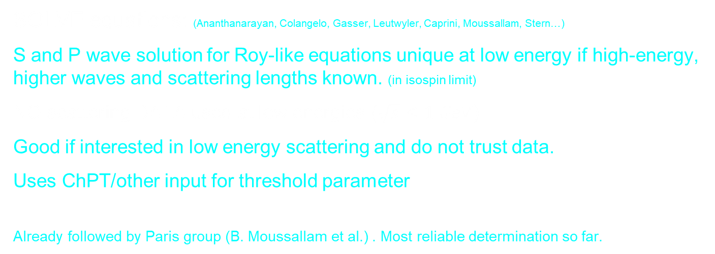
Two strategies
SOLVE equations: (Ananthanarayan, Colangelo, Gasser, Leutwyler, Caprini, Moussallam, Stern…)
S and P wave solution for Roy-like equations unique at low energy if high-energy, higher waves and scattering lengths known. (in isospin limit)
NO scattering DATA used at low energies ($\sqrt{s}≤1 GeV$)
Good if interested in low energy scattering and do not trust data.
Uses ChPT/other input for threshold parameter
Already followed by Paris group (B. Moussallam et al.) . Most reliable determination so far.
Impose Dispersion Relations on fits to data. (García-Martín, Kaminski,JRP, Ruiz de Elvira, Ynduráin)
Use any functional form and fit to DATA imposing DR within uncertainties.
Also needs input on other waves and high energy.
(But you can use physical inspiration for clever choices of parameterizations)
THIS IS OUR APPROACH

Slide 14
Partial—wave vs. fixed-variable Dispersion Relations
So, we need to get rid of ONE VARIABLE to write CAUCHY THEOREM in terms of the other one
TWO MAIN APPROACHES
1) Integrate one variable and keep the other
(partial wave dispersion relations)
2) Fix one variable in terms of the other
(fixed-t, hyperbolic relations…)

Slide 15
Fixed-t Dispersion Relations (DR)
Simple analytic structure in s-plane, simple derivation and use
Left cut: With crossing can be rewritten in terms of physical region
Most popular: t₀=0, FORWARD DISPERSION RELATIONS (FDRs).
(Kaminski, Pelaez , Yndurain, Garcia Martin, Ruiz de Elvira, Rodas )
One equation per amplitude.
High Energy part known since Forward Amplitude~ Total cross section
Calculated up 1.7 GeV for πK (and 1400 MeV for ππ)
JRP, A .Rodas, Phys.Rev. D93 (2016) no.7, 074025
Not directly usable for unphysical sheets but very useful to constraint physical amplitudes up to relatively high energies

Slide 16
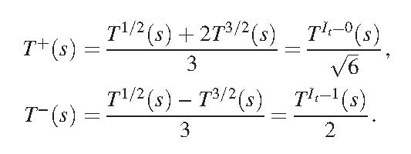
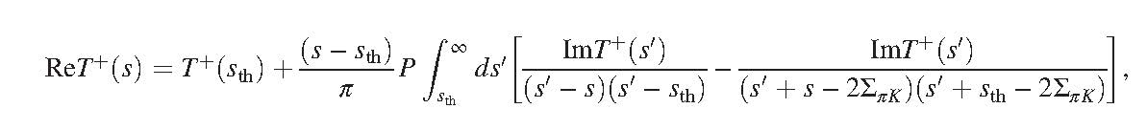
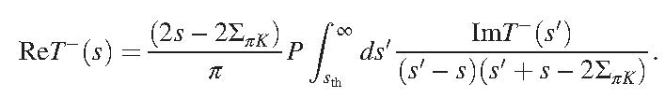

Forward dispersion relations for K π.
Since interested in the resonance region, we use minimal number of subtractions
Defining the s↔u symmetric
and anti-symmetric amplitudes
at t=0
We need one subtraction for the symmetric amplitude
And none for the antisymmetric
where $Σ_{πK}=m_{π}^{2}+m_{K}^{2}$

Slide 17
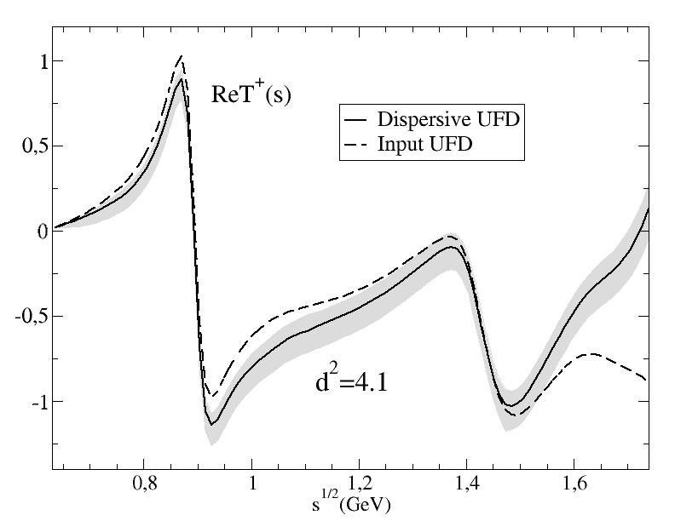
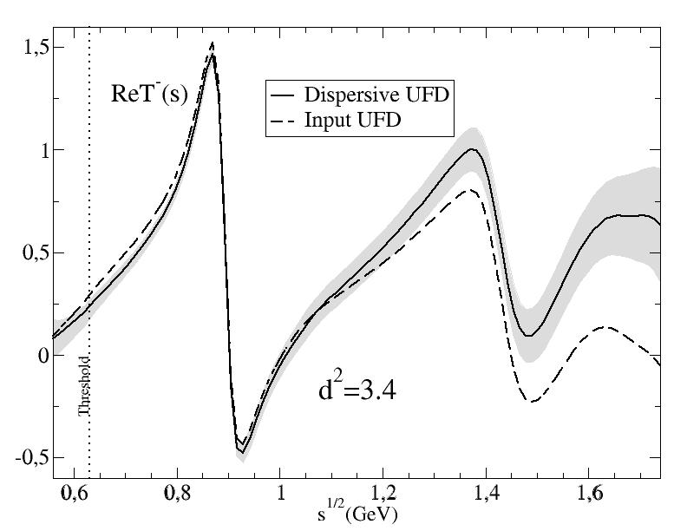
(not a solution of dispersión relations,
but a constrained fit)
A.Rodas & JRP, PRD93,074025 (2016)
Dispersive analysis of
πK scattering DATA
up to 1.6 GeV
First observation:
Forward Dispersion relations
Not well satisfied by data
Particularly at high energies
So we use
Forward Dispersion Relations as CONSTRAINTS on fits

Slide 18

How well Dispersion Relations are satisfied by unconstrained fits
Every 22 MeV calculate the difference between both sides of the DR /uncertainty
Define an averaged χ² over these points, that we call d²
d² close to 1 means that the relation is well satisfied
d²>> 1 means the data set is inconsistent with the relation.
This can be used to check DR
To obtain CONSTRAINED FITS TO DATA (CFD) we minimize:
$$+ {\overline{d_{1/2}}}^{2}+{\overline{d_{3/2}}}^{2}+\sum_{k}{\frac{{(p_{k}−p_{k}^{exp})}^{2}}{{δp}_{k}^{2}}}$$
$χ^{2}$=$W\left\{{\overline{d_{T+}}}^{2}+{\overline{d_{T−}}}^{2}\right\}$
2 FDR’s
Sum Rules
threshold
Parameters of the unconstrained data fits
W roughly counts the number
of effective degrees of freedom
(sometimes we add weight on certain energy regions)

Slide 19
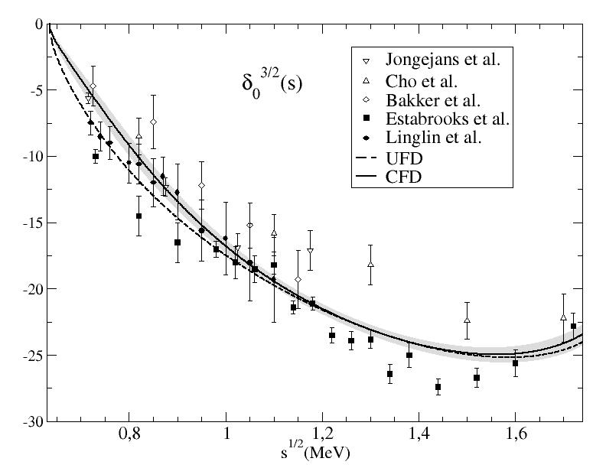
From Unconstrained (UFD) to Constrained Fits to data (CFD)
S-waves. The most interesting for the K₀* resonances
Largest changes from UFD to CFD
at higher energies

Slide 20
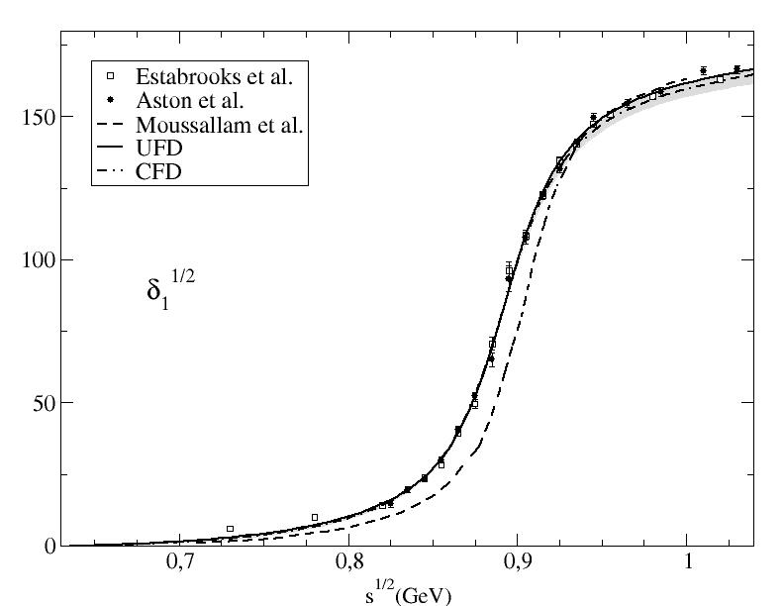
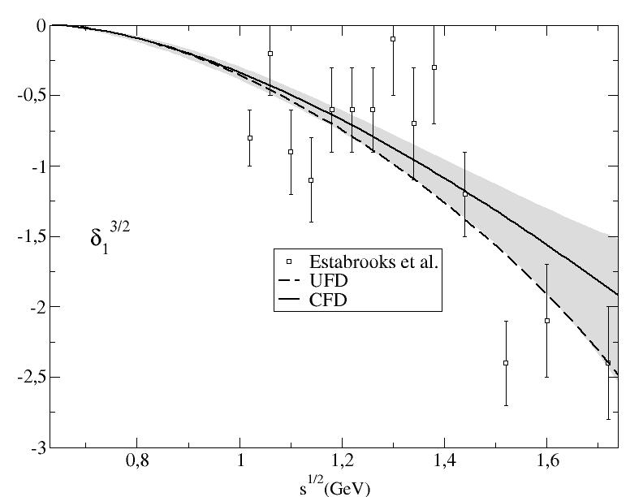
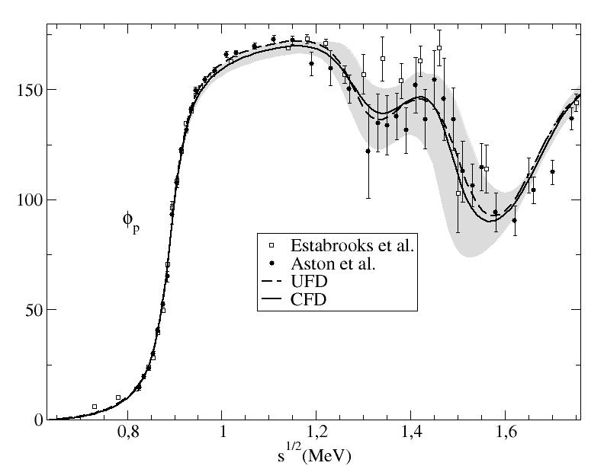
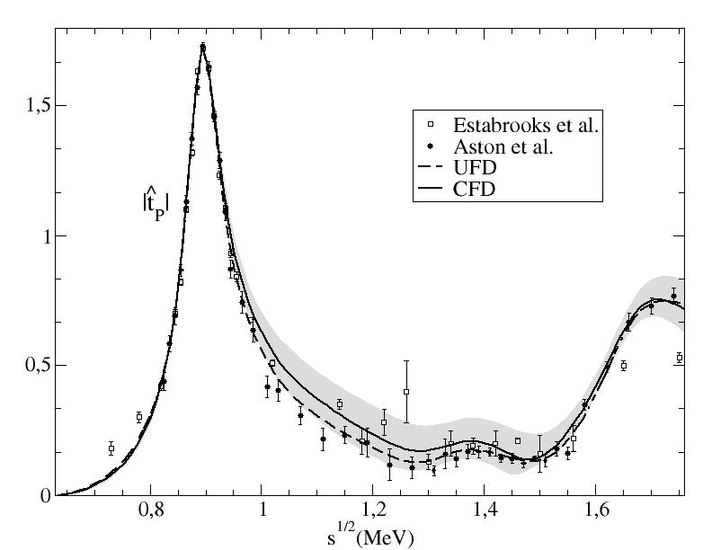
From Unconstrained (UFD) to Constrained Fits to data (CFD)
P-waves: Small changes
Our fits describe data well
SOLUTION from previous Roy-Steiner approach

Slide 21
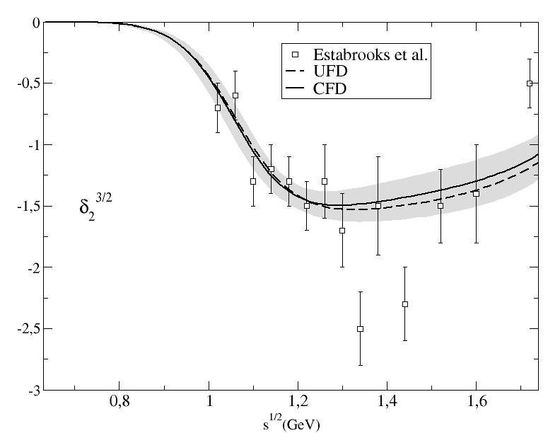
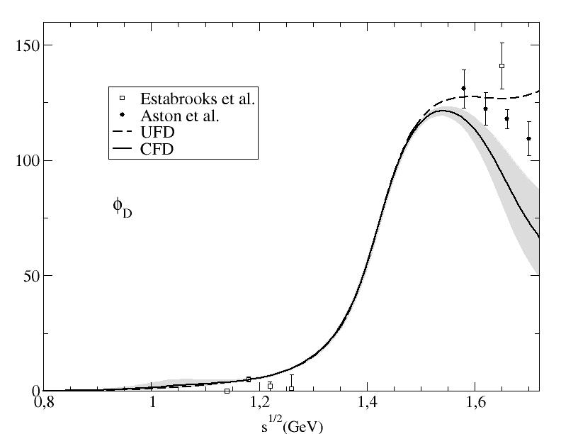
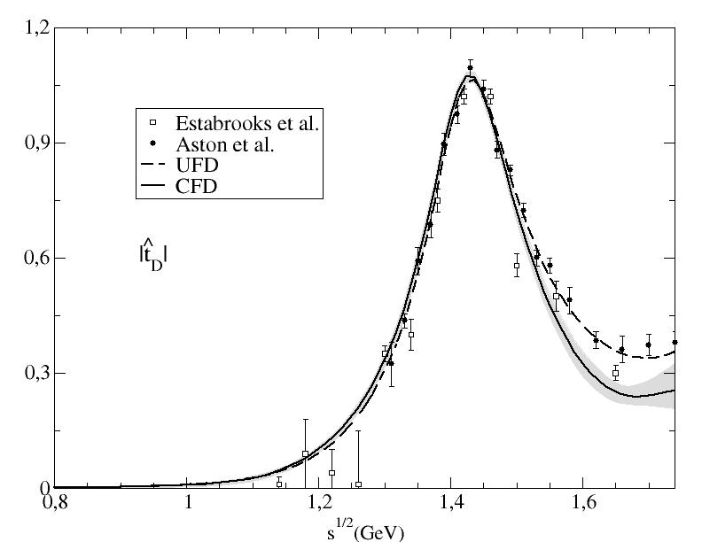
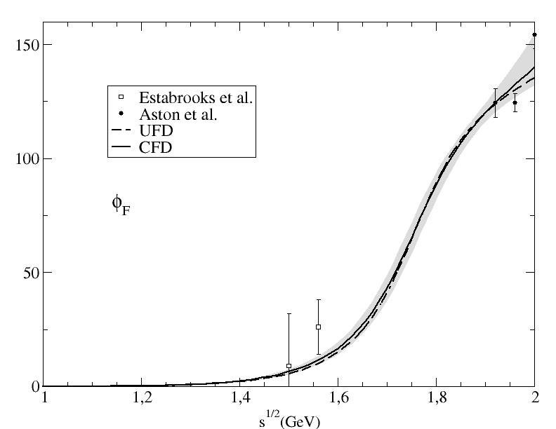
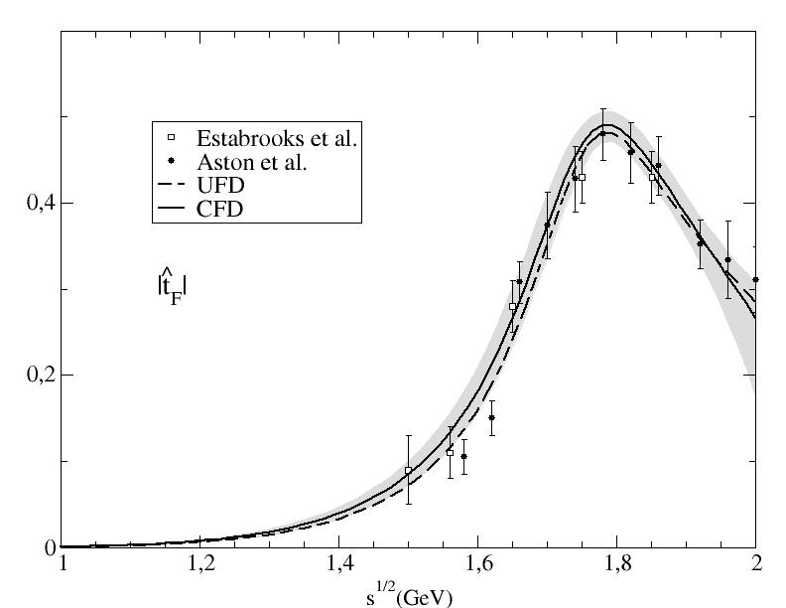
From Unconstrained (UFD) to Constrained Fits to data (CFD)
D-waves: Largest changes of all, but at very high energies
F-waves:
Imperceptible changes
Regge parameterizations allowed to vary: Only πK-ρ residue changes by 1.4 deviations

Slide 22
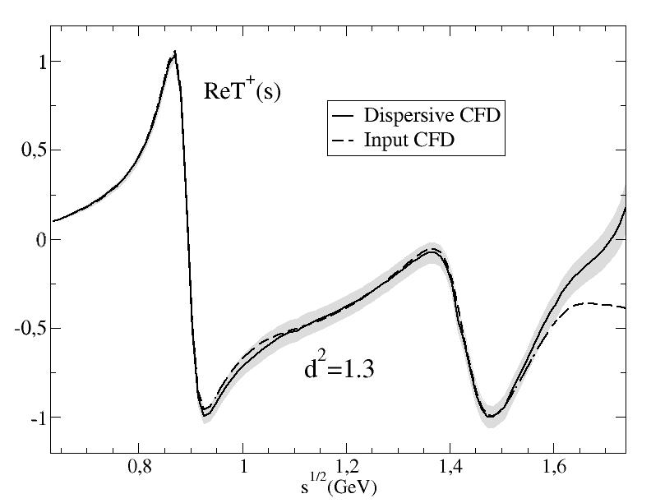
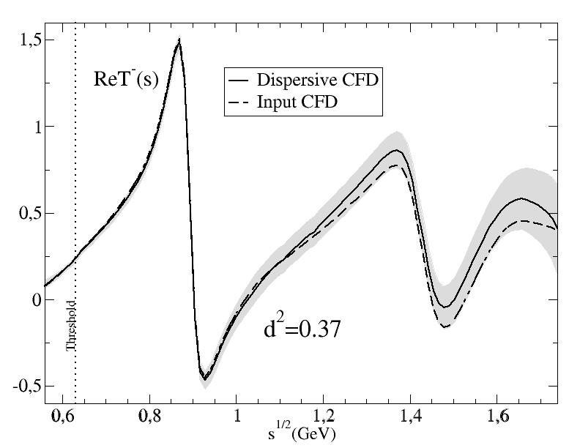
Consistency up to 1.6 GeV!!
Consistency up to 1.74 GeV!!

Slide 23

Summary of this part
We have used FORWARD DISPERSION RELATIONS to constraint
$πK$ scattering amplitudes up to 1.6 GeV:
    Simple parameterizations. Easy to use
    Still describe data
    Consistent with unitarity, ANALYTICITY and crossing
In progress:
We are about to finish the ππ→KK Roy-Steiner analysis up to 1.5 GeV
Working on the Roy-Steiner analysis for πK→πK. See final slides

Slide 24
Strange scalar resonances from dispersive analysis and analytiicty
J. R. Peláez, A. Rodas, J. Ruiz de Elvira
Eur.Phys.J. C77 (2017) no.2, 91
JRP, A. Rodas in preparation

Slide 25
Kappa pole from CFD
We have amplitudes that describe data and satisfy dispersion relations up to 1.6 GeV
There is also a κ POLE in the elastic piece of our CFD parameterizations

Slide 26
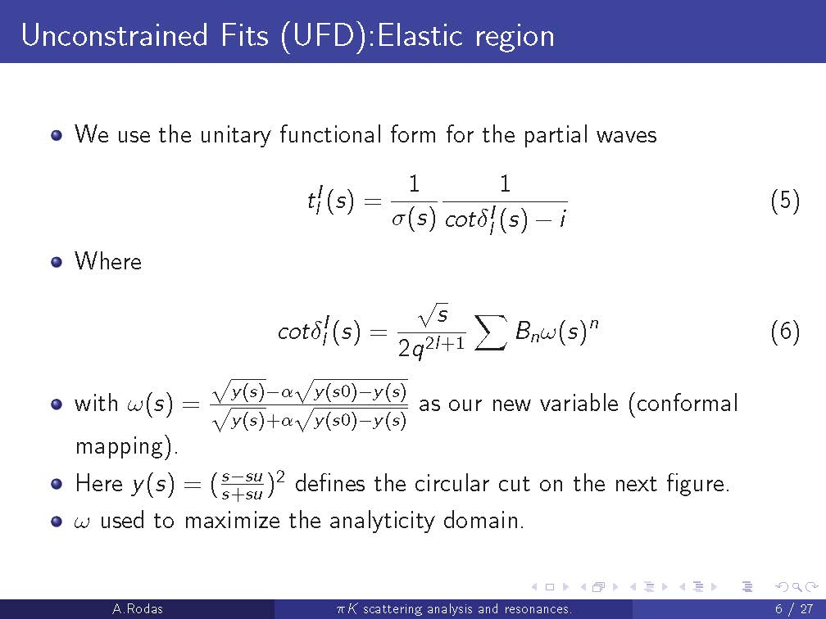

Slide 27
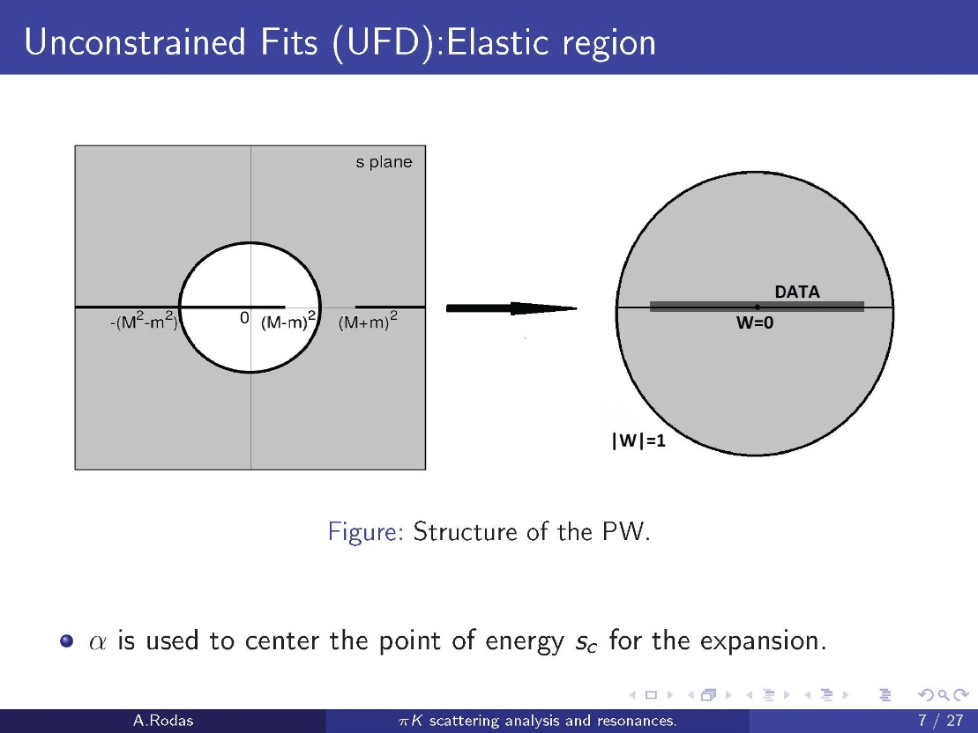

Slide 28
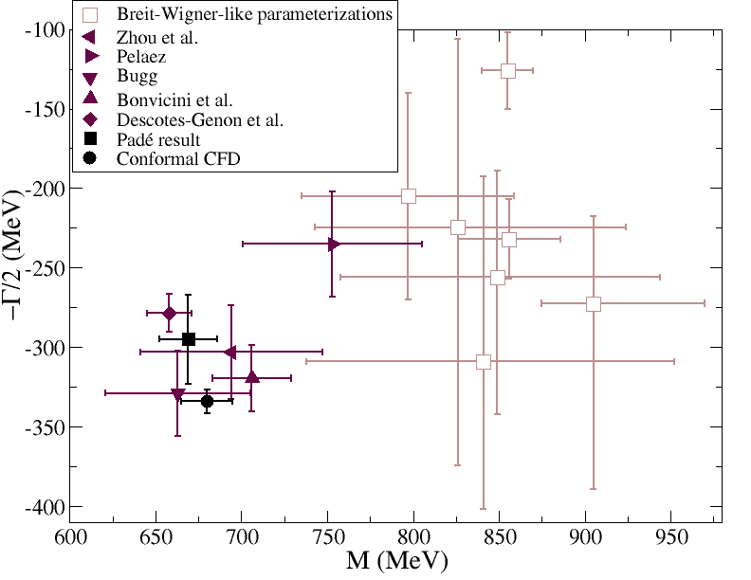
Kappa pole from CFD
1) Extracted from our conformal CFD parameterization A.Rodas & JRP, PRD93,074025 (2016)
Fantastic analyticity properties,
but still not completely model independent
(680±15)-i(334±7.5) MeV

Slide 29
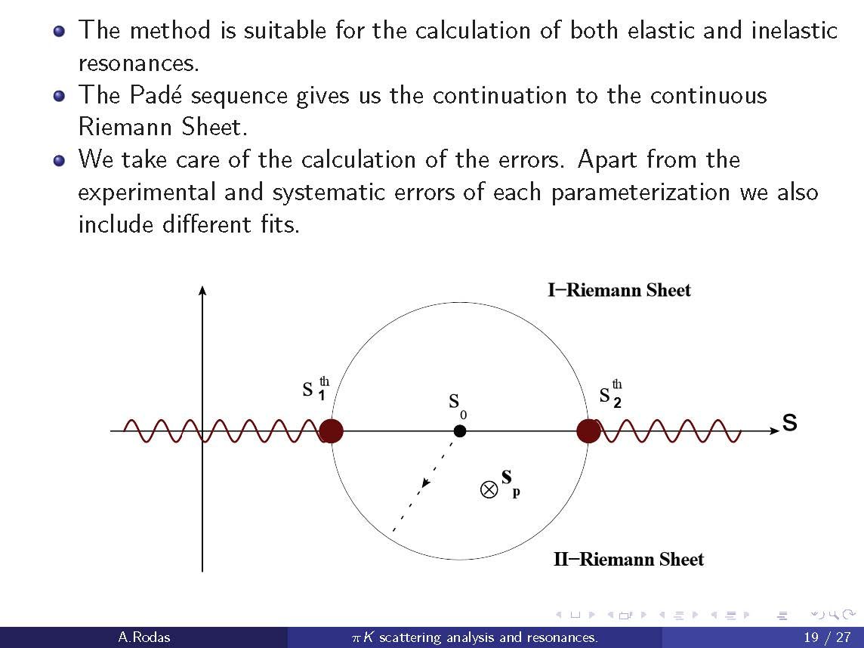
Kappa pole from CFD: Using Padé sequences A.Rodas & JRP & J. Ruiz de Elvira. Eur. Phys. J. C (2017) 77:91
Almost model independent: Does not assume any particular functional form
(but local determination)
Based on previous works by P.Masjuan, J.J. Sanz Cillero, I. Caprini, J.Ruiz de ELvira

Slide 30
Kappa pole from CFD
1) Extracted from our conformal CFD parameterization A.Rodas & JRP, PRD93,074025 (2016)
Fantastic analyticity properties,
but still not completely model independent
(680±15)-i(334±7.5) MeV
2) Using Padé Sequences…
A.Rodas & JRP & J. Ruiz de Elvira. Eur. Phys. J. C (2017) 77:91
(670±18)-i(295± 28) MeV
Compare to PDG:
(682±29)-i(273±12) MeV

Slide 31
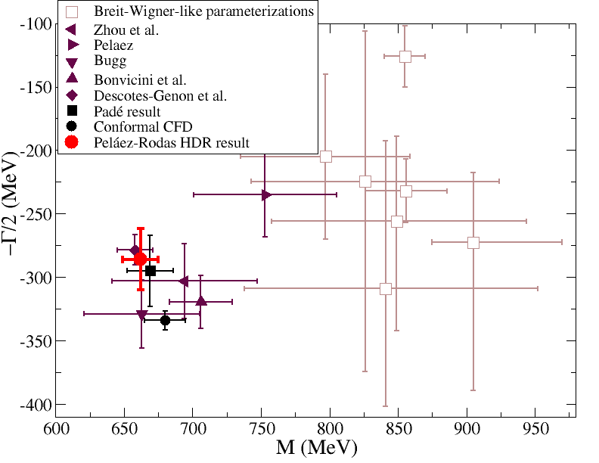
Model independent analysis
Roy-Steiner SOLUTION from Paris group
Decotes-Genon-Moussallam 2006
(658±13)-i(278.5±12) MeV
Our Roy-Steiner analysis of FIT to data
JRP, A. Rodas, in preparation
(662±13)-i(289±25) MeV
NEW!!
Preliminary
We have:
Constrained Fit to data (not solved)
Improved P-wave (data OK)
Used Hyperbolic DR both in real axis and complex plane.
Improved Pomeron
Constrained ππ→KK input with DR
Other technicalities
Independent dispersive determination of the K₀*(800)

Slide 32
Summary
Dispersion relations have been useful for establishing the existence of resonances and for rigorous determinations of their parameters
For light scalars, they have settled the longstanding σ-meson controversy and are on the way to settle that of the κ-meson.
We have provided first preliminary results for K₀*(800)
Still in progress:
A second dispersive determination with Roy-Steiner and FDRs will finally settle the κ/K₀*(800) issue at the PDG. Our group has been asked to do it.
First preliminary results available. Nice agreement with other dispersive aproach
We are about to finish the ππ→KK analysis needed as input for πK→πK

